Slide 1
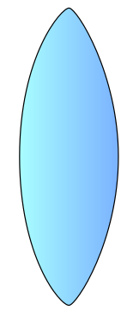
Lenses and Telescopes
Can you draw a lens diagram for two convex lenses in series?

Slide 2
Rays parallel to the principle axis
If the distance between the two lenses is adjusted so that it is equal to f₁ + f₂ then you get the following diagram:
f

Slide 3
Rays not parallel to the principle axis
Things to remember:
The incident rays are all parallel
The centre ray does not refract
All the rays meet at the focal point of BOTH lenses
The rays continue in a straight line to the second lens
The central ray refracts as if it came parallel to the focal point
The other rays exit the second lens parallel to the central ray
Extending the previous exercise, a telescope is unlikely to be perfectly aligned with the object to view in the exact centre. Therefore, how would the rays appear if there is a small angle subtending from the unaided eye to the object?
f

Slide 4
Telescope lenses and angles
The two main angles you can label on this diagram are the angle subtended by the eye to the object (α) and the angle subtended from the eye to the image (β)
f
β
α
Eyepiece
Objective lens

Slide 5
Magnifying power
Recall that the power of a lens (in Dioptres) is the reciprocal of the focal length (in metres):
The magnifying power is then the ratio of the objective lens focal length to the eyepiece focal length:
Another useful formula is that the magnifying power is also the ratio of the angles subtending to the image and object:

Slide 6
Lens formula
The focal length of a lens can be calculated using the following formula, if the image and object distances are known:
How does this formula change if the distance to the object approximates to infinity? (i.e. a star)

Slide 7
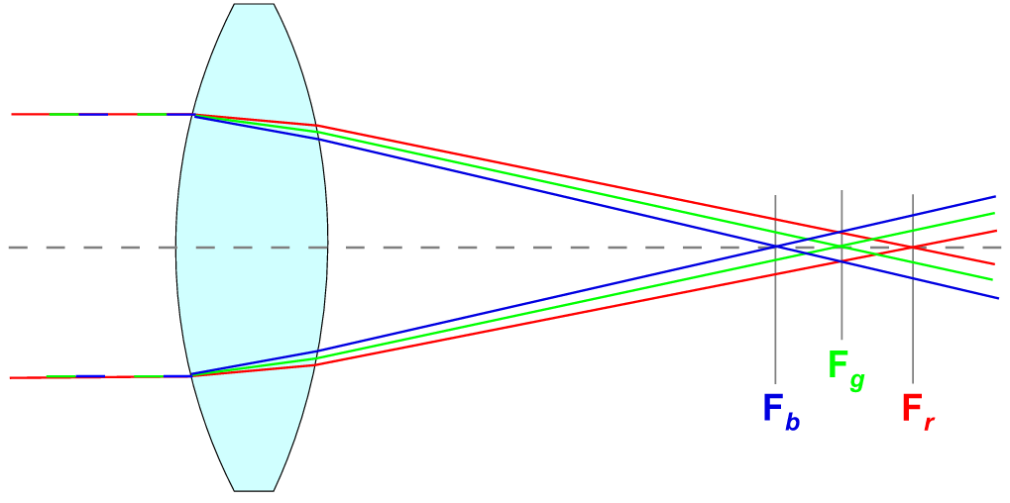
Chromatic aberrations
The angle at which a light ray refracts at is slightly dependant on the wavelength of the light (You know this from Newton’s prism experiments to split light into a spectrum)
If light of various colours is refracted through one or more lenses then the different colours form images at slightly different positions. This causes a blurring of the colours

Slide 8
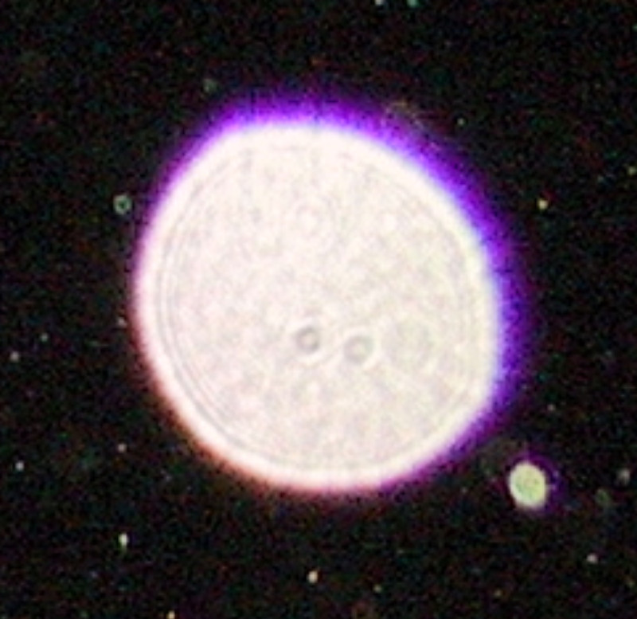
A picture of a star showing chromatic aberration

Slide 9
Minimising chromatic aberrations
You can reduce the effect of chromatic aberrations by:
Using a larger lens and using only the centre of the lens
Using a coloured filter to allow only one wavelength of light through the lens
The problem with these solutions is that they both reduce the amount of light getting through the lens and hence will reduce the sensitivity of the optical device

Slide 10
Summary
A telescope can be created with two lenses, an objective lens and an eyepiece
The two lenses are arranged so that the sum of their focal lengths is equal to their separation
The ray diagrams for this must be created so that the rays all pass through the focal point and all refract parallel at the eyepiece
Chromatic aberrations occur due to different wavelengths of light refracting different amount; this can be reduced by using only the centre of a lens or a coloured filter

