Slide 1
The Doppler Effect
Why does the pitch of a racing car’s engine change as it drives past you?

Slide 2
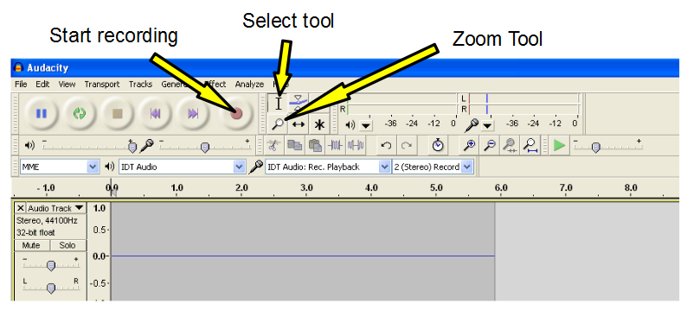
Measuring sound waves
By opening the "Audacity" software you can record a sound which will be displayed as a waveform. Ensure you select "Line in..." when asked if a pop-up appears when connecting a microphone.

Slide 3
Measuring sound waves
Using a sine wave generator linked to a speaker, create a constant frequency sound
Record the sound using the audacity software and zoom in to measure across several waves, then calculate and average time period / frequency

Slide 4
Measuring sound waves
Repeat the experiment but this time move the microphone away from the speaker quickly.
Zoom in and record the time period / frequency again and compare it to the previous result for a stationary observer. Can you estimate the speed you moved the microphone?

Slide 5
Calculating Doppler Effect
The ration of wavelength against expected wavelength (for a stationary system) is the ratio of the velocity of the object to the speed of the wave:
Therefore looking at the observed wavelength and the expected wavelength we can extend the formula and simplify to give:

Slide 6
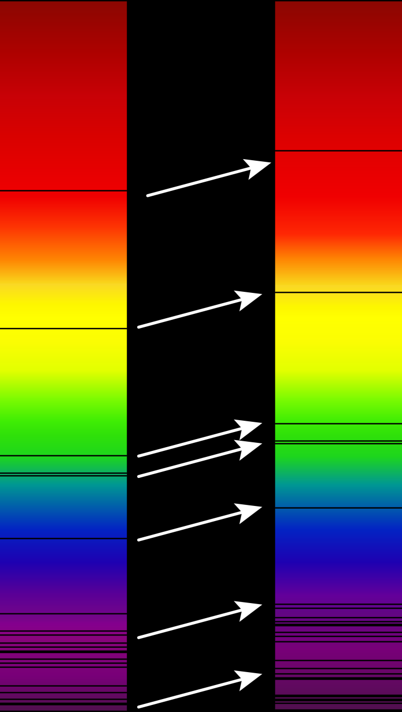
Cosmology - Doppler Effect
Hydrogen is the most common element in the Universe. All stars "burn" Hydrogen into Helium at some point in their life cycle.
Any light given off by a star (and hence a galaxy of stars) will pass through Hydrogen in the envelopes of stars as well as through interstellar gas clouds.
The light spectra from distant galaxies contains the expected Hydrogen absorption lines (Balmer Lines) but they are in the wrong place (They are redshifted)

Slide 7
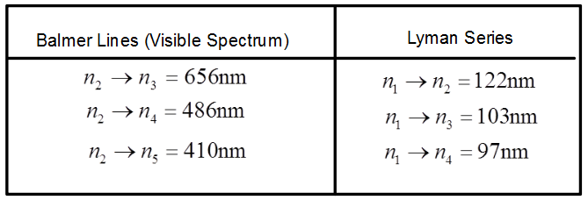
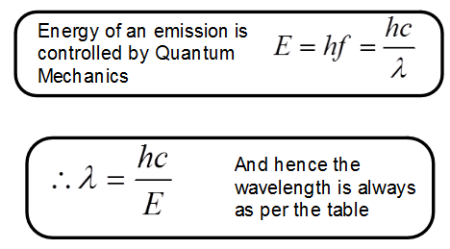
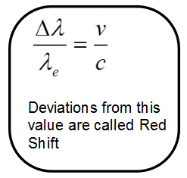
Hydrogen Lines

Slide 8
Calculating Doppler Effect for light
Given that the Balmer lines are at set frequencies, what would the observed wavelength be of the n₁ → n₂ line from a galaxy receding at 2.7x10⁸ m s⁻¹?
Note: This formula only works accurately for non-relativistic speeds of v

Slide 9
Binary systems and spinning galaxies
By comparing the red-shift in the light from two stars orbiting a common centre of gravity their relative speeds can be calculated
By comparing the red-shift from either side of a spinning galaxy the speed of the galaxies rotation can be calculated
These calculations require the sources to be rotating in the plane in-line with our solar system
Galaxies are seen to spin too fast and hence more gravity is needed in them than the stars provide – dark matter is one theory to explain this

Slide 10
Using the Doppler Effect in Cosmology
The calculated value of v is the speed of recession of the source of the electromagnetic radiation. Remember that the radiation itself must always travel at the speed of light.
The proportion of the speed of light that a distant object (Usually a galaxy) is receding is call the z factor or the Cosmological Redshift.

Slide 11
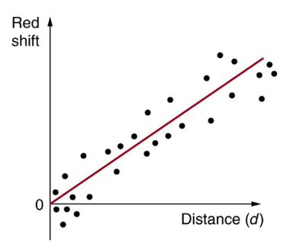
Hubble constant
Edwin Hubble realised that Galaxies that were further away had a greater Redshift value z so he plotted a diagram that showed the straight line correlation between Redshift and Distance.
Unfortunately there is not a strong correlation between the two variables. This also assumes that the "constant" has always remained the same during the life of the universe, however the universe is believed to be accelerating (which requires an elusive dark energy)

Slide 12
Distance Calculations
Given the value for the Hubble Constant it is possible to calculate the distance to any galaxy based on its redshift value z.
Care MUST be taken over the units for the Hubble constant H:
H = 500 km s⁻¹ Mpc⁻¹

Slide 13
Summary
The Doppler effect occurs if an object is moving, relative to an observer, when a wave is created
The ratio of the observed and expected wavelength is the same as the ratio of the velocity of the object and the expected speed of a wave (usually the speed of light but this formula also works for sound waves)
Edwin Hubble noticed that all distant galaxies were receding when he observed a red-shift in the Balmer lines in their spectra
Plotting z against the distance of the galaxies enabled Edwin Hubble to calculate the Hubble constant which can be used to estimate the distance of a galaxy from its recessional velocity

