Slide 1
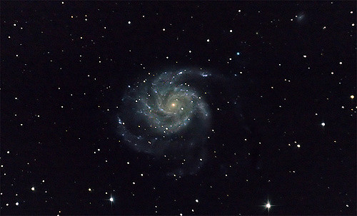
Distance Ladder
How can you calculate the distance to a star or galaxy without ever leaving the Earth?

Slide 2
Trigonometric Parallax
Recall that the distance to a nearby star can be calculated by observing its apparent motion against a background star as the Earth orbits around the sun
Using the angle of parallax in seconds of a degree and the base length of the observation as one astronomical unit gives a distance in parsecs
This method is limited to a maximum range of about 10³ parsecs (about 10% across the Milky Way Galaxy)

Slide 3
Spectroscopic Methods
Looking at the emission of stars and calibrating for distance, speed and absorption you can estimate their intrinsic luminosity (or absolute magnitude).
Comparing to their apparent magnitude here on Earth you can calculate their distance.
This is limited to ranges of about 10⁶ parsecs (The distance to the nearby M31 galaxy)

Slide 4
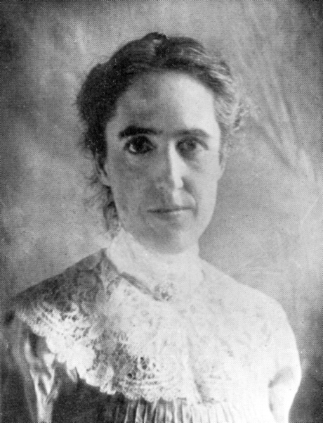
Cepheid Variables
These stars change their brightness on a timescale of days or weeks. It has been discovered (by comparison to the Spectroscopic analysis) that their period is directly related to their size (and hence luminosity)
This means that you can calculate their absolute magnitude from their period, and hence thereby calculate their distance based on their apparent magnitude.
Henrietta Swan Leavitt who discovered this relationship is one of the unsung heroes of astronomy.
Range 10² to 10⁷ parsecs

Slide 5
Supernovae
Type Ia supernovae have approximately the same intrinsic brightness and hence are an ideal candidate as a standard candle
Type Ia supernovae are extremely bright and can be seen in galaxies outside the Milky Way.
Type II supernovae are less uniform but still add to the ability of cosmologists to calculate the distances to galaxies. Range 10⁶ to 10⁹ parsecs.
Because they are caused by an accreting white dwarf exceeding the Chandrasekhar limit so always have the same mass
Why are type Ia supernovae all about the same intrinsic brightness?

Slide 6
Hubble's Law
This law states that there is a relationship between how far away a galaxy is and its Red Shift (and hence it's speed of recession)
The greater the red shift of a Galaxy then the further away it is.
This WILL NOT work for anything nearby (or even in the Virgo Cluster) due to gravitational attraction and relative motion causing inaccuracies in the measurements.
Range 10⁸ to 10¹⁰ parsecs

Slide 7
Hubble's Law
The relationship between the red shift of galaxies and their distances was performed by building up a distance ladder – this was used to calibrate the Hubble constant
Redshift v = Hd
Assuming that the expansion of the universe has been approximately constant over time then the age of the universe can be calculated from the Hubble constant (giving an age of about 13.8 billion years)
One major piece of evidence for the big bang and the expanding universe theory is that the light from the time that atoms first formed is now stretched to the microwave pat of the spectrum
The cosmic microwave background (CMB) has been measured and mapped, giving a map of the very early universe

Slide 8
Helium / Hydrogen abundance
In the very early universe protons and neutrons will have formed in approximately equal amounts.
Neutrons are not stable on their own and have a half life of 881 seconds
Given the theoretical temperatures and time of expansion of the early universe it is possible to calculate the amount of Helium that would be formed from neutrons and protons combining to make stable Helium
The ratio of Hydrogen (Protons) (73%) and Helium (25%) in the universe appear to match the predictions and hence support the theory of the big bang

Slide 9
Quasars
The most luminous and distant objects in the universe are called quasars
These objects are believed to be active galaxies, where a supermassive black-hole at the centre are absorbing huge amounts of matter.
This creates jets of radiation to be emitted which are detected by radio telescopes
Quasars have the largest red-shift of any objects found in the universe and are hence considered the most distant objects observed
They absorbed all of the matter near to the black-hole early in the life of the universe so none now exist; when we look at distant Quasars we are looking back in time.
Why are there no nearby Quasars?

Slide 10
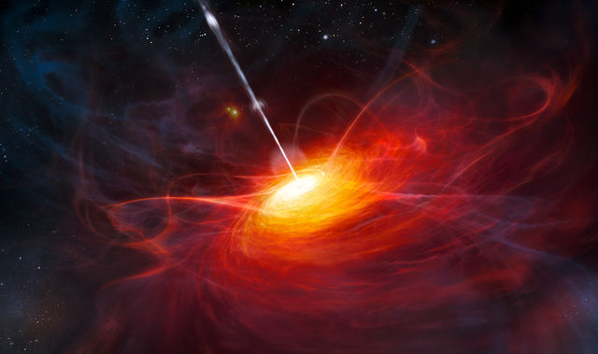
Artist impression of a Quasar

Slide 11
Summary
Red shift in distant galaxies is interpreted as an expansion of the universe
Given that v = Hd from redshift data then the age of the universe can be calculated, assuming H is constant.
Cosmological microwave background radiation and the relative abundance of hydrogen and helium aid weight to this theory.
Quasars are the most distant measurable objects, discovered as bright radio sources.
Quasars are believed to be active supermassive black holes at the centres of galaxies

