Slide 1
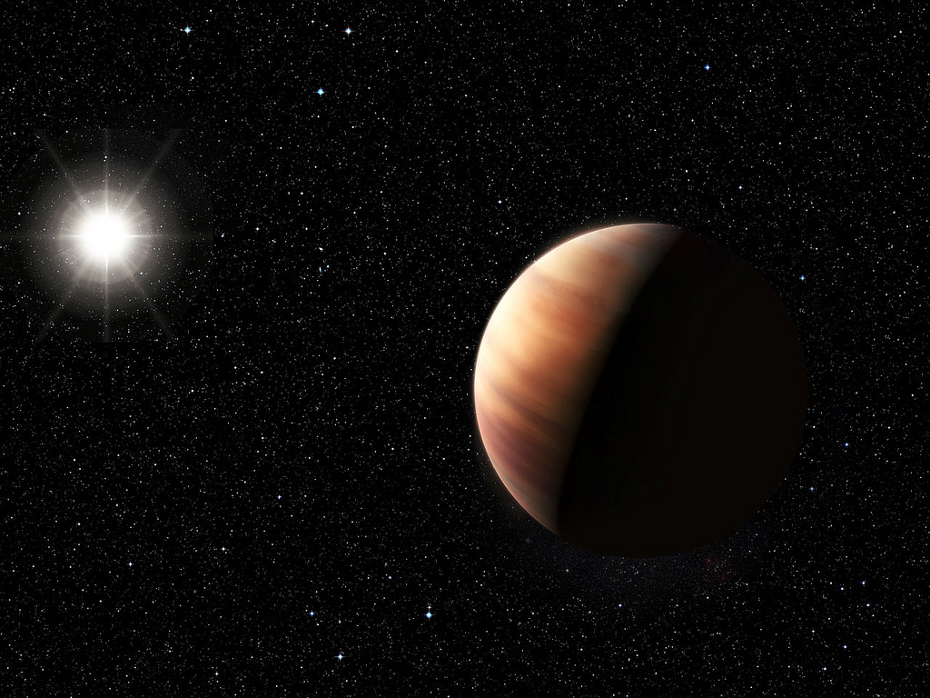
Exoplanets
What is an Exoplanet?
Why is their search important?

Slide 2
The search for planets around stars
Consider the resolution problems associated with resolving a planet around another star
What is the angular separation between the sun and the earth if observed from 500ly away?
What would be the angular separation between either side of the Earth when viewed from that distance?
Consider the amount of light that a star creates and compare this to the reflected light from a planet (Even if it was 100% reflective what would the ratio be for the Earth to the Sun?)
The output of the sun radiates outwards to be received on Earth.
Given the radius of the Earth and considering it a disc within a sphere of light from the sun we get:

Slide 3
Finding exoplanets
The problem resolving a small planet around a distance star means that the presence of the planet must be inferred from other data; there are two main methods:
Transiting exoplanets; looking at light curves
Doppler shift changes in a star; Radial velocity technique
Discuss what the differences and similarities might be between theses methods

Slide 4
Transiting exoplanets
A planet transits across the face of a star if the orientation of the system is such that the plane of the planetary orbits exactly face planet Earth.
Consider the Earth / Sun system; what is the angle subtended from the Earth to the edge of the sun?
What percentage of space around our system would see us transit the Sun?
When a planet transits a star then it causes a periodic dip in the light from the star. What does this tell us?
The depth of the dip gives a measure of the size of the planet
The length of the dip can be used to calculate the orbital time and hence the distance of the planet from the sun

Slide 5
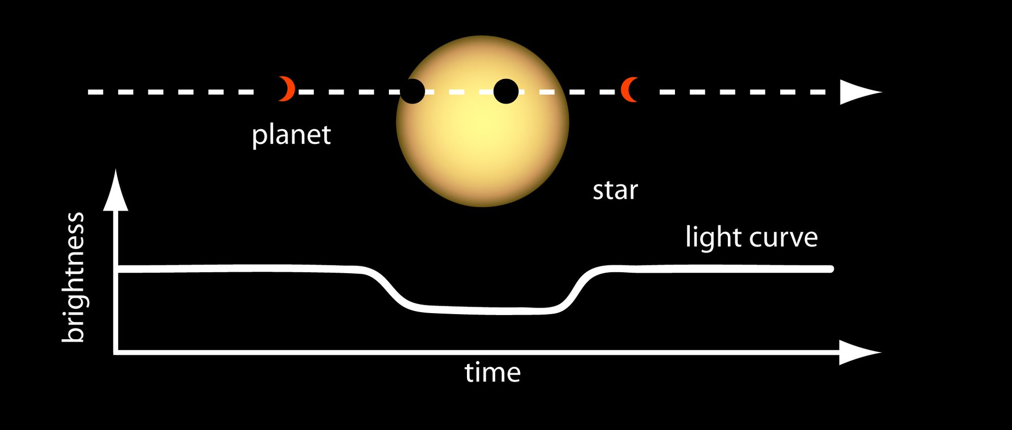
Describing and analysing a light curve

Slide 6
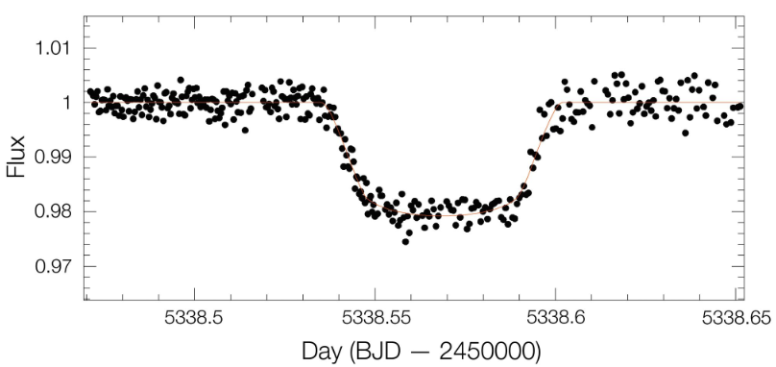
Data collected on exoplanet Wasp-19b

Slide 7
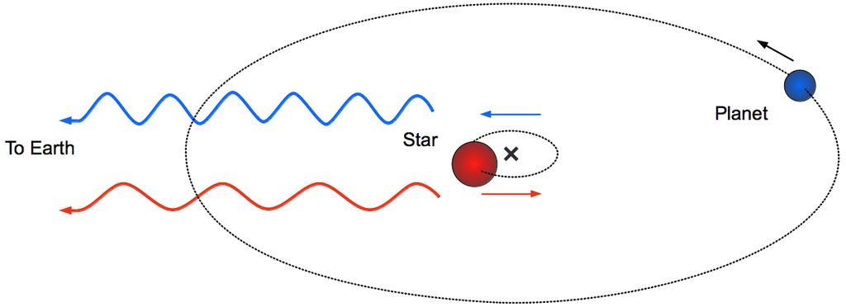
Radial velocity technique
Recall that the Hydrogen lines in the spectrum from a star can enable the viewer to measure the velocity of the object (radially relative to the observer) using red-shift
As a planet orbits a star it makes the star wobble periodically; radial velocities as small as 1ms⁻¹ can be observed
Although the planetary orbits must still align with the observer this method works even when the alignment does not allow for a transit

Slide 8
Comparing techniques
The radial velocity technique can be used in a wider variety of circumstances so is going to generally find more exoplanets
The transiting method enables more accurate data to be found for the size of the planet and its exact orbital time as the angle of the planetary orbit can be accurately calculated
The transiting method may enable the atmosphere of the planet to be measured as some of the light from the star will pass through the planet’s atmosphere and will leave faint absorption lines

Slide 9
Selection bias
What sort of planets do you think would be easiest to find?
Large planets that create large Doppler shifts and / or larger light curve dips
Planets close to the sun that have short orbital periods
Most of the exoplanets that have been discovered are “Hot Jupiters” meaning they are gas giants in very tight, fast orbits

Slide 10
Summary
It is very difficult to observe a star orbiting another star due to the relative sizes and brightness's of the objects
Radial velocity changes in a star that occur periodically can be caused by a planet orbiting the star – this Doppler effect can be observed in the absorption lines
Transiting exoplanets create a periodic dip in the light curve from a star; they may also include data about the planet’s atmosphere

