Slide 1
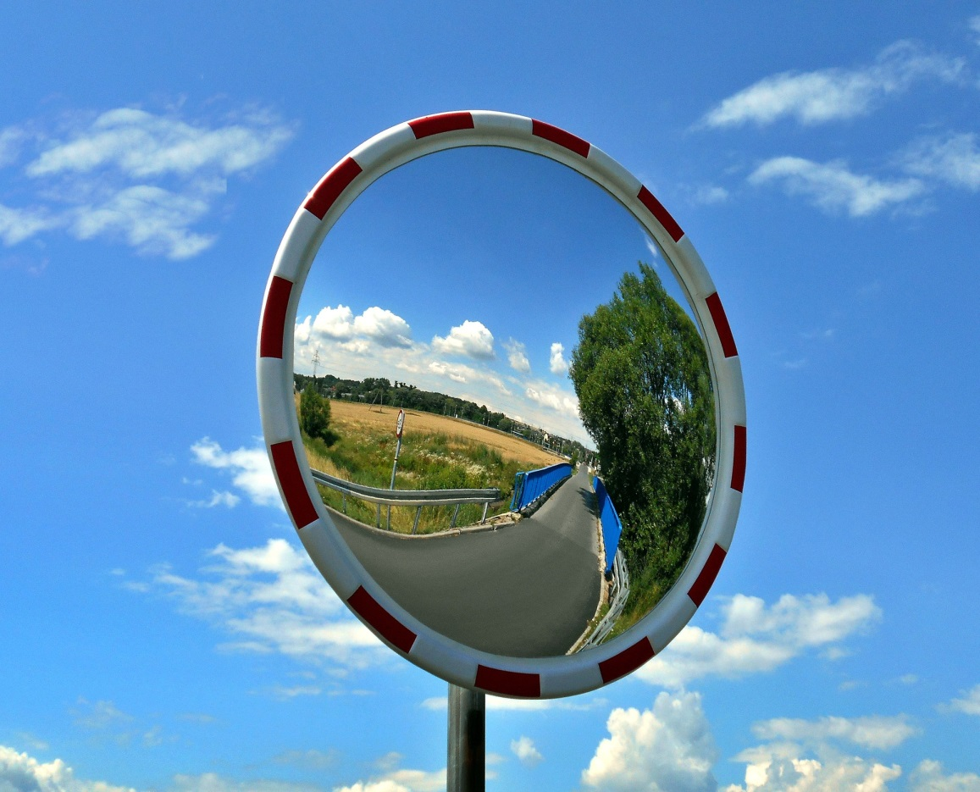
Reflecting telescope
How can a mirror be used to focus light?

Slide 2
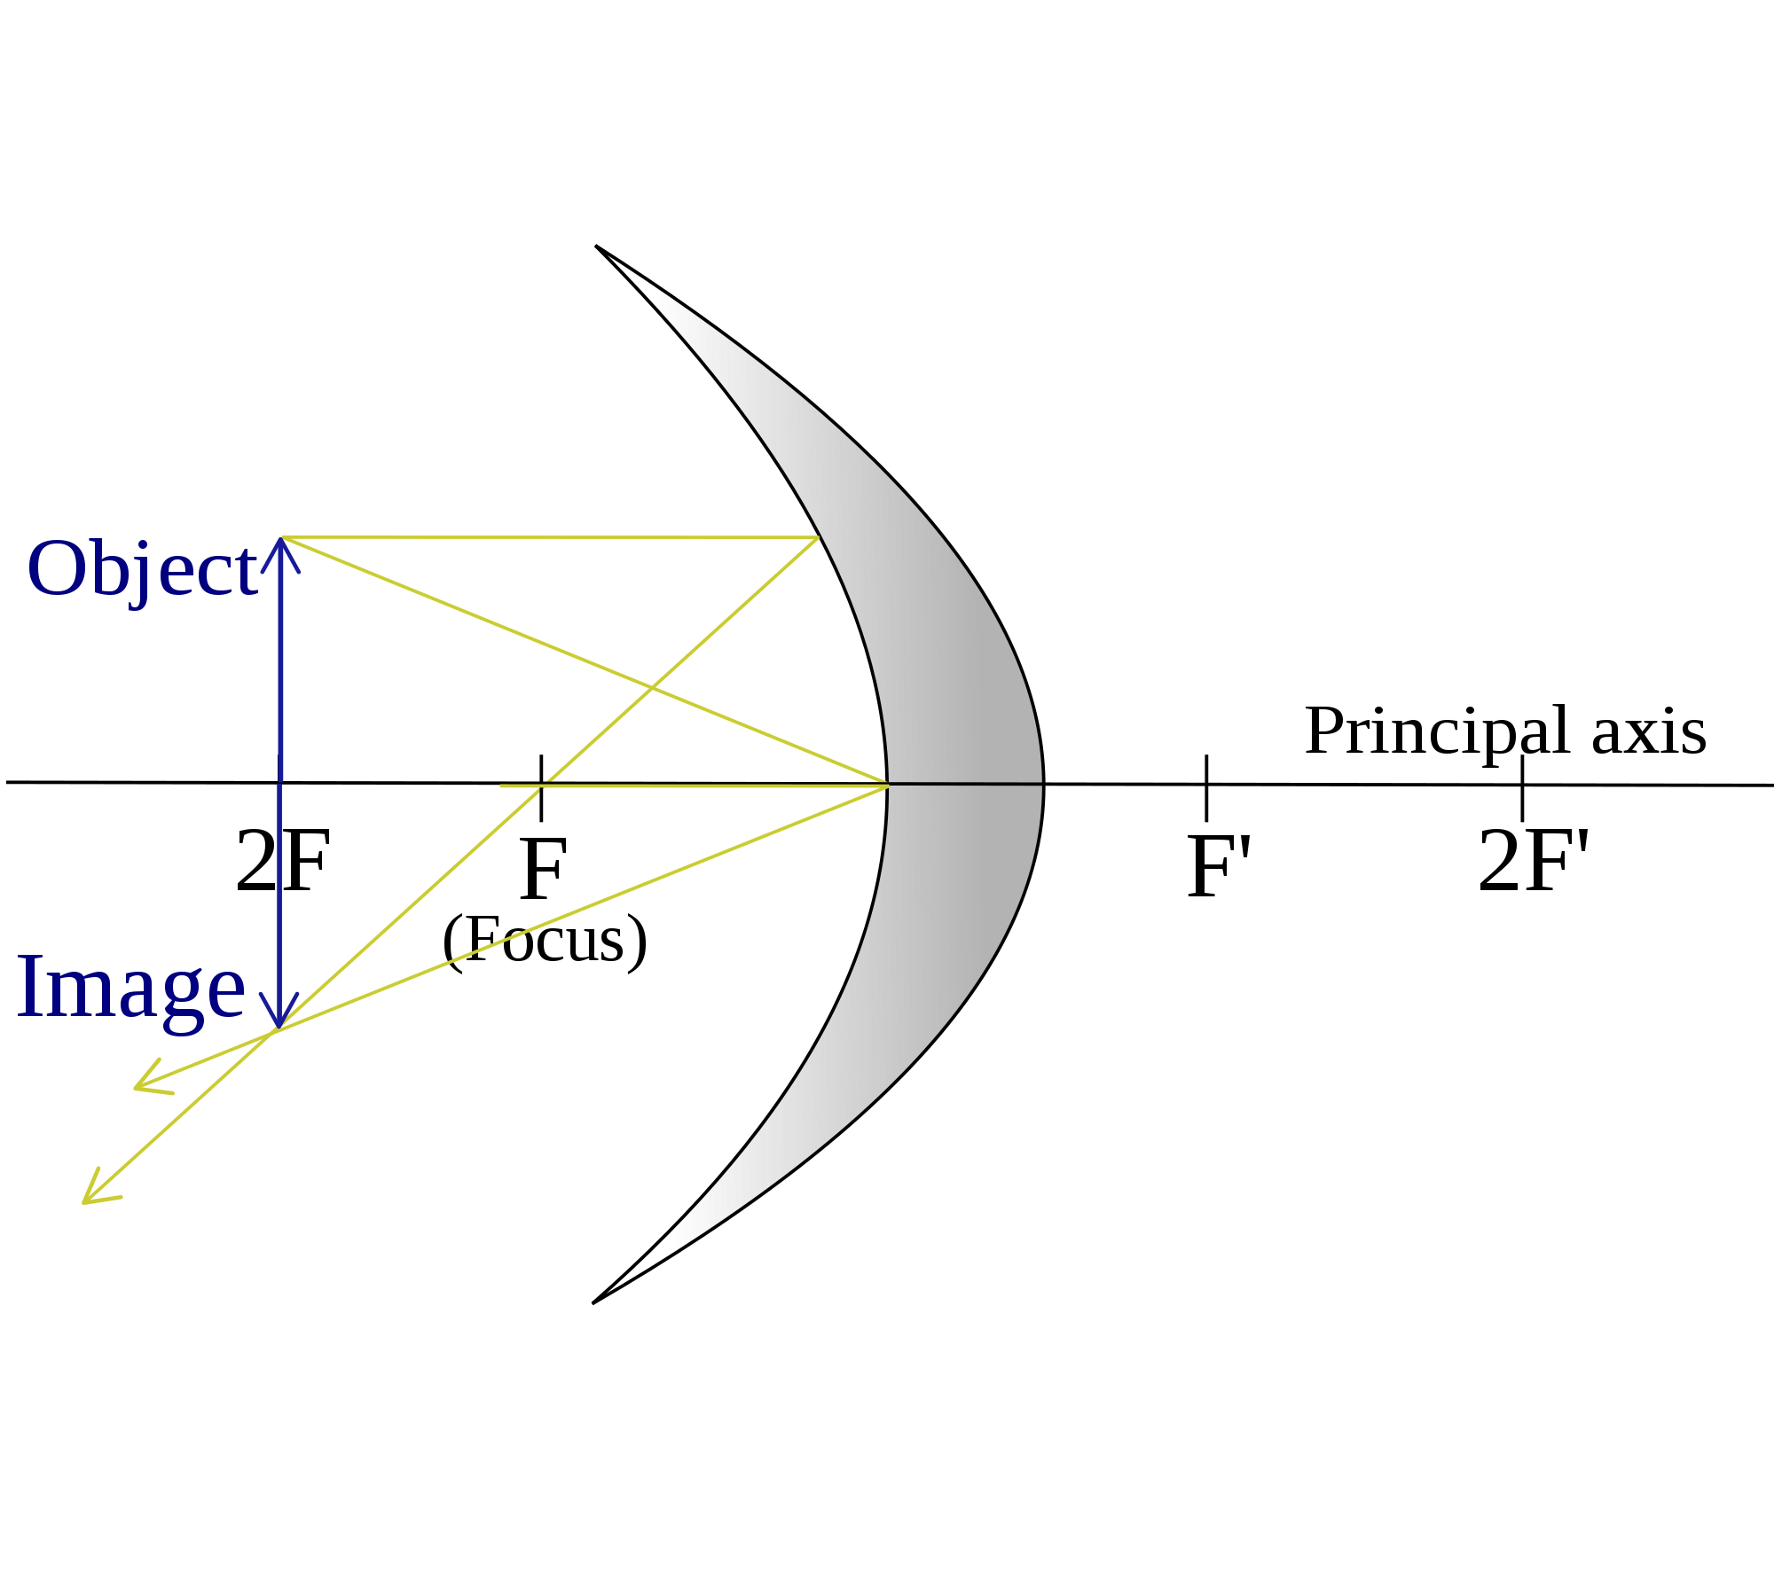
Reflecting telescope
Using parabolic mirrors to focus light gets rid of the problem of chromatic aberrations; This is because the angle of reflection is independent of wavelength.
Light that travels parallel to the normal will reflect through the principle focus
Light that travels along the principal axis will reflect straight back along that line.
Any ray that strikes the principal axis will reflect at the same angle as the angle of incidence

Slide 3
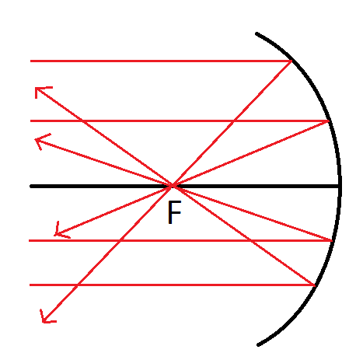
Focusing light
Light from a distant object can therefore be focused onto a point from a concave mirror without chromatic aberration

Slide 4
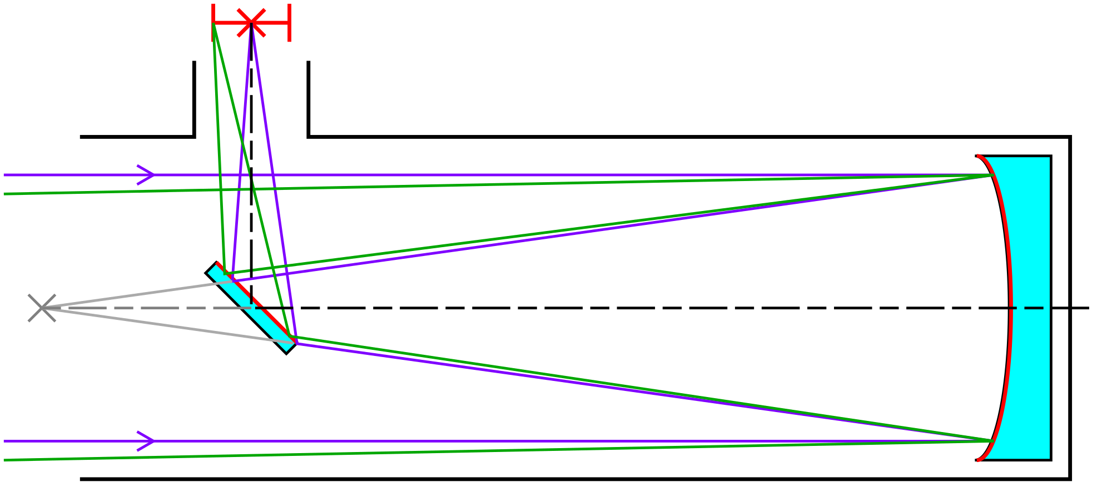
Newtonian Telescope
Light is reflected off a primary mirror before being sent, via a plane mirror, to the eyepiece at the side.
Note that the rays will be parallel before entering your eye. The lens in your eye brings them to focus on your retina

Slide 5
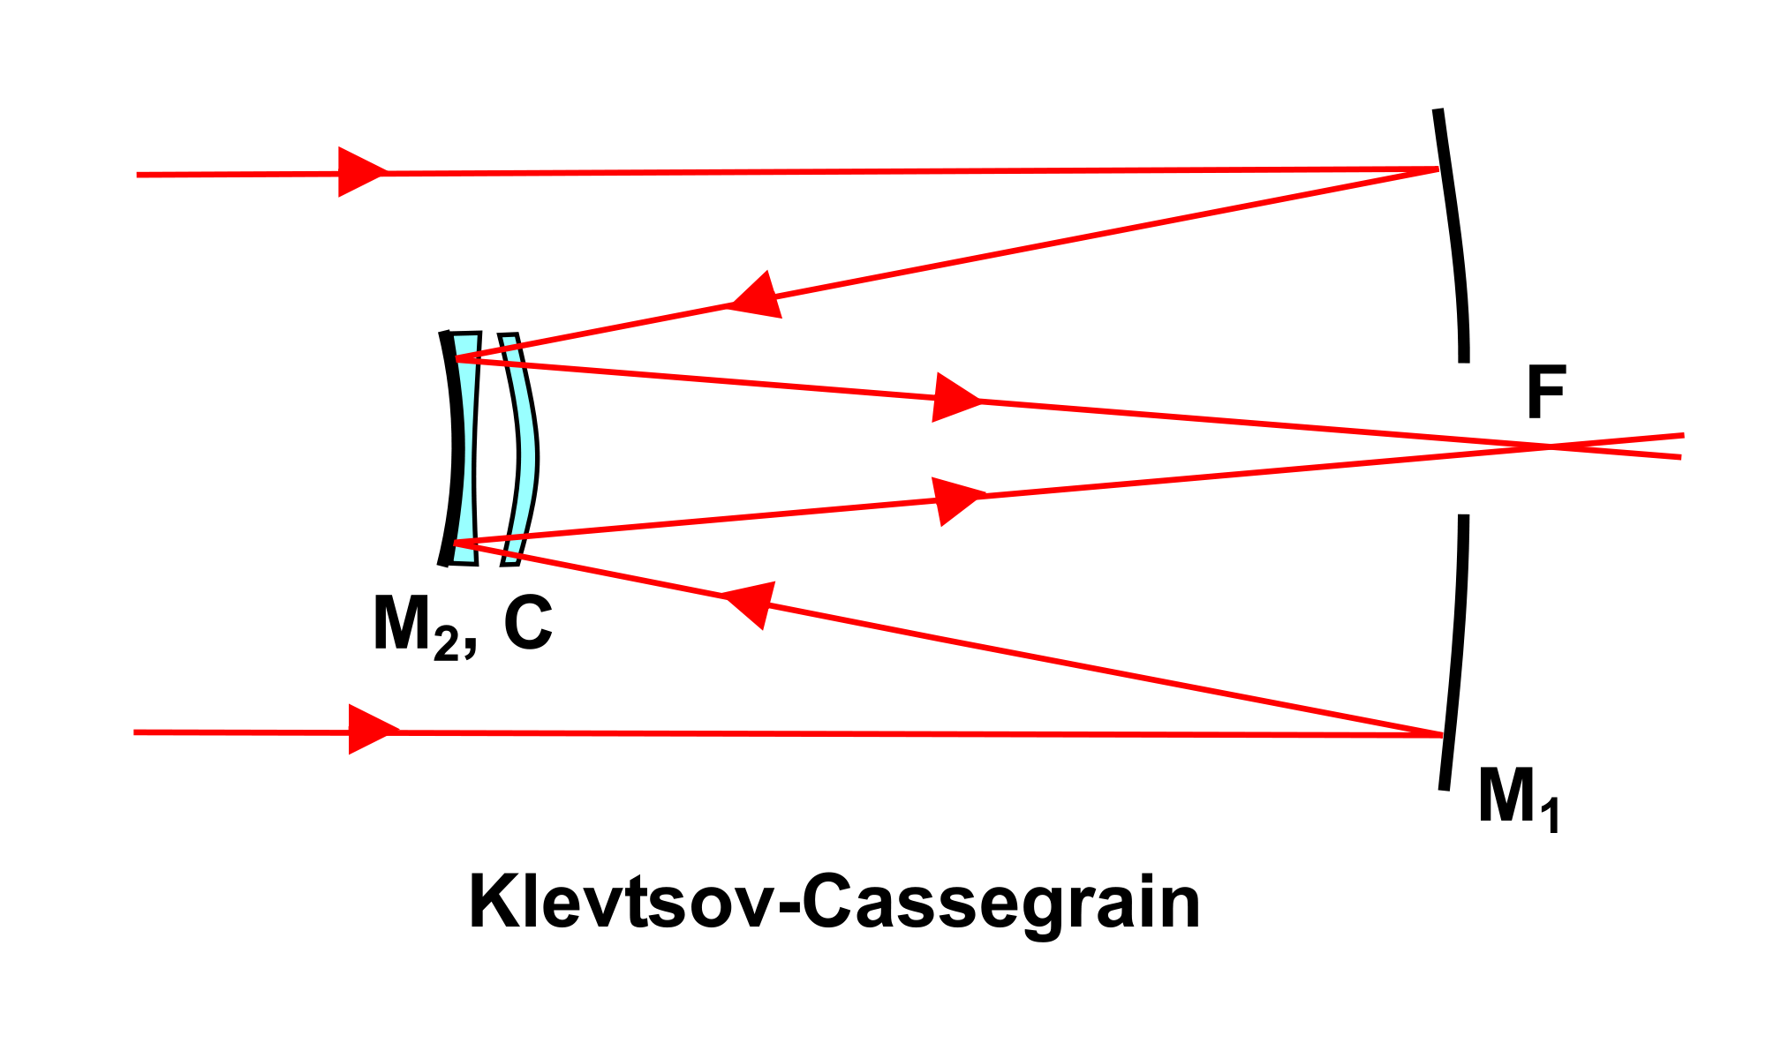
Cassegrain Telescope
This works in a similar way to a Newtonian telescope except that there is a convex mirror that straightens out the rays after they have been focused from the primary mirror.
Spherical aberrations still can exist in mirrors but large diameter mirrors with large focal lengths and using light only from closer to their centres avoids this.

Slide 6
Mirrors versus lenses
The main advantages of a mirror over a lens are:
Lighter
Only the surface needs to be perfect as opposed to the body of the lens
Thin so can be adjusted as it is moved using pressure pads
Cheaper to manufacture
Able to be made in segments and fitted together
No chromatic aberrations

Slide 7
Spherical aberrations
Spherical aberrations occur in both lenses and mirrors and it is because light hitting different sections do not always meet at the principle focus
These cannot be overcome simply with design changes in shape as it varies with the angle of the incident light
The effect can be minimised by using oversized lenses / mirrors and closing the aperture to only use the centre when pin-sharp images are needed

Slide 8
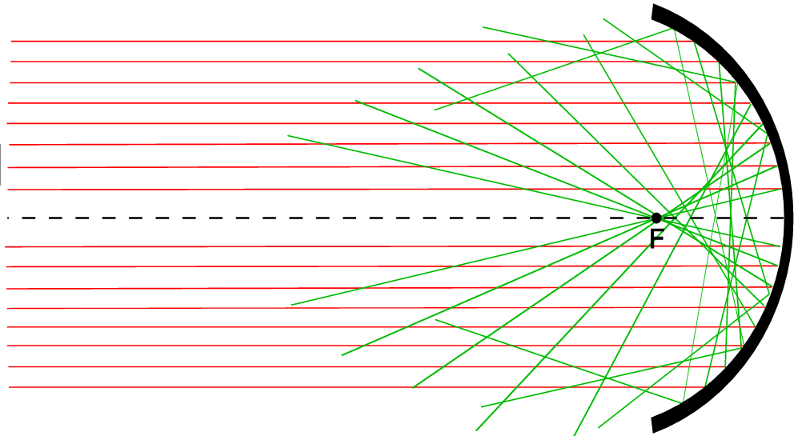
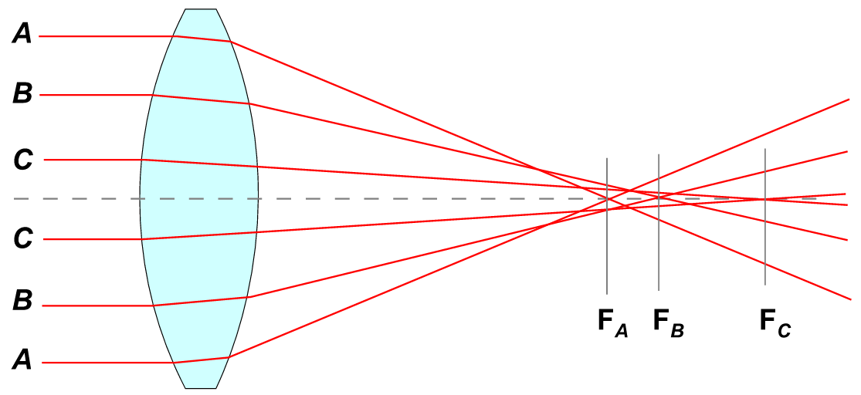
Spherical aberrations

Slide 9
Summary
The use of mirror in telescopes means that they can be built cheaper, bigger and removes the chromatic aberrations
Newtonian and Cassegrain telescopes differ slightly in the positions of the eyepiece and in the use of plane or convex mirrors in the centre
You must be able to draw ray diagrams for each of these telescopes
Remember that the rays that enter the eye must be parallel so a final eyepiece is used to achieve this
Spherical aberrations can be removed by only using the middle of a large lens or mirror

