Slide 1
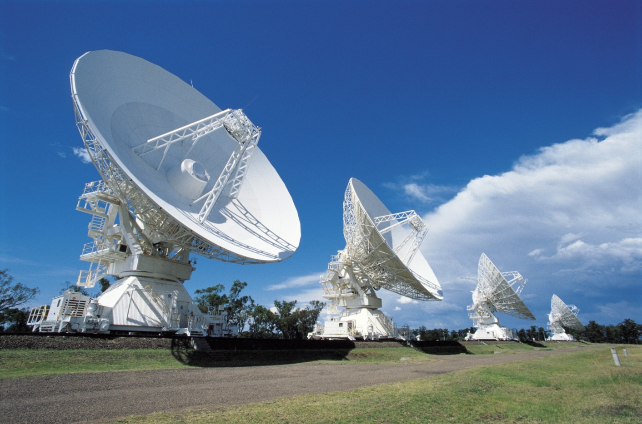
Non-optical Telescopes
What are the benefits in not using light to probe the universe?

Slide 2
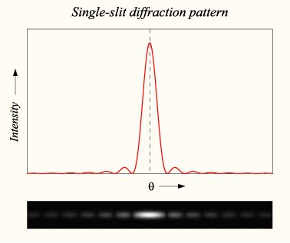
Resolving Power
When an electromagnetic wave passes through an aperture then it diffracts creating a diffraction pattern.
From a point source (i.e. a distant star) going through a circular aperture this looks like this:

Slide 3
Resolving two objects
If two objects are close together and far away (i.e. their angular separation is very small) then their diffraction patterns will begin to overlap
This means that if the angular separation is too small then they will appear as a single object; they cannot be resolved

Slide 4
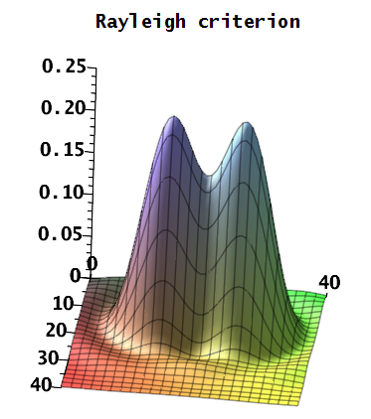
Rayleigh Criterion
If the maximum of one lines up with the minimum of another one then this is the limit of the sources being resolvable. This is the Rayleigh Criterion.

Slide 5
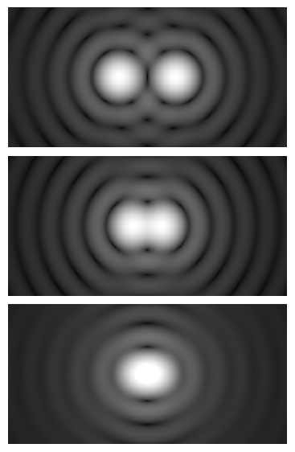
Resolving binary stars
Resolved objects
Rayleigh criterion
Unresolved objects

Slide 6
Calculating resolving power
The resolving power needed to resolve two point sources can be calculated using:
Example
A car is 5km away and has a headlights 1.5m apart. What resolving power is needed to resolve the headlights?

Slide 7
Calculating the resolving power for telescopes
Given the diameter of the telescope aperture d and the wavelength of the incident waves then the Rayleigh criterion can be calculated for any telescope. This is it's maximum resolving power.
If the resolving power for objects exceeds this then the telescope cannot resolve them.

Slide 8
Keplar 22-b
An exoplanet has been detected orbiting Keplar 22. The radial distance of the planets orbit is 127 million km.
Keplar 22 is 600 ly from the Earth.
How big does a telescope need to be on Earth to resolve the Star / planet pair?

Slide 9
Summary
When light goes through an aperture it diffracts
If the diffraction patterns overlap from two objects then the two objects cannot be resolved
The Rayleigh criterion is where two objects can just be resolved
The further away and the closer together two objects are then the smaller the angular separation is; hence the more difficult they are to resolve

