Slide 1
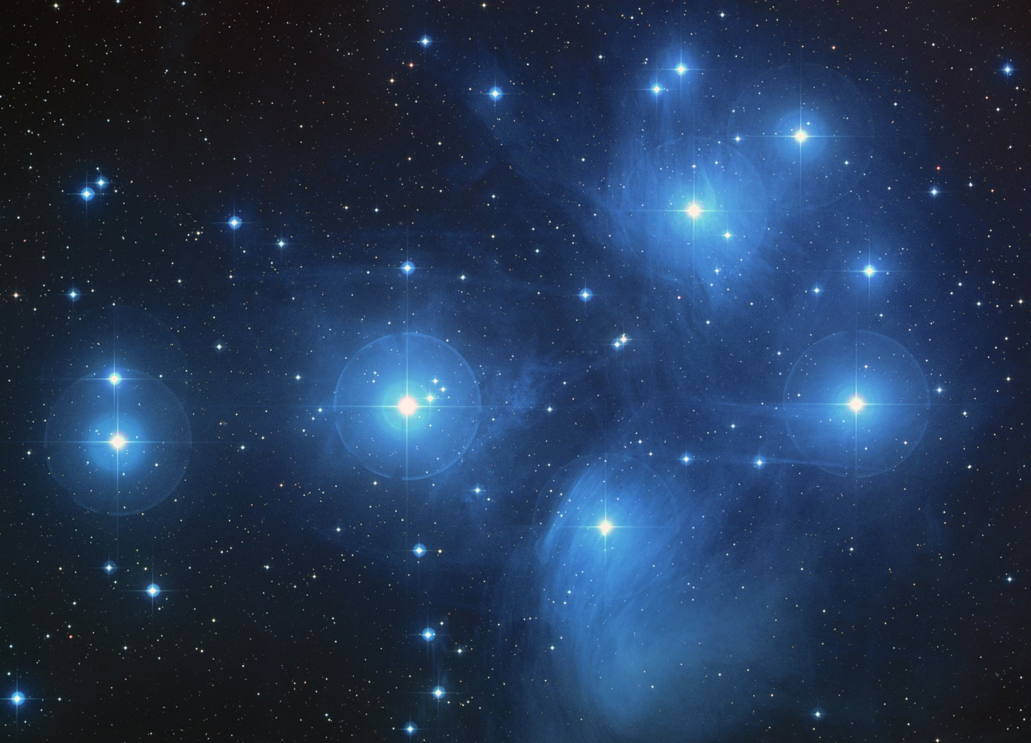
Classification of stars
How many different types of stars do you know?
What properties make them fall into different groups?

Slide 2
Classification of Stars - Apparent and Absolute Magnitude
The most important factor in knowing what type of star you are observing is understanding it's Luminosity.
Luminosity is a measure of the Output of a star in Watts
This can be measured using just the visual spectrum or the total output (bolometric)

Slide 3
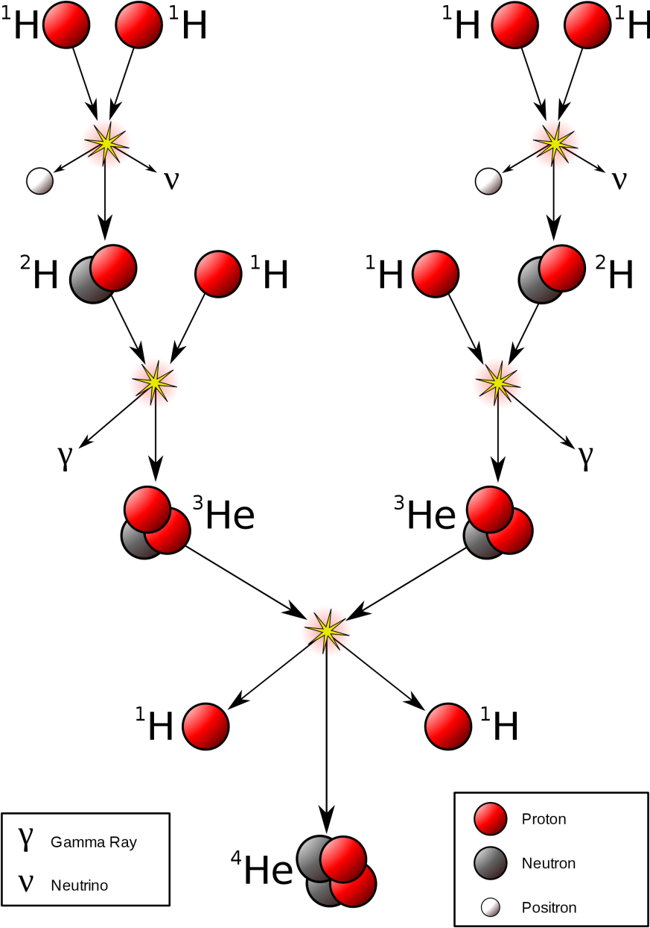
Fusion
Remember that the output from a star is due to Nuclear Fusion reactions in the core and in Main Sequence stars this is due to Hydrogen being fused into Helium.
Understanding these processes enables an astronomer to understand how different types of stars occur.

Slide 4
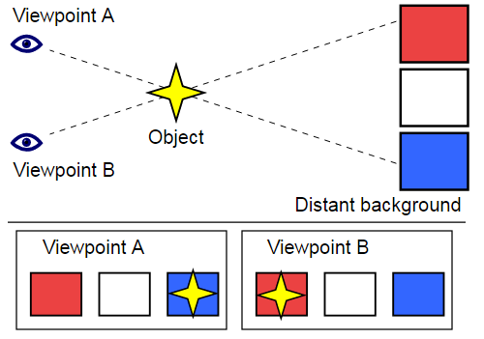
Calculating luminosity
Unfortunately to measure the luminosity of a star you must know it's distance away. For relatively close stars the best method is parallax measurements.
Place an object at one side of the classroom. Using only a ruler, large piece of paper and a protractor estimate the distance to the object without walking over to it

Slide 5
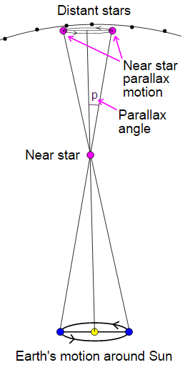
Stellar parallax
The Earth orbits the sun at a distance of approximately 150 million km. If you observe nearby stars during our orbit over a 6 month period they appear to move relative to the distant, fixed background stars.
If the angle p is measured in radians and the base line is 1 astronomical unit
(1AU = 150 million km)
then the distance d will be calculated in parsecs:

Slide 6
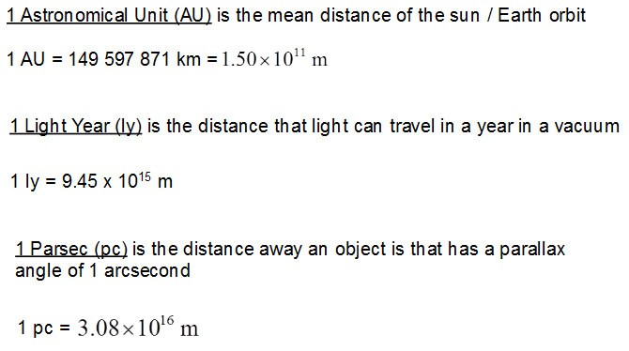
Units of distance in Astrophysics

Slide 7
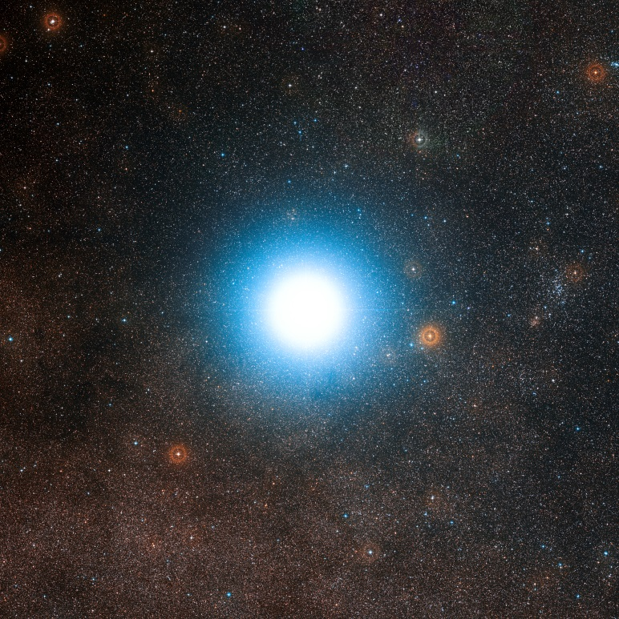
Astronomical Distance examples
Nearest star
Pleiades is an open star cluster visible as the "Seven Sisters" by the naked eye.
Distance - 130 pc
Alpha Centauri is 1.33 pc away from us

Slide 8
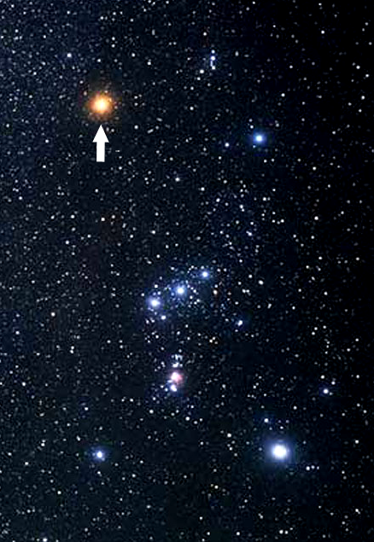
Astronomical Distance examples
Betelgeuse is a super red giant in Orion
Distance - 197 pc

Slide 9
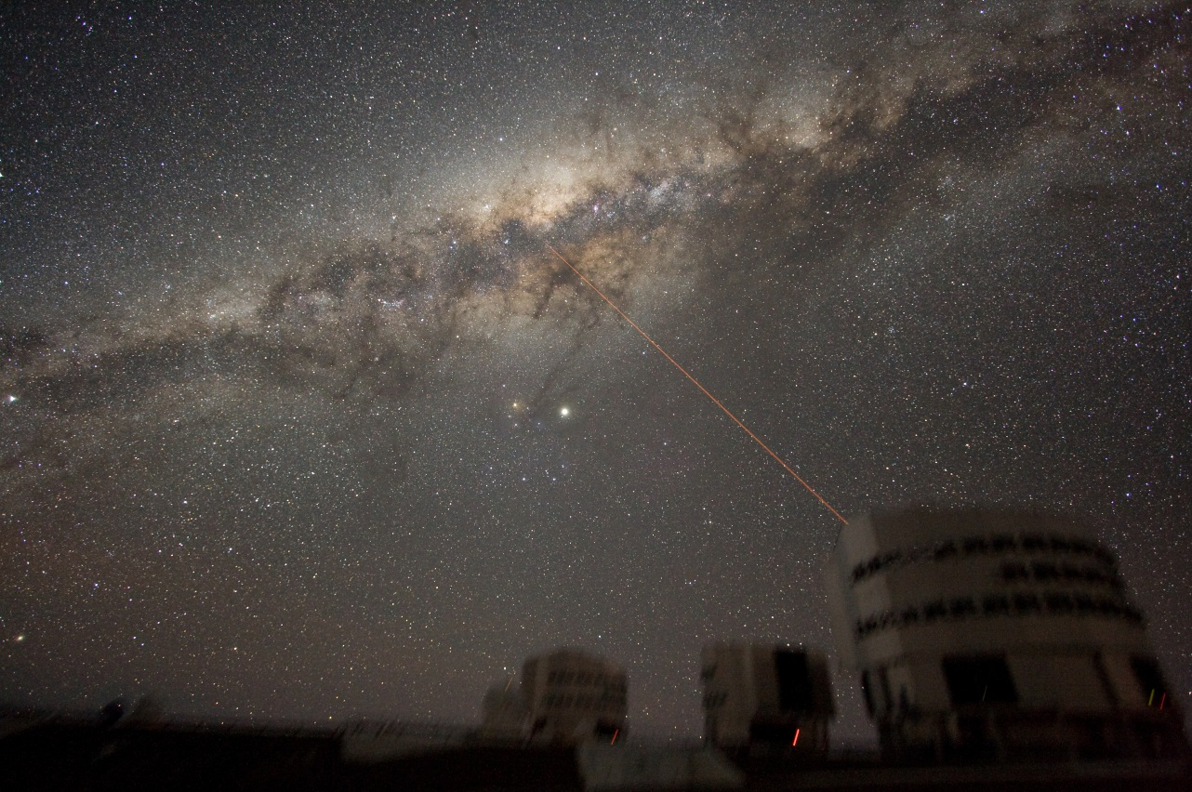
Milky Way Galaxy
The main (90% of stars) part of our galaxy is about 40,000 ly across
The entire radius is about 100,000 ly across

Slide 10
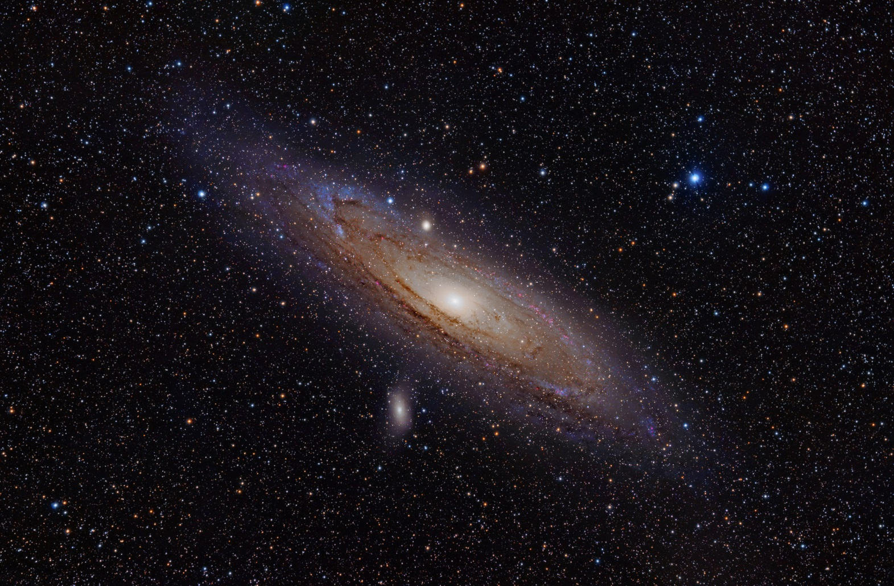
Andromeda Galaxy
Andromeda is our nearest large spiral galaxy.
It is 2.5 million light years away

Slide 11
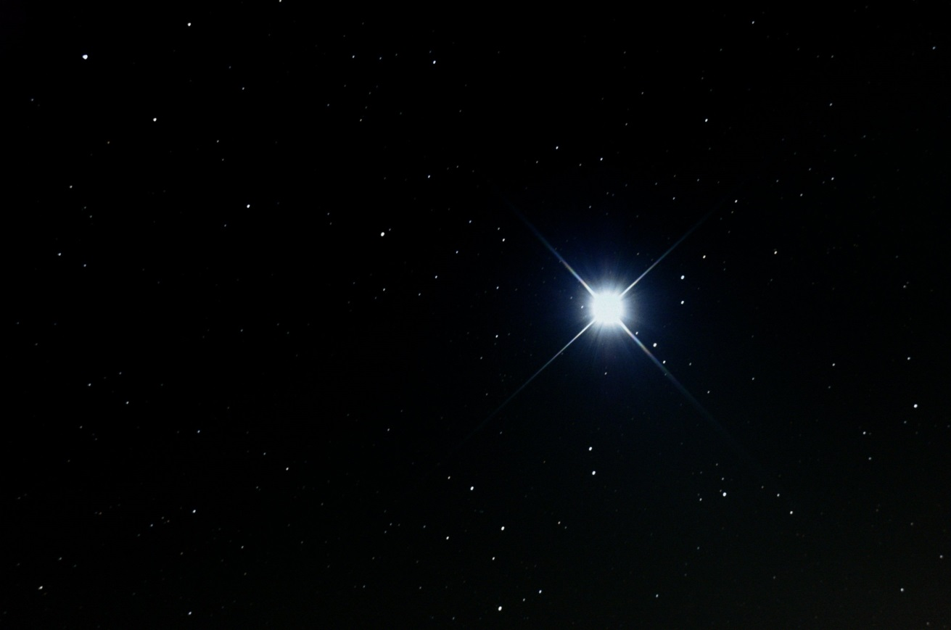
Magnitudes of Stars (The Hipparcos scale)
Star magnitudes were first measured by Hipparcos in 102BC
The early magnitude scale went from 1 - 6 (as integers) and were from Bright to Dim
The modern scale uses this scale but it has been extended, especially in the region of very faint objects. It also now has a mathematical description which means that it is a continuous measurement as opposed to being discrete. This has caused very bright objects to have a negative visual magnitude!
Sirius is the brightest star with visual magnitude m of -1.46 at a distance from Earth of only 8.6 ly

Slide 12
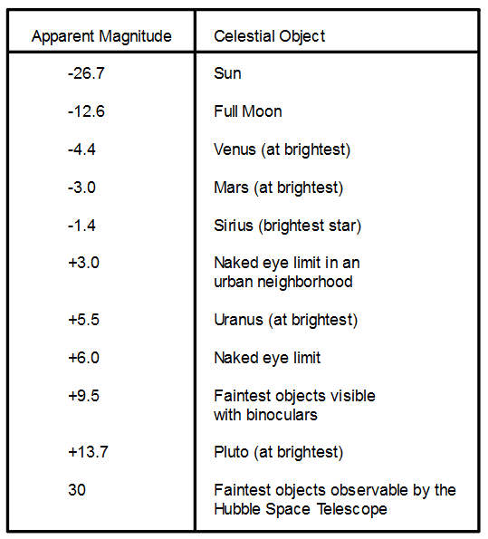

Slide 13
Apparent and Absolute Magnitude
The magnitudes that have been discussed so far are the apparent magnitudes which means that this is how bright the objects appear from Earth
To compare one star to another you must have a standardised method of comparing them. This is done by calculating what their magnitude would be if you were 10 parsecs from it; their absolute magnitude
The human eye perceives that a magnitude 1 star is about 100 times brighter than a magnitude 6 star. Therefore a logarithmic scale of base 2.51 is appropriate:

Slide 14
Apparent and Absolute Magnitude
This means that a star that is one magnitude (absolute) brighter than another star is actually 2.51 times brighter than it
Remember brighter objects have lower magnitudes
Calculating the absolute magnitude M of a star from it's apparent magnitude m and distance D (in parsecs) is done using this formula:
Note that there are various ways of writing this formula so you may get a different form in the exam

Slide 15
Example calculation
Spica is 67 pc away and has an apparent magnitude of m = 1.0 what is it's absolute magnitude?

Slide 16
Linking Luminosity to Temperature
The actual flux of energy from a star can be calculated. Stefan's law links Temperature of a star to it's Luminosity (in Watts)

Slide 17
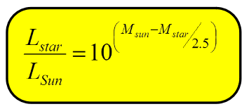
Extension
It is possible to convert absolute magnitudes of stars in Luminosity values in Solar units using the formula below however this is not on the A-level course.

Slide 18
Summary
Luminosity is one of the most important variables that must be known for a star
The brightness of a star is known as its magnitude:
Apparent magnitude is a measure of how bright a star appears from Earth
Absolute magnitude is how bright a star would look if the observer was 10 pc from it
Absolute magnitude can be calculated using the following formula:
Luminosity and the temperature of a star are linked via the Stephan-Boltzmann formula

