Slide 1
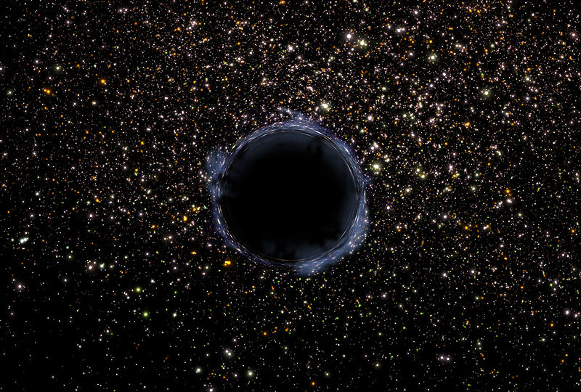
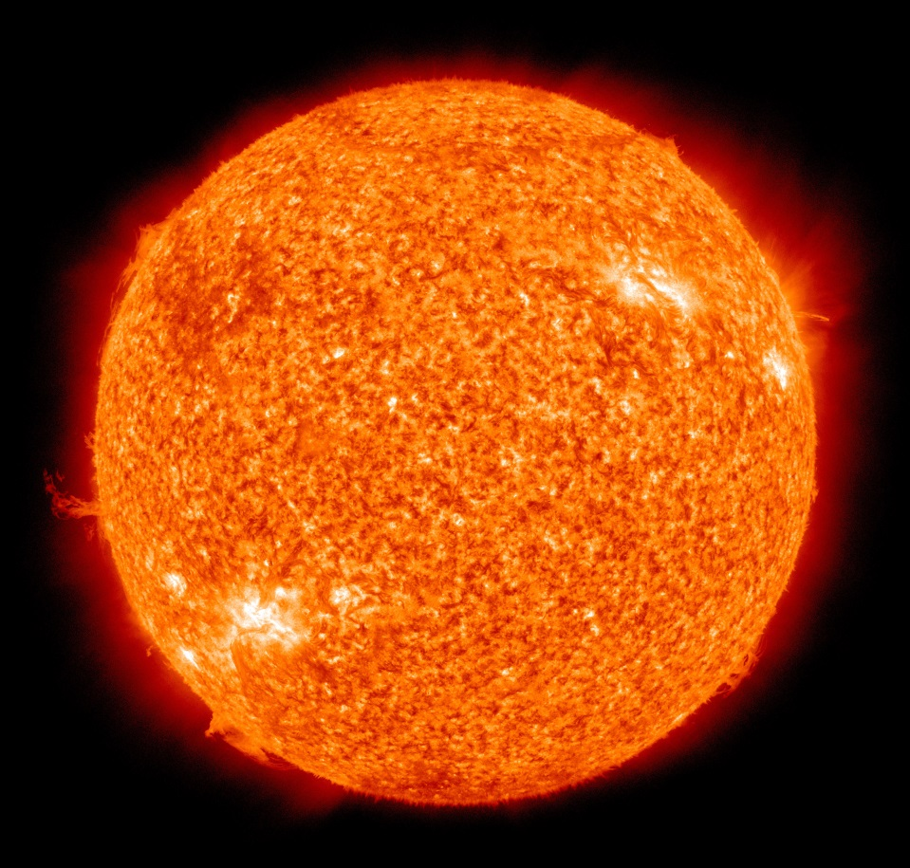
Black body radiation
Why do objects have colour? Would this effect the light they emit if they were hot? What colour would a cold star be?
Stars are generally opaque so they could be considered to be black, they would perfectly absorb all light that hit them

Slide 2
Black body radiation
Why do stars shine? Why are they luminous?
Stars emit Electromagnetic radiation because they are hot.
The amount of radiation given off at each Wavelength is dependant on the temperature of the star.
Stars emit this energy like a "Black Body" in other words the curve follows a very good estimate to a hot object that was perfectly black.

Slide 3
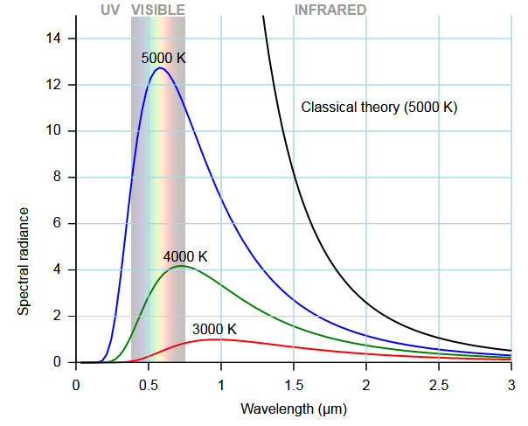
Black body radiation curve
By analysing the curve of the output of a star against wavelength you can estimate the temperature of the star's surface.

Slide 4
Wein's Displacement Law
The peak of a blackbody curve can be calculated from the Temperature of an object using Wein's displacement law (and vice versa from analysis of the spectrum of light from a star):
Use the formula above and the chart (in nm) to estimate the temperature of the following stars:
Betelgeuse - Red
Rigel - Blue
Sun - Yellow

Slide 5
Spectral Classes
Oh Be A Fun Girl Kiss Me
Once you know the surface temperature of a star then you can assign it to a Spectral Class
Spectral Class | Surface Temperature /10³ K | Colour
O | 25 – 50 | Blue
B | 11 – 25 | Blue
A | 7.5 – 11 | Blue / White
F | 6.0 – 7.5 | White
G | 5.0 – 6.0 | Yellow / White
K | 3.5 – 5.0 | Orange
M | < 3.5 | Red

Slide 6
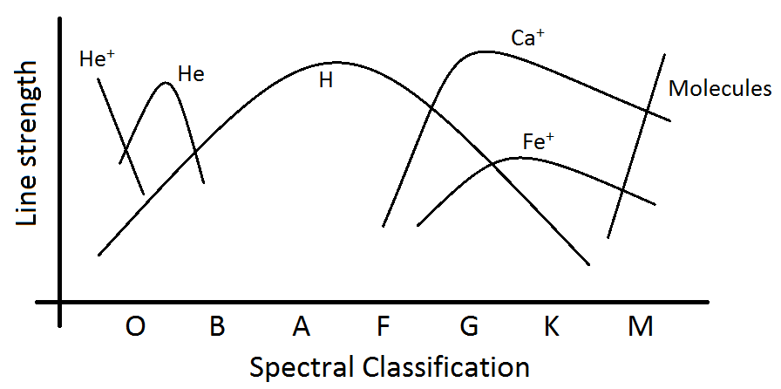
Spectral Type vs Emission Spectra
A star emits light because it is hot however there are absorption lines in the spectrum due to the presence of molecules, atoms and ions in the photosphere and the corona. The temperature of the star will effect which chemicals will be present.

Slide 7
Power and Flux
Stefan's law links Temperature of a star to it's Luminosity (in Watts)
Flux is the power per unit area at a position d distance from the star:
This is sometimes called the power of the star and the L is replaced with a P

Slide 8
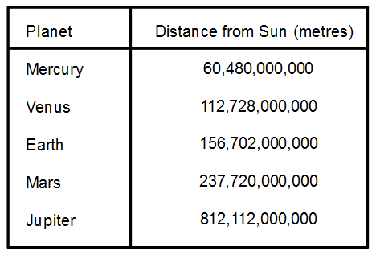
Flux from the Sun at different planets
What assumptions have you made in this calculation?
Given that the power of the sun is 3.839x10²⁶ Watts, what is the flux at each of the planets below?
You have assumed that the atmospheres do not absorb any radiation

Slide 9
Summary
Stars are black body absorbers meaning that they emit a near perfect spectrum of radiation
The temperature of a star can be calculated from the peak wavelength of the emission
The temperature then places the star into a classification
The spectrum will also contain absorption lines which will help to confirm the temperature of the star
Cooler stars contains molecules, warmer ones contain metal ions, very hot stars contain helium ions

