Slide 1
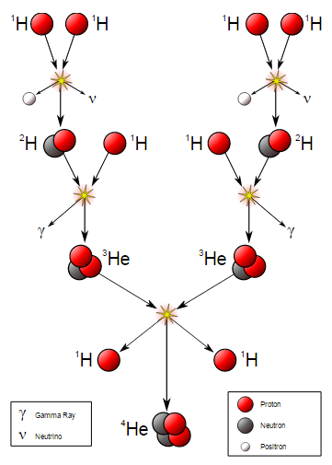
Fusion and the life of stars
Why do different types of stars have different core temperatures?

Slide 2
Fusion and the Life of stars
Main sequence stars are kept hot by p-p chain Hydrogen fusion. Once the proportion of Helium in the core of the star reaches about 10% then the fusion begins to only occur in a shell around the core.
At this point the star begins to expand to form a Red Giant.

Slide 3
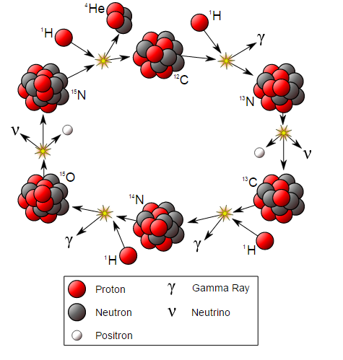
The C-N-O cycle
In stars that are more massive than the sun, Hydrogen fusion utilises Carbon 12 as a catalyst.
This is a cyclic system called the C-N-O cycle; The larger the star the more important this cycle becomes.
In very hot stars another cycle using Nitrogen and Oxygen can also function

Slide 4
Atomic nuclei and relative sizes
The radius of the electron orbit in a Hydrogen atom is called the Bohr radius and measures about 5 x 10⁻¹¹m
What is the radius of the nucleus?
An atomic nucleus is of the order 10⁻¹⁵m

Slide 5
End of the Main Sequence
Stars which are on the main sequence are turning Hydrogen into Helium
Once the proportion of Helium reaches about 10% then the C-N-O cycle begins to dominate
Hydrogen burning can continue via a shell around the core when the star begins to run out of Hydrogen and the star will begin to grow in size
As it does this:
It cools
Its luminosity remains about constant (Larger star but cooler)

Slide 6
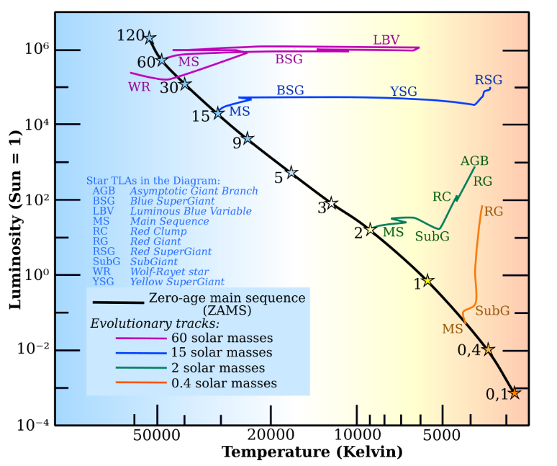
End of main sequence tracks on the Hertzsprung-Russell diagram

Slide 7
Sub-Giant Stars and the instability strip
Stars which leave the Main sequence and begin shell Hydrogen fusion become unstable (due to complex convective activity inside them). This means that they vary in brightness over a period of days or weeks
Because stars stay in this part of their lives for relatively short periods of time there are few to be seen. There are however some obvious candidates that sit on the "instability" strip on the H-R diagram:
Dwarf Cepheids
RR Lyraes
Cepheid Variables

Slide 8
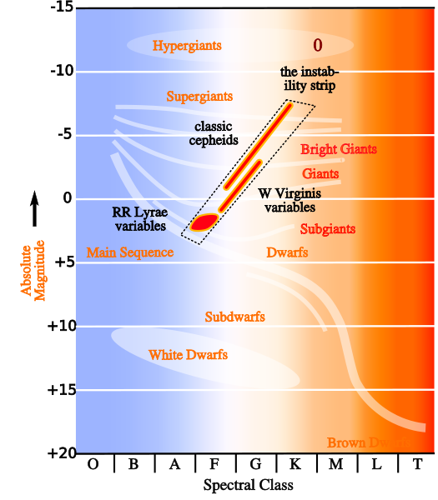

Slide 9
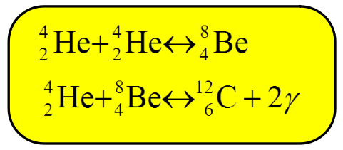
Helium Burning - The Triple Alpha Process
Stars with a mass greater than half a solar mass will get hot enough upon collapse when they run out of Hydrogen for Helium burning or fusion to occur
This can create Carbon 12 by the following reactions:
Note that Beryllium 8 is unstable so Beryllium is not made in stars by this process and hence is rare in the universe! (The stable isotope is Beryllium 9 and there is no fusion path for this)

Slide 10
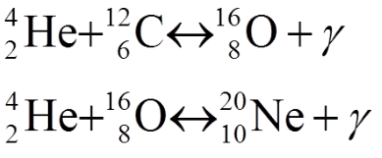
Further Helium burning reactions
Further reactions can occur during Helium burning but these become progressively rarer and rarer:
These can account for the production of Magnesium 24 and Silicon 28. Note that the in-between elements must be made from cosmic ray interaction with pre-existing elements (e.g. Supernovae) but are NOT produced in nucleosynthesis in star fusion

Slide 11
Helium Flash
When the Helium burning initiates, the star expands, but not rapidly enough so the core becomes extremely hot in a short time
This increases Helium burning rates as a runaway reaction and causes a Helium Flash to occur on a timescale of a few days.

Slide 12
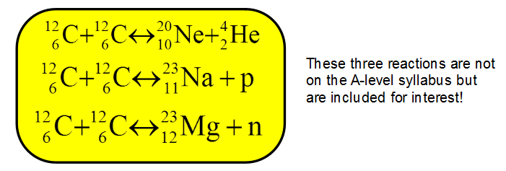
Massive stars and advanced fusion
In High mass stars they do not end their lives when their Helium burning phase ends. There are a series of burning process that can occur, each requiring hotter cores from more massive stars. These are Carbon nuclear burning, Oxygen nuclear burning, and onwards through the period table

Slide 13
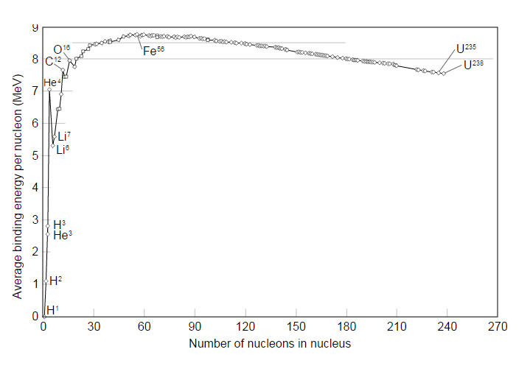
Stability curve and Iron
Atomic Binding energies show that there is a peak at Iron (Fe 56)
This means that a star can never go beyond Iron creation by means of Nuclear Fusion

Slide 14
What happens when a star collapses?
The Pauli exclusion principle states that "Electrons cannot be in the same quantum states". This essentially means that they cannot be in the same place in space (with the same energy and quantum numbers)
As star runs out of fuel it collapses. It can only collapse as far as the electrons will allow. When this happens a White Dwarf is created. No fusion is present and this would slowly cool by radiation to make a Black Dwarf
The Chandrasekhar limit is calculated at about 1.4 solar masses. Beyond this mass it has been calculated that the electron pressure will not stop further collapse

Slide 15
More massive stars (5+ Solar Masses)
The Chandrasekhar limit is calculated at about 1.4 solar masses. Beyond this mass it has been calculated that the electron pressure will not stop further collapse.
Further collapse would create Neutrons from the Protons and Electrons (hence removing Pauli's principle) and collapse would make a core 1/10000th the radius!
Upon collapse the star will suddenly stop collapsing when the Neutron stage has no further collapse available. This will create a supernovae and a huge explosion

Slide 16
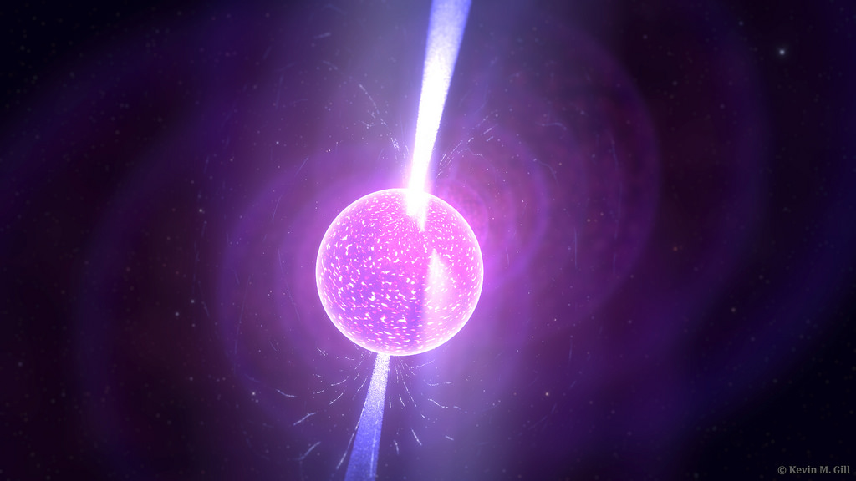
Pulsars and neutron stars
A neutron star with a mass in excess of 1.4 solar masses will be left behind
If the radiation beams sweep past the Earth then we detect a Pulsar

Slide 17
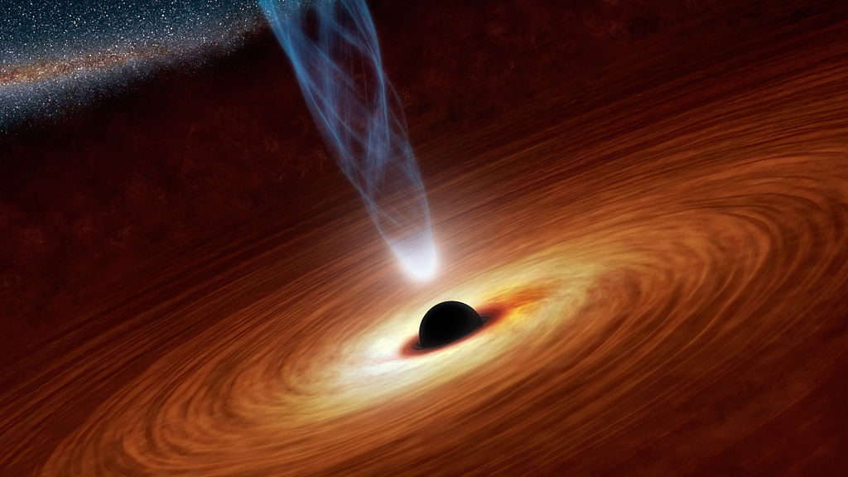
Huge stars of Mass 8+ Solar Masses
Stars even bigger will collapse until their gravity exceeds the speed of light. The core mass remaining after the supernovae will exceed 2.5 solar masses
What remains is called a Black Hole

Slide 18
Summary
Main sequence stars are converting Hydrogen to Helium
Low mass stars do this via the p-p chains
Higher mass stars combine this with the C-N-O cycle
When the helium content of the core gets above 10% then only shell burning occurs
As the fusion ceases the core collapses and heats up creating a helium flash
Further fusion uses helium addition to make larger and larger nuclei at ever higher temperatures
1.4 solar masses is that maximum that a core can attain upon collapse and not become a neutron star – stars that were originally above 5 solar masses will do this
Stars of original mass above 8 solar masses will collapse to create a black hole

