Slide 1
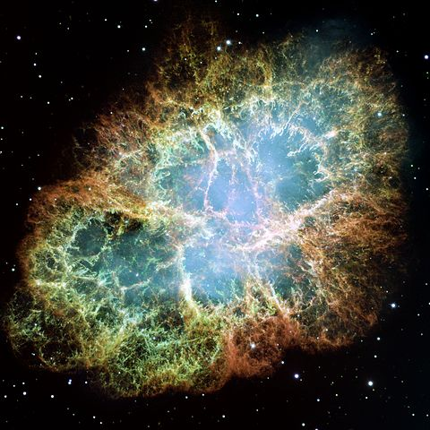
Supernovae and black holes
What are these two phenomena and are they linked?

Slide 2
Supernovae
A supernovae occurs when a star eventually gets to the end of its life. Collapse occurs and a massive explosion is created.
During this collapse electron capture creates a mass of neutrons; a neutron star is created. It has a density the same as that of a nucleon , about 10¹⁷ kg m⁻³
Type 2 (Type II) supernova
A Type II Supernova contains Hydrogen Lines in its spectrum, this means that the envelope of the star which contains Hydrogen was intact when the star exploded. The absolute magnitude of these varies with stellar mass.

Slide 3
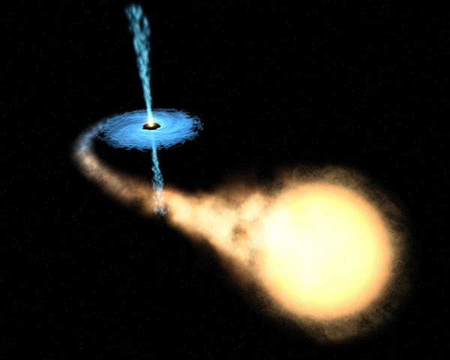
Roche Lobe Overflow
In a binary system matter can be drawn onto a white dwarf. This is called Roche Lobe overflow. Once the mass of the White Dwarf exceeds 1.4 solar masses then core collapse occurs creating a Type Ia supernova.

Slide 4
Type 1a (or Type 1) supernova
Do NOT contain Hydrogen lines. This is because they form when a White Dwarf (which has no Hydrogen envelope) accretes matter from a binary neighbour.
Once the mass of the White Dwarf exceeds 1.4 solar masses (Chandrasekhar Limit) it explodes. These are always similar brightness's and have similar light curves (over time) so can be used for distance calculations.

Slide 5
Supernovae energy and Gamma ray bursts
Gamma rays are detected coming from all regions of the cosmos – one possible source for these extremely energetic photons is supernovae explosions
The power output of a supernovae is so large that a type II supernovae can outshine a galaxy that it occurs in. This means that they can be more luminous than 100 billion stars
Type Ia supernovae always have similar intrinsic brightness’s, about 5 billion times the luminosity of our sun

Slide 6
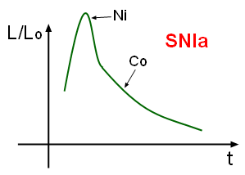
Type 1a light curve
The light curve declines in brightness ( ~ 0.087 mag /day) for 3 – 4 weeks.
By about a month after maximum light, the decline rate has changed again (to a steady ~ 0.015 mag/day) with the light curve
The light curve of a type 1a supernova increases rapidly (Mainly due to Nickel-56 decaying) and then follows a half life curve (due to the decay of cobalt-56 into Iron-56)
Radioactive decay of ⁵⁶Co. has a half life of 77 days

Slide 7
Nucleosynthesis beyond Iron and Neutron Capture
Once you get to Iron elements in the periodic table then the coulomb barrier (the repulsion between positive charges) gets to a stage where further nucleosynthesis cannot occur by Proton capture or Alpha capture.
Further nucleosynthesis is possible however from Neutron capture because neutrons are neutral so there is no Coulomb Barrier to overcome.

Slide 8
The slow process
Inside stars, Neutrons can be formed (believed to occur between the boundaries of shell burning) and these are captured by nuclei.
Either the next isotope is stable for example:
Or it is unstable and will then undergo Beta decay:

Slide 9
The rapid process
During a supernova, neutron flux densities are extreme and they overtake the expanding (mainly Hydrogen) envelope of the exploding star.
This means that successive Neutron capture can occur within timescales of much less than a second.
Very large atoms can be created through Beta decay after this process and therefore the stable elements that are eventually formed can include all of the stable elements in the periodic table (up to Uranium)
These elements are then also free of the remaining star remnant and go out into the galaxy to seed new stars and new planets.

Slide 10
Black holes
Consider the rest mass of a particle:
Now consider the energy of a photon:
Equate these two together and you get:
You can now rearrange this formula to give the effective mass of a photon in a gravity field:

Slide 11
Escape velocity and light
You can calculate the escape velocity of a sphere using:
As the mass of a stellar remnant (a neutron star) increases then the escape velocity increases until eventually is exceed the speed of light:

Slide 12
Schwarzschild radius
As you move away from a source of gravity then the gravity field decreases in strength.
Rearranging this formula you can calculate how far from a spherical body the escape velocity will be greater than the speed of light.

Slide 13
Calculations
What is the Schwarzschild radius of a black hole with mass of 2.50 solar masses?
A super-massive black hole resides at the centre of the Milky Way galaxy. If it has a Schwarzschild radius of 30.1AU, what is its mass (in solar masses)?

Slide 14
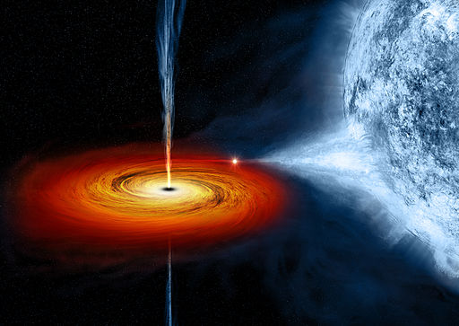
Artist impression of a black hole

Slide 15
Summary
Type II supernova are caused as stars collapse and hence contain hydrogen lines – the luminosity depends on the mass of the star
Type Ia supernova occur when an accreting star reaches 1.4 solar masses, and hence does not contain hydrogen lines and has a standard luminosity
The light curve of a type Ia supernova is predictable as it is due to the decay of Ni⁵⁶ and Co⁵⁶ isotopes
The Schwarzschild radius of a black hole is the distance from a gravity source where the escape velocity is equal to the speed of light
The formula to calculate the Schwarzschild radius is:

