Slide 1
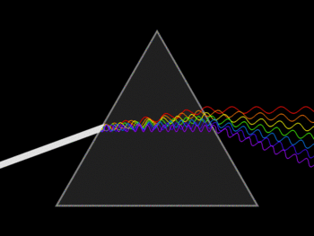
Early theories of light
Revision:
From AS Unit 1, we learnt about light and its different properties. State what the nature of light is?
Describe 2 experiments which provide evidence for this?
From my learning today I will be able to:
Key: | Compare Newton’s Corpuscular Theory with Huygens’ Wave Theory in general terms C
Boost: | Explain Newton's thought experiment and an experiment for Huygens Wave theory - B
Aspire: | Discuss nature of electromagnetic waves and explain why Huygen’s wave theory was slow in being accepted – A/A*

Slide 2
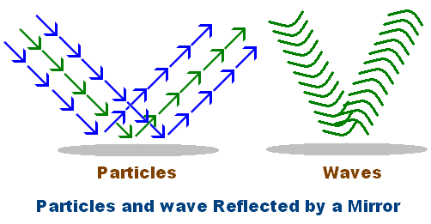
Wave Particle Duality

Slide 3
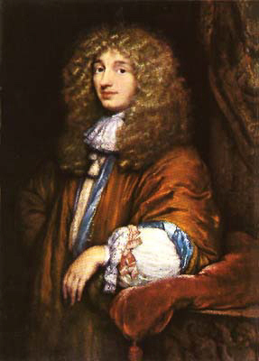
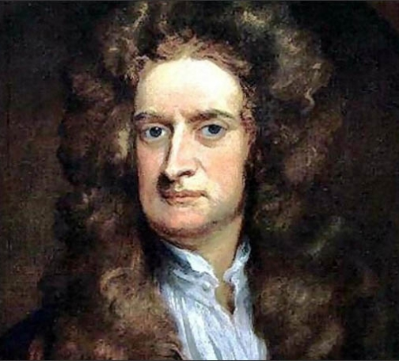
Isaac Newton (1642 – 1727)
Hans Christiaan Huygens (1629 – 1695)

Slide 4
Use the resource pages to research the models Newton and Huygens proposed for the nature of light
You must:
State and what they believed light was made of
Describe how they thought light interacted at different boundaries
Explain fully:
What evidence Newton used to back up his idea
How Thomas Young’s experiment backed up Huygens’ explanation
Suggest what was good about their models
Suggest what the limitations of their models were
NEWTON
What happens to the resultant velocity as a result of the change that Newton proposed?
Is it consistent with what you know about the speed of light in a material?
HUYGENS
When a wave is reflected, its phase changes by 180o . How do you think this is consistent with Huygens ideas?
Is his theory of refraction consistent with what you know already about refraction?

Slide 6
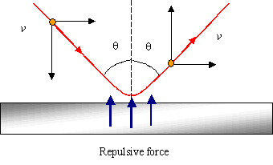
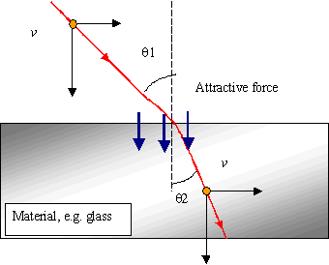
Isaac Newton (1642 – 1727)

Slide 7
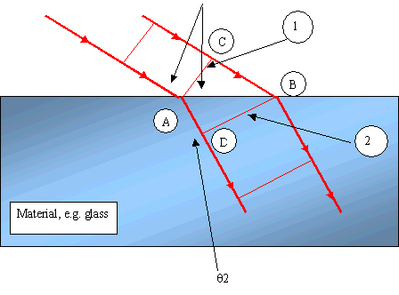
Hans Christiaan Huygens (1629 – 1695)

Slide 8
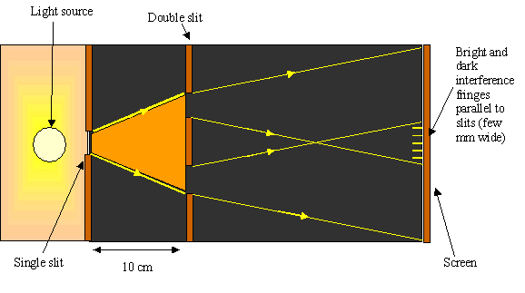
Young’s Double Slits
In this experiment, Thomas Young demonstrated interference. effect could be seen convincingly, and the experiment became a turning point in the debate between those who considered light as a wave. There was no way that it could be explained by particles. On the other hand it could be explained easily by wave theory

Slide 9
Although this was clearly a wave phenomenon, there was some delay before it was whole-heartedly accepted, which happened when a good mathematical argument was worked out. Even then not all were convinced.
In 1850 the speed of light was measured in air and in water. The speed of light in water was found to be lower than that in air, which:
gave the answer predicted by the wave theory of refraction
and contradicted the particle theory.
Then the particle theory was finally abandoned in mainstream Physics thinking.

Slide 11
To answer this question:
1-2 | The information conveyed by the answer is poorly organised and may not be relevant or coherent. There is little correct use of specialist vocabulary. The form and style of writing may be only partly appropriate
3-4 | The information conveyed by the answer may be less well organised and not fully coherent. There is less use of specialist vocabulary, or specialist vocabulary may be used incorrectly. The form and style of writing is less appropriate.
5-6 | The information conveyed by the answer is clearly organised, logical and coherent, using appropriate specialist vocabulary correctly. The form and style of writing is appropriate to answer the question.

