Slide 1
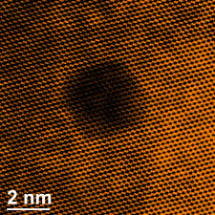
CW | Electron Microscopes | 22/03/2017
What’s this image made by?
Why not a conventional one?
From my learning today I will be able to:
Key: | State and describe the operation of SEM and TEM (AO1)
Boost: | Explain why it’s the limitations of each (B) (AO2)
Aspire: | Suggest how they are improved upon (A/A*) (AO3)
Objective

Slide 2
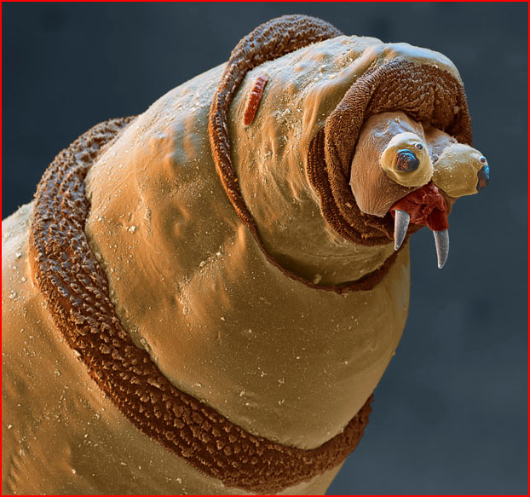

Slide 3
The head of a maggot

Slide 4
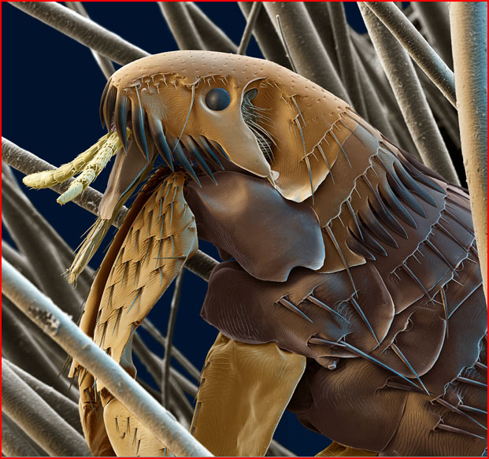

Slide 5
Cat flea

Slide 6
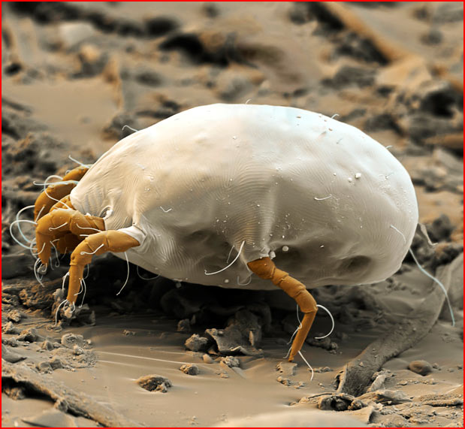

Slide 7
Dust mite

Slide 8
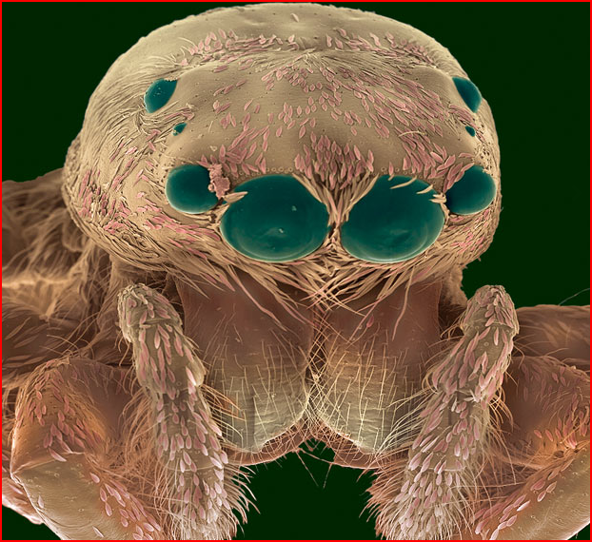

Slide 9
Jumping spider

Slide 10
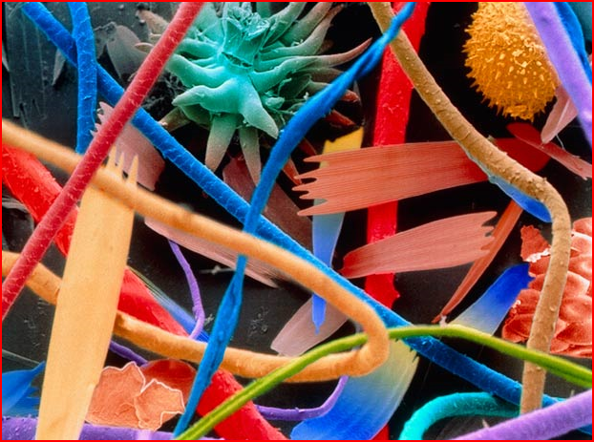

Slide 11
House hold dust including cat hair, insect scales, insect remains and fibres

Slide 12
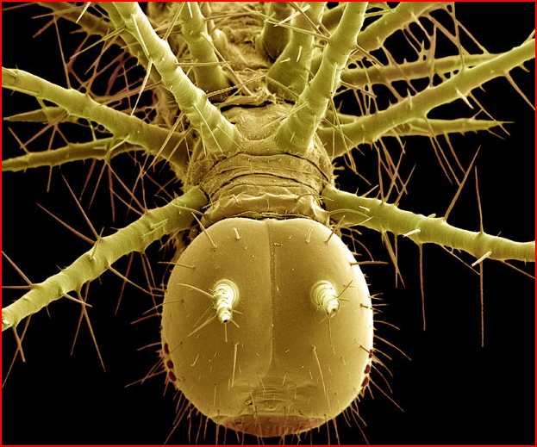

Slide 13
Tropical caterpillar

Slide 14
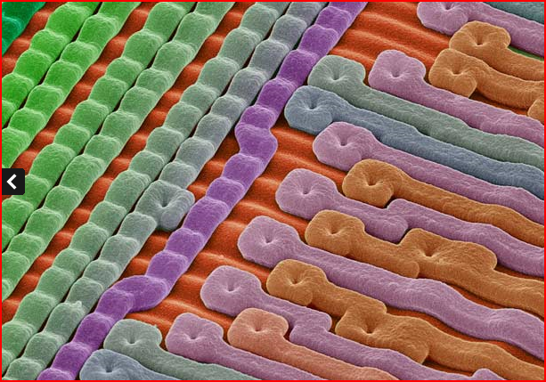

Slide 15
Surface of a microchip

Slide 16
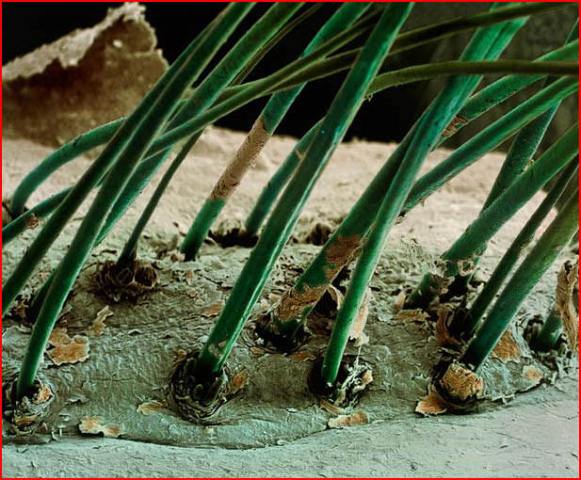

Slide 17
Eyebrow hairs growing out of human skin

Slide 18
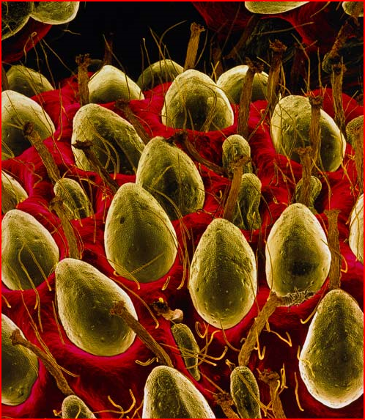

Slide 19
Surface of a strawberry

Slide 20
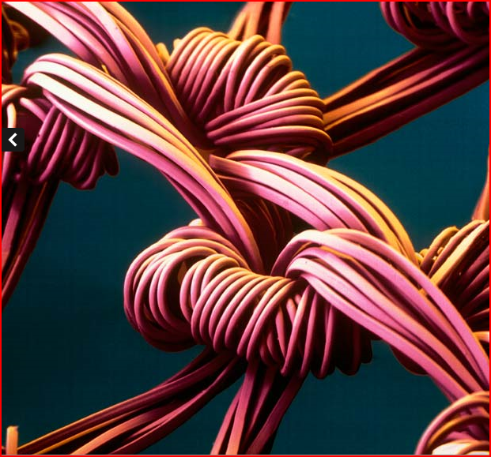

Slide 21
Weave of a nylon stocking

Slide 22
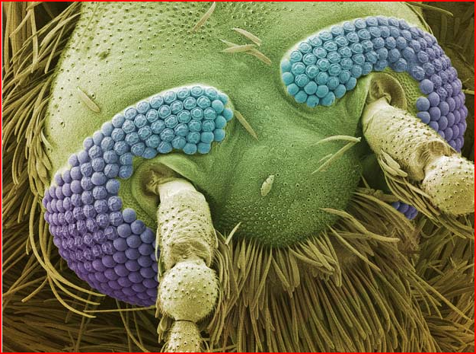

Slide 23
Head of a mosquito

Slide 24
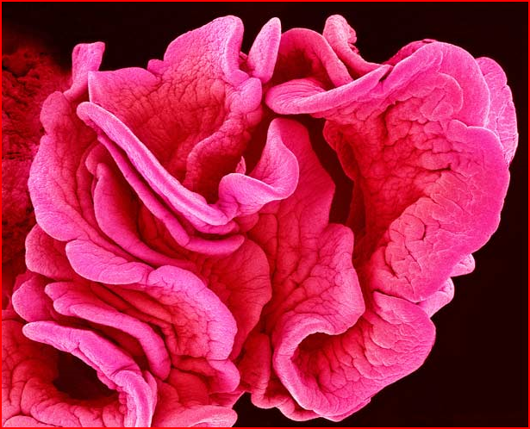

Slide 25
Part of the fallopian tube

Slide 27
The dual nature of electromagnetic radiation
Light and other forms of electromagnetic radiation behave like waves and particles.
On most occasions one set of properties is the most significant
The longer the wavelength of the electromagnetic wave the more significant are the wave properties.
Radio waves, the longest wavelength, is the most wavelike.
Gamma radiation is the most particle like
Light, of intermediate wavelength, is best considered to be equally significant in both

Slide 28
Matter waves
In 1923 de Broglie proposed that particles such as electrons, protons and atoms also displayed wave like properties.
The de Broglie wavelength of such a particle depended on its momentum, p according to the de Broglie relation:
λ = h / p
As momentum = mass x velocity = mv
λ = h / mv
This shows that the wavelength of a particle can be altered by changing its velocity.

Slide 29
Question 1
Calculate the de Broglie wavelength of an electron moving at 10% of the speed of light. [m_{e} = 9.1 x 10⁻³¹ kg]
(h = 6.63 x 10⁻³⁴ Js; c = 3.0 x 10⁸ ms⁻¹)
v = 10% of c
= 3.0 x 10⁷ ms⁻¹
λ = h / mv
= (6.63 x 10⁻³⁴ Js) / [(9.1 x 10⁻³¹ kg) x (3.0 x 10⁷ ms⁻¹)]
de Broglie wavelength = 2.43 x 10 ⁻ ¹¹ m
This is similar to the wavelength of X-rays.
Particle properties dominate.

Slide 30
Evidence for de Broglie’s hypothesis
A narrow beam of electrons in a vacuum tube is directed at a thin metal foil. On the far side of the foil a circular diffraction pattern is formed on a fluorescent screen. A pattern that is similar to that formed by X-rays with the same metal foil.
Electrons forming a diffraction pattern like that formed by X-rays shows that electrons have wave properties.
The radii of the circles can be decreased by increasing the speed of the electrons. This is achieved by increasing the potential difference of the tube.

Slide 31
TEM vs. SEM
Describe and Explain the Construction of both types?
Explain how each produces an image?
How does SEM and TEM differ from each other?
For TEM only
State and explain one reason why it is important that the electrons in the beam have the same speed.
When the potential difference is increased, a more detailed image is seen. Explain why this change happens
In practice, the resolving power of a T.E.M. is limited. State and explain the factors that limits the resolving power.
For SEM only
Explain why electrons transfer between the tip of the probe and the surface when the gap between the tip and the surface is very narrow and a pd is applied across it.
Explain, why it is necessary for a potential difference to exist across the gap?
The tip is made to scan the surface along a horizontal line. Describe and explain the effect on the current between the tip and the surface if the tip moves across a pit in the surface.

Slide 32
TEM vs. SEM
Describe and Explain the Construction of both types?
Explain how each produces an image?
How does SEM and TEM differ from each other?
For TEM only
Question 1
force on an electron in a magnetic field depends on speed
electrons at different speeds would be focussed differently so image would be blurred
or electrons at different speeds would have different (de Broglie) wavelengths therefore resolution would be reduced]
Question 2
increase in pd increases speed (1)
increase in speed/momentum/E_{k} causes reduction of (de Broglie) wavelength (1)
reduced (de Broglie) wavelength gives better resolution (1)
Question 3
lens aberrations [or defects] (1) caused by electrons having a range of speeds [repelling each other] (1)
or sample thickness (1) which causes loss of electron speed (1)

Slide 33
TEM vs. SEM
Describe and Explain the Construction of both types?
Explain how each produces an image?
How does SEM and TEM differ from each other?
For SEM only
Question 1
electrons have a wave-like nature (1)
there is a (small) probability that an electron can cross the gap
[or an electron can tunnel across the gap] (1)
transfer is from - to + only (1)
Question 2
with a p.d., electrons transfer from - to + only (1)
with zero p.d., equal transfer in either direction (1)
[or so a current can flow for (1) (only)]
Question 3
current would fall (1)
then rise again (1)
probability of transfer decreases with increased gap width (1)
gap width widens then reduces as tip moves across pit (1)

