Slide 1
Relativity
What is the speed of B relative to A, A to be and both to the road
Describe the Principle of the Michelson-Morley interferometer;
Outline the experiment as a means of detecting absolute motion;
Describe significance of the failure to detect absolute motion;
Describe the invariance of the speed of light;

Slide 2
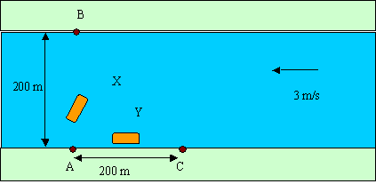
(a) What is the velocity of X relative to the river bed (Use a vector diagram)? (b) What is the time for X to travel from A to B to A? (c) What is the velocity of Y relative to the river bed going from A to C and the time? (d) What is the velocity of the boat Y going from C to A and its time? (e) Which boat wins and by how much?

Slide 3
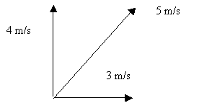
Velocity is 4 m/s (since it’s a 3, 4, 5 triangle)
(b) What is the time for X to travel from A to B to A?
Time = distance ¸ speed = 400 m ¸ 4 s = 100 s
(c) What is the velocity of Y relative to the river bed going from A to C and the time?
Velocity = 5 m/s – 3 m/s = 2 m/s
Time = 200 m ¸ 2 m/s = 100 s
(d) What is the velocity of the boat Y going from C to A and its time?
Velocity = 5 m/s + 3 m/s = 8 m/s
Time = 200 m ¸ 8 m/s = 25 s
(e) Which boat wins and by how much?
Boat X wins
By 25 s

Slide 4
Inertial Frame of Reference
An inertial frame of reference is one in which Newton I is valid. If you are in a train travelling at constant speed, all objects behave as if they were stationary in the stationary train. The train is travelling at 60 m/s, the passengers and their luggage are all travelling at 60 m/s.

Slide 5
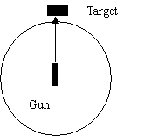
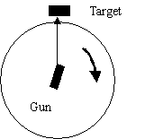
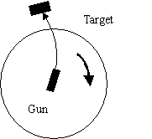
Now consider this situation. A person is standing at the centre of a roundabout. He has a gun. A target is placed outside the roundabout as shown
When the roundabout is stationary, it is easy to see that the path of the bullet is straight. What about when the roundabout is turning?
For an observer on the ground the path of the bullet will be a straight line. For the person on the roundabout, the path will appear curved.
Why is this not consistent with Newton I?
What kind of frame of reference is the roundabout? Explain your answer.

Slide 8
With this type of analysis in mind, physicists before Einstein realised that the phenomenon of light interference could be used to detect such very small differences. They confidently expected that the Earth’s absolute motion through the ether could be detected.

Slide 9
https://www.youtube.com/watch?v=7qJoRNseyLQ

