Slide 1
CW | Relativity | 29/02/2016
From my learning today I will be able to:
Key: | State Einstein's postulates
Boost: | Apply time dilation and length contraction equations
Aspire: | Explain twin paradox

Slide 2
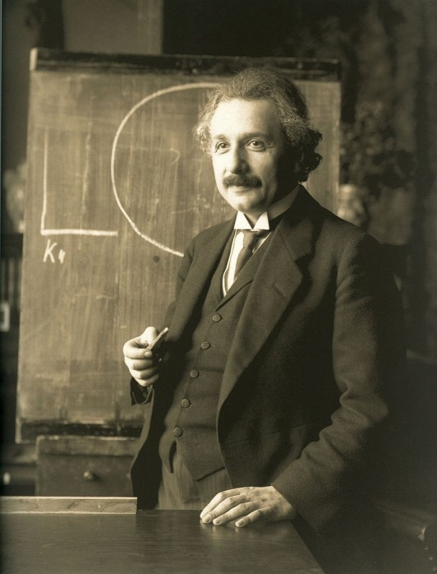
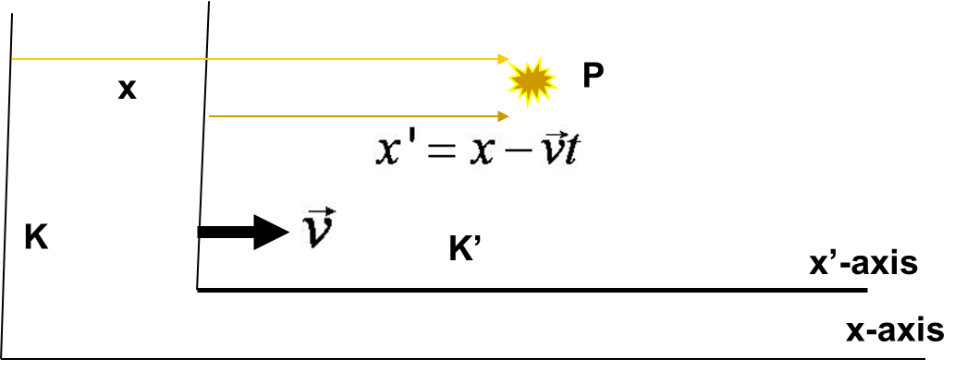

Slide 3
Time Dilation
To understand time dilation the idea of proper time must be understood:
The term proper time,T₀, is the time difference between two events occurring at the same position in a system as measured by a clock at that position.
Same location

Slide 4
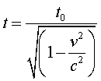

Slide 5
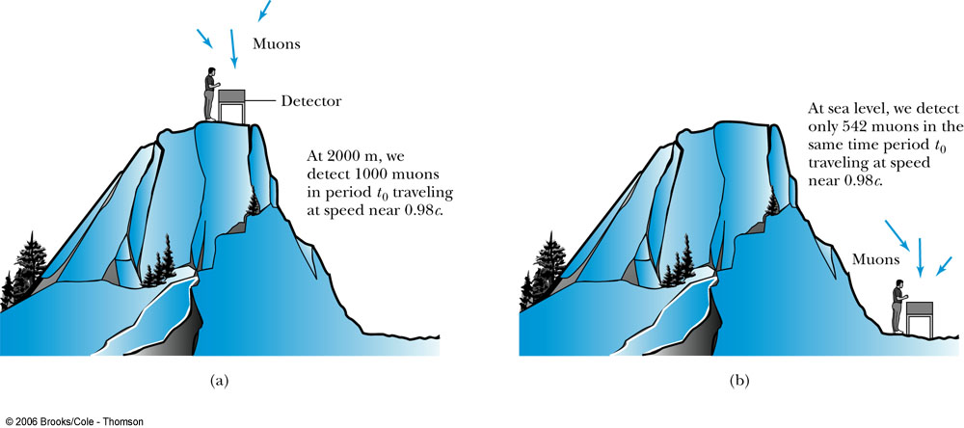
Time Dilation and Muon Decay
Figure 2.18: The number of muons detected with speeds near 0.98c is much different (a) on top of a mountain than (b) at sea level, because of the muon’s decay. The experimental result agrees with our time dilation equation.

Slide 6
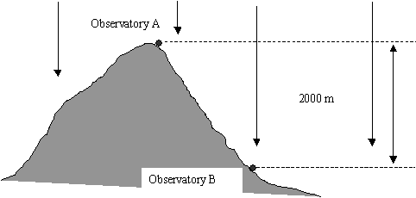
Half life for Muon at rest = 1.5 us
V = 0.996c
How far would it travel before 50% were detected?
The particles were shown to have a drop off to 50% intensity at 5000m.
What is their half life while moving at this speed?
Show that this agrees with Special relativity

Slide 7
A beam of a certain type of elementary particle travel at a speed of 2.85 × 108 ms-1. At this speed the average lifetime is measured to be 2.5 × 10-6 s. What is the particle’s lifetime at rest?
What is the speed of a beam of pions if their average lifetime is measured to be 3.5 × 10-8 s? At rest their lifetime is 2.6 × 10-8 s.

Slide 8
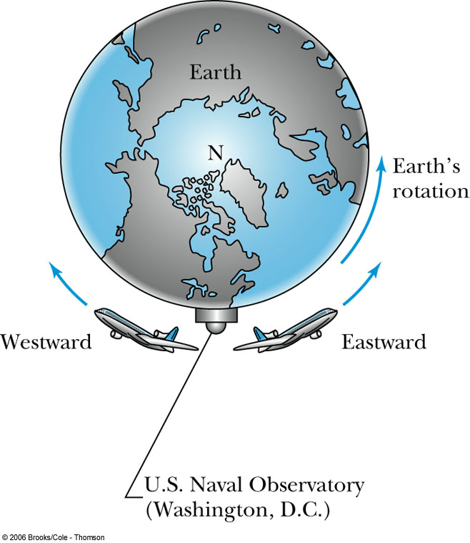
Atomic Clock Measurement
Figure 2.20: Two airplanes took off (at different times) from Washington, D.C., where the U.S. Naval Observatory is located. The airplanes traveled east and west around Earth as it rotated. Atomic clocks on the airplanes were compared with similar clocks kept at the observatory to show that the moving clocks in the airplanes ran slower.

Slide 9
2.8: Twin Paradox
The Set-up
Twins Mary and Frank at age 30 decide on two career paths: Mary decides to become an astronaut and to leave on a trip 8 lightyears (ly) from the Earth at a great speed and to return; Frank decides to reside on the Earth.
The Problem
Upon Mary’s return, Frank reasons that her clocks measuring her age must run slow. As such, she will return younger. However, Mary claims that it is Frank who is moving and consequently his clocks must run slow.
The Paradox
Who is younger upon Mary’s return?

Slide 10
A spaceship passes you at a speed of 0.8c. You measure its length to be 90 m. How long would it be when at rest?
You are sitting in your sports car when a very fast sports car passes you at a speed of 0.18c. A person in the car says her car is 6.0 m long and yours is 6.15 m long. What do you measure for these two lengths?

Slide 11
The nearest star to Earth is Alpha Centauri, 4.2 light years away.
At what constant velocity must a spacecraft travel from Earth if it is to reach the star in 3.0 years time? [20]
How long does the journey take according to an observer on Earth?

