Slide 1
Local and Distant Place Study
Specification details:
A place study involves exploring the developing character of a place (past to present). You need to undertake two place studies as a requirement for the exam paper. One should be a local place near your place of study. The other has to be a contrasting place, which is different economically, demographically, culturally or in terms of its political or economic organisation.
Sources of information must include qualitative and quantitative data to represent places in the past and present.
Godalming and Stratford

Slide 2
Representations of place and the use of quantitative and qualitative sources
Aims
To investigate and present your two place studies using a variety of quantitative and qualitative sources
To analyse the limitations of the sources available

Slide 3
Godalming Case Study
Answer the following questions by referring to your recent study of Godalming:
  Outline how you can investigate a place using qualitative data [4 marks]
  Why do some people feel like outsiders in a locality you have studied [4 marks]
Carry on with your Godalming place study, using the relevant guide and additional hand out to check you have included the relevant points in line with the AQA specification.
Remember to include any recent findings from the fieldtrip
At the end of the lesson, print out all that you have completed on Godalming

Slide 4
Suggested mark scheme
  Outline how you can investigate a place using qualitative data [4 marks]
Award 1 mark for each relevant point with extra mark(s) for developed points. (AO1)
Places can be represented qualitatively with the use of photographs (1 mark) or artistic images from the past (1 mark). Equally, qualitative data might include old and current maps (1 mark), publicity materials or newspaper articles about the place (1 mark). Interviews (1 mark) may have been recorded orally or by questionnaire (1 mark). Developed points where you relate this to a place you have studied (1+1).
Why do some people feel like outsiders in a locality you have studied [4 marks]
Sample answer:

Slide 5
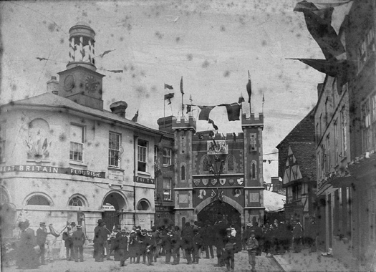
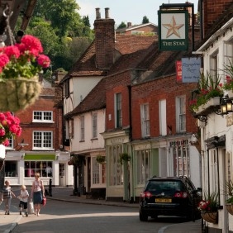

Check list:
Both place studies must focus equally on:
People's lived experience of place in the past and present
a Changing demographic and cultural characteristics and b Economic change and social inequalities.
Suitable data sources could include:
  statistics, such as census data
  maps
  geo-located data
  geospatial data, including geographic information systems (GIS) applications
  photographs
  text, from varied media
  audio-visual media
  artistic representations
  oral sources, such as interviews, reminiscences, songs, etc

Slide 6
Case Study Questions – pair work
Analyse the factors, relationships and connections that have shaped the character of a place that you have studied [6 marks]
See print out from Student Guide – 6 mark analyse question – be prepared to compare similar data for Godalming V Stratford (pg. 77)
Evaluate how past and present connections have shaped the characteristics of one place you have studied [20 marks]
Name a quantitative source that you have used in one of your place studies (your source could be census data, maps or any geospatial data). Assess the usefulness of that source in helping you understand the character of place. [6 marks]
For your local area, identify a qualitative source that you have used (e.g. photographs, maps, a painting, song, poem, text or newspaper source). Describe the nature of the information provided about your chosen place, and explain how it helped you to understand the character of that place. [6 marks]
See additional Hodder questions. Use as revision for the benchmark exam next week.
Notes:
Question one is from Oxford text book. Questions two and three are from the AQA Hodder Student Guide Book. Question 4 and 5 Cambridge back of book.

