Slide 1
Welcome to Explore + – LAW NEXT – Week 2;

Slide 2
What are we covering today? – Week 2
HIGHER EDUCATION:
LAW / NON-LAW DEGREES
+ LAW CONVERSION COURSES
ALTERNATIVE LAW BASED CAREERS (BEYOND THAT OF A LAWYER).

Slide 3
What is HIGHER EDUCATION?
Higher education (HE) – the level of education UCAS can help you apply to – from undergraduate courses when you’ve finished further education, to postgraduate courses you can move on to after graduating from an undergraduate degree.
Higher Education Institutions (HEI) – universities, colleges are sometimes referred to as higher education institutions.
Further education (FE) – this is post-compulsory secondary or pre-university education in the UK. Courses typically focus on vocational or basic skills.
https://www.ucas.com/ucas-terms-explained

Slide 4
LAW versus NON-LAW DEGREE – what to consider…. + LAW CONVERSION COURSES
Interests outside of law - study a subject at university that will stand you in good stead for your future career or studying something that you really have an interest for?
If you already eat, breathe and sleep law, then the odds are a law degree might just be right for you. An LLB will set you up with all the theory to get started, and once you’ve graduated you’ll be eligible to move straight onto either the LPC or BPTC (the vocational courses for solicitors and barristers respectively).
A BA in law, or a non-law degree however, will not – you’d still have to do the conversion course following graduation.

Slide 5
What is the key to deciding?
Research your options fully…
Of course, there will be other factors that you will want to consider, such as course fees and living expenses. There is no statutory funding for law courses and funding from local education authorities is rare.
The majority of people embarking on law conversion courses will finance their studies from a variety of sources, such as parents, loans, scholarships etc.
Some law firms offer sponsorship for conversion courses;

Slide 6
Cost of a Law degree? Cost of a Non-law Degree/GDL
A university degree will currently set you back up to £9,000 a year – with most courses lasting either three or four years + living costs.
Non-law students and those who study BA law rather than the LLB, will then have to pay for the GDL, and then their chosen vocational course.
The average fees for the GDL currently stand at £7,250 to £10,200, whilst the LPC costs around £7,500 to £14,765, and the BPTC even more at £12,965 to £18,175.
Non-law students can apply for funding for both their GDL and LPC or BPTC. If budding solicitors secure a training contract with a law firm, they will often pay for the trainee to take these mandatory courses.

Slide 7
Difference between LLB and GDL…
True or False? - In reality by the time students begin their LPC or BPTC course, there isn’t much between someone who did a law degree first, and someone who took the non-law/GDL path.
A LPC course director, has stated that the difference between the law degree and GDL students is barely noticeable – but what is the value of 3 years of law study over 1 year of core law modules?
The LPC and BPTC differ significantly from law degrees – it is skills and competence based meaning it’s pretty much level pegging for all students whatever route they take to get there.

Slide 8
What is a qualifying Law degree?
The LLB is the abbreviation for the Law Degree programme offered by the majority of universities around the United Kingdom and beyond.
The LLB abbreviation stems from the Latin Legum Baccalaureus, which translates to Bachelor of Laws, meaning that the actual degree classification is equivalent to that of a BA or a BSc.
There’s a number of ways of studying an LLB, from the standard three-year undergraduate course to a part time option which can be completed over up to six years.
https://www.ucas.com/undergraduate/subject-guide-list/law
https://www.manchester.ac.uk/study/undergraduate/courses/2020/09672/llb-law/

Slide 9
What is a qualifying Law degree?
The main bulk of the LLB degree consists of a core seven modules, which together comprise the underlying requirements of any qualifying law degree in the UK.
These seven components areas are as follows: constitutional and administrative law; contract law; criminal law; equity and trusts; EU law; land law; and public law.

Slide 10
What is a qualifying Law degree? https://youtu.be/1dN2qad_Ag8
On top of this, there’s a host of supplementary elective modules available over the course of the LLB, where you can specialise your knowledge of particular areas of the legal jurisdiction that interest you.
Some Universities are obviously better at particular specialisations than others, so when researching where you want to study your LLB, you should be taking into account the areas that might be of interest to you and then tailoring your search to make sure you have the options to take electives in these areas.

Slide 11
What is a qualifying Law degree? LLB
The LLB course is a literature-heavy one, and you’ll be expected to complete a lot of reading over your time studying it. As a lawyer, your ability to scan texts, analyse them and use that information is crucial, and the LLB sets you up to this through an intensive reading list that you’ll be expected to work through comprehensively.
Whilst hard work, the LLB is the backbone and platform from which a high number of law careers are launched.
From the completion of the LLB, you can move on to the LPC, BPTC or even an LLM, depending on the route you wish to follow in your career, but the LLB gives you the understanding and knowledge to launch your legal career from solid ground.

Slide 12
Extra/optional modules for an LLB – from Bristol University – Year 2

Slide 13
Extra/optional modules for an LLB – from Bristol University – Year 3

Slide 14
What LLB course option are available for you to study?
Look through pages 4-15 – The University of Law – undergraduate course guide 2020 – at the range of options available– which interests you? Take a note of them.

Slide 15
What will the law conversion/GDL course involve?
In addition to an introduction to the legal system and an optional subject, conversion courses will cover seven core topics:
Contract law;
Criminal law;
Law of tort;
Property law;
EU law;
Constitutional and administrative law;
And equity and law of trusts.

Slide 16
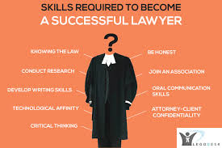
What are the key skills you need to be a lawyer? https://www.youtube.com/watch?v=n-YKXlxYLQ8
Interpersonal skills;
The ability to analyse and assimilate large amounts of complex and disparate information;
Workload and time-management skills;
Stamina;
Commercial awareness;
Persistence;
Patience;
And attention to detail.
In addition, barristers need to be able to represent their clients confidently and eloquently in court.

Slide 17
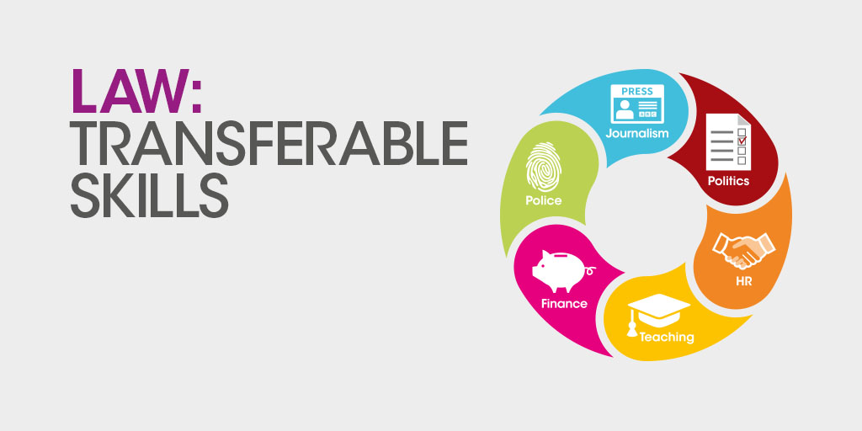
What other law based careers exist? - Law Enforcement/Justice system Local/national government – Business and Industry

Slide 18
Your follow up work for this week = to find out what you study for the 7 core components of an LLB/GDL
Module/Component | What does this cover/mean?
Constitutional and administrative law;
Contract law;
Criminal law;
Equity and trusts;
EU law;
Land law;
Public law

Slide 19
Explore your Options….
Look up 3 different Universities and what they offer for their LLB courses and make a note of them below – how do they differ?
Find out more about an alternative law based career other than a lawyer that interests you, what does the job involve and how can you get to do that job?

