Slide 1
Welcome to Explore + – LAW NEXT – Week 3;

Slide 2
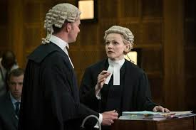
What are we covering today? – Week 3
Feeding back on AW and looking at Law degree options at different Universities.
BARRISTERS – WHAT IS THEIR ROLE and WORKLOAD?
HOW DO YOU BECOME ONE
+ CAREER PROGRESSION.

Slide 3
Your follow up work for this week = to find out what you study for the 7 core components of an LLB/GDL
Module/Component | What does this cover/mean?
Constitutional and administrative law;
Contract law;
Criminal law;
Equity and trusts;
EU law;
Land law;
Public law

Slide 4
BARRISTERS – WHAT DO YOU WANT TO KNOW ABOUT THEM?
Write down 3 things you want to find out and know about Barristers….

Slide 5
BARRISTERS – WHAT IS THEIR ROLE and WORKLOAD?

Slide 6
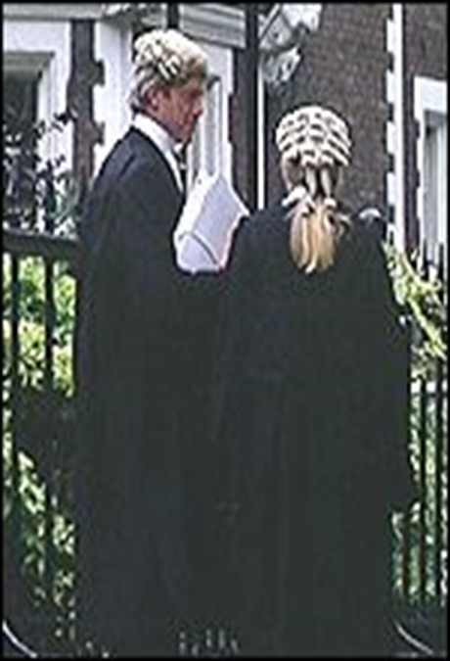
BARRISTERS
Some barristers spend a lot of time in court, whereas others spend more time in an office environment drafting written opinions and meeting clients.
Those involved with criminal law tend to be more focused upon the court environment, whereas those involved with family or property law will provide individuals with advice from a base in Chambers.
Many also do mediation and arbitration work
a day in the life
https://www.youtube.com/watch?v=AWZi2Mpl8hM

Slide 7
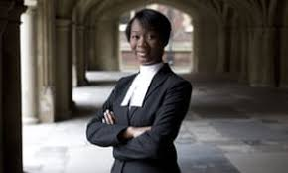
HOW DO YOU BECOME A BARRISTER?
https://www.theguardian.com/law/shortcuts/2013/aug/11/britain-youngest-barrister-gabrielle-turnquest

Slide 8
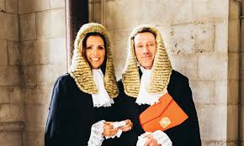
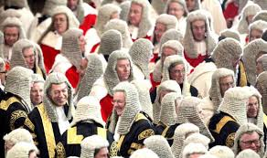
+ CAREER PROGRESSION - BARRISTERS.
https://www.youtube.com/watch?v=wMLAeKlP2w0
https://www.supremecourt.uk/about/biographies-of-the-justices.html
https://www.youtube.com/watch?v=wTHrynZIsBo

Slide 9
+ books on the reality of working as a BARRISTERS – suggested reading to find out more….. https://www.amazon.co.uk/Your-Defence-Stories-Life-Law/dp/085752528X

Slide 10
+ law programmes on the reality of working as a BARRISTERS. https://www.bbc.co.uk/iplayer/episode/b0bkbf4t/defending-the-guilty-series-1-episode-1

Slide 11
BARRISTERS – WHAT IS THEIR ROLE and WORKLOAD?

Slide 12
HOW DO YOU BECOME A BARRISTER?

Slide 13
HOW DO YOU BECOME A BARRISTER?

Slide 14
+ CAREER PROGRESSION - BARRISTERS.

Slide 15
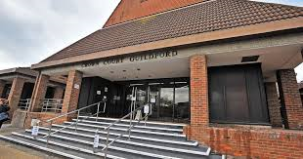
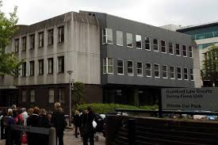
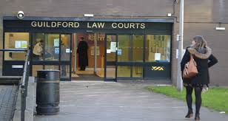
HALF TERM - Work
Visit a working civil (County or High Court) and criminal court (Magistrates or Crown Court).

