Slide 1
Welcome to Explore + – LAW NEXT – Week 4;

Slide 2
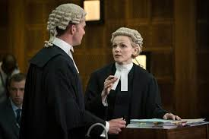
What are we covering today? – Week 4
Feeding back on AW – Court Visit
SOLICITORS – WHAT IS THEIR ROLE and WORKLOAD?
HOW DO YOU BECOME ONE
+ CAREER PROGRESSION.

Slide 3
SOLICITORS
Key definition;
“A legal professional who
advises clients about the Law and acts on behalf of clients in legal matters”.
https://www.youtube.com/watch?v=XwnyfczkBYA
a day in the life
They have FULL rights of audience automatically in lower courts - Mags/County
can qualify as Solicitor Advocate to obtain Higher Rights of Audience

