Slide 1
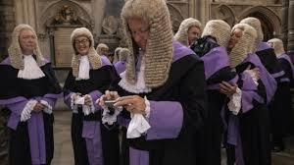
Welcome to Explore + – LAW NEXT – Week 6;

Slide 2
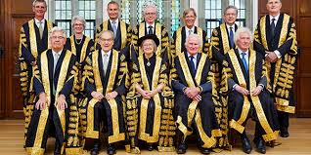
What are we covering today? – JUDGES
JUDGES- WHAT IS THEIR ROLE and WORKLOAD?
HOW DO YOU BECOME ONE
+ CAREER PROGRESSION.

Slide 3
WHAT’S YOUR IMAGE OF A JUDGE?
AGE
GENDER
EDUCATION BACKGROUND
SOCIAL STATUS

Slide 4
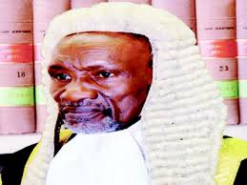
ARE THE STATEMENTS ABOUT THE JUDICIARY….

Slide 5
What is the role of a Judge? Does this role vary, according to the different type/level of Judge?

Slide 6
Judges…
Generally Judges are either barristers or solicitors,
Although some may be academic lawyers. It is also possible for legal executives to attain judicial office (as of Nov 2008)
Appointments to the Bench are made by an independent Appointment Commissions (The Judicial Appointments Commission) FOR ALL LELVEL OF JUDGES OTHER THAN THOSE IN THE SUPREME COURT.
To be a judge you must first have the relevant legal qualification, as set down in The Tribunals, Court and Enforcement Act 2007.

Slide 7
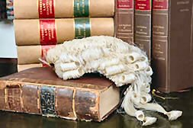
Two Types of Judges:
Inferior Judges
These are all judges below those that serve in the High Court.
Superior Judges
All judges who serve in the High Court and above

Slide 8
ROLE OF A JUDGE – IN THE TRIAL COURTS;
Primary role = to interpret and apply the law.
Criminal = to direct the Jury and pass sentence.
Civil = decide the outcome, Liable/Not liable and amount of compensation.

Slide 9
ROLE OF A JUDGE – IN THE TRIAL COURTS;
You be the judge; could you choose an appropriate sentence?
http://ybtj.justice.gov.uk/

Slide 10
ROLE OF A JUDGE – APPEALS
Hear application for Appeal and either grant leave or refuse an Appeal.
Hear Appeal only cases.
Criminal = appeals against sentence + conviction, acquittals and points of Law.
Civil = appeals against Liability, amount of damages/remedies awarded and points of law.

Slide 11
ROLE OF A JUDGE – IN APPEALS;
https://www.supremecourt.uk/about/introductory-film.html
https://www.supremecourt.uk/news/judicial-vacancies.html

Slide 12
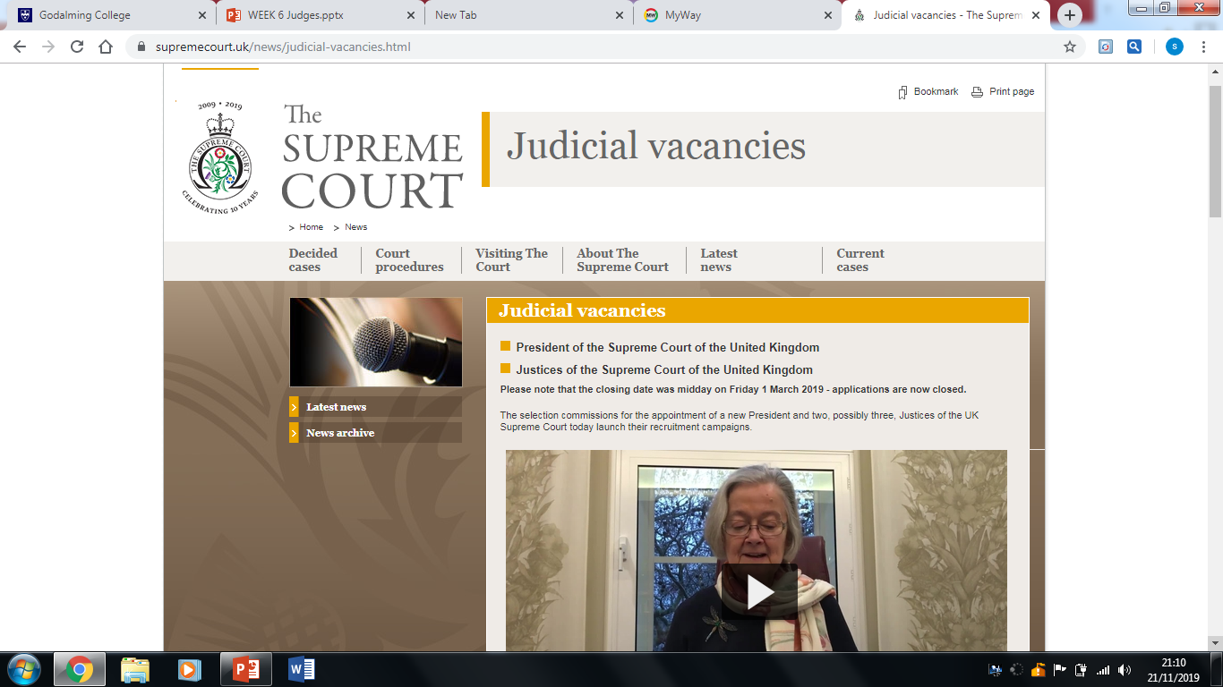
HOW DO YOU BECOME ONE
Apply!!!

Slide 13
+ CAREER PROGRESSION – FOR A JUDGE.

Slide 14
Want to find out more? Further reading;

