Slide 1
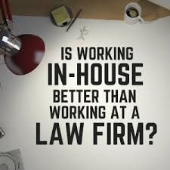
Welcome to Explore + – LAW NEXT – Week 7;

Slide 2
What are we covering today? – IN –HOUSE lawyers
WHAT IS THEIR ROLE and WORKLOAD?
HOW DO YOU BECOME ONE
+ CAREER PROGRESSION.
PRO’S + CON’S OF WORKING IN-HOUSE

Slide 3
IN HOUSE LAWYERS – WHAT DO THEY DO?
Look after the legal needs of the organisation they work for…..
“An imaginative in-house lawyer, besides reducing legal expenses and freeing up manager’s time that might otherwise have been spent on legal problems, can use law to create business opportunities that contribute directly to the company’s profitability”.

Slide 4
IN HOUSE LAWYERS – WHAT SKILLS ARE NEEDED? https://www.youtube.com/watch?v=19AyT4Cm_2A

Slide 5
IN HOUSE LAWYERS – HOW DO YOU PROVE YOUR WORTH?/ADD VALUE?

Slide 6
WHERE CAN YOU WORK IN HOUSE? https://www.youtube.com/watch?v=so5wxciDjz0
Commerce & Industry
Public sector e.g. local and national government
Charities
Trade Unions
Armed Forces
Crown Prosecution Service

Slide 7
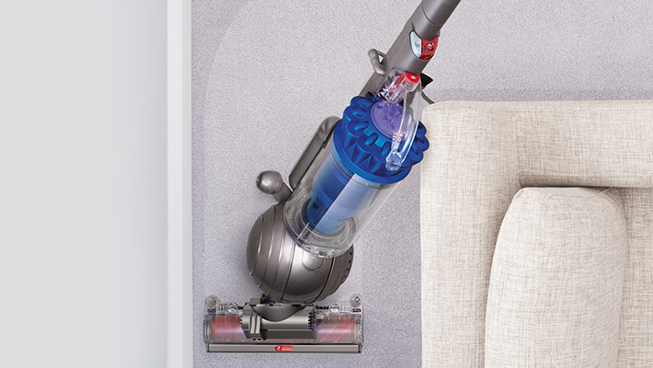
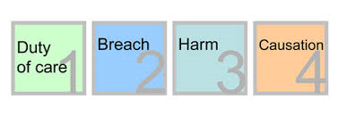
What legal issues could arise within Dyson?

Slide 8
What legal issues could arise within British Airways?

Slide 9
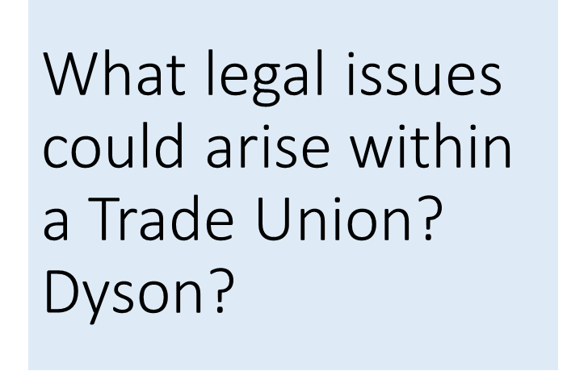
WHAT COULD YOU DO WORKING IN HOUSE?
What legal issues could arise within a Trade Union – for example The National Education Union?
What legal issues could arise within the Royal Air Force?
What legal issues could arise within Local Government?
What legal issues could arise within a charity? For example Amnesty International or the RSPCA – Royal Society of Protection against Cruelty to Animals?

Slide 10
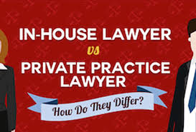
Why work in house? https://www.youtube.com/watch?v=EISDHXeXyvo
PROS | CONS
Not driven by chargeable hours & fees. You have an in depth knowledge of your client. Variety in your working day. | Salary. Perceived as a cost to the company. Perceived as a spoiler! Sole lawyer problems.

Slide 11
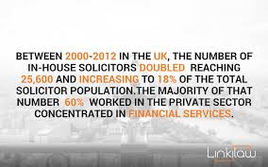
IN HOUSE LAWYERS ARE ON THE RISE!!!

Slide 12
How do you get a job as an In-house lawyer? How do you become one? Do you train via a different route?
The same as you would do for any other job, apply..
As a qualified lawyer; Training contracts, Solicitor or Barrister, Law or non-law degree + In house legal executives/paralegals

Slide 13
+ CAREER PROGRESSION.
AKA - in-house counsel/strategic business partner – rise to the top…..
https://www.lexisnexis.co.uk/research-and-reports/in-house/the-evolution-of-the-in-house-counsel-role.html#vid-iframe
Company Secretary https://www.youtube.com/watch?v=U_ww1IXEJGY

Slide 14
Want to find out more? Further reading;

