Slide 1
Developing your magazine idea
EXPLORE

Slide 2
PLANNING FOR COVER:
Look at some other magazine covers to get an idea of what you would like yours to look like
Decide on the font you would like to choose – both for the cover lines and the masthead – experiment with the masthead using different fonts and decide which one you think works best
Start to write your cover lines – remember to consider who your target audience is
Take some photographs for your cover – use the studio?
Design your cover using either Publisher or Photoshop (A4)

Slide 3
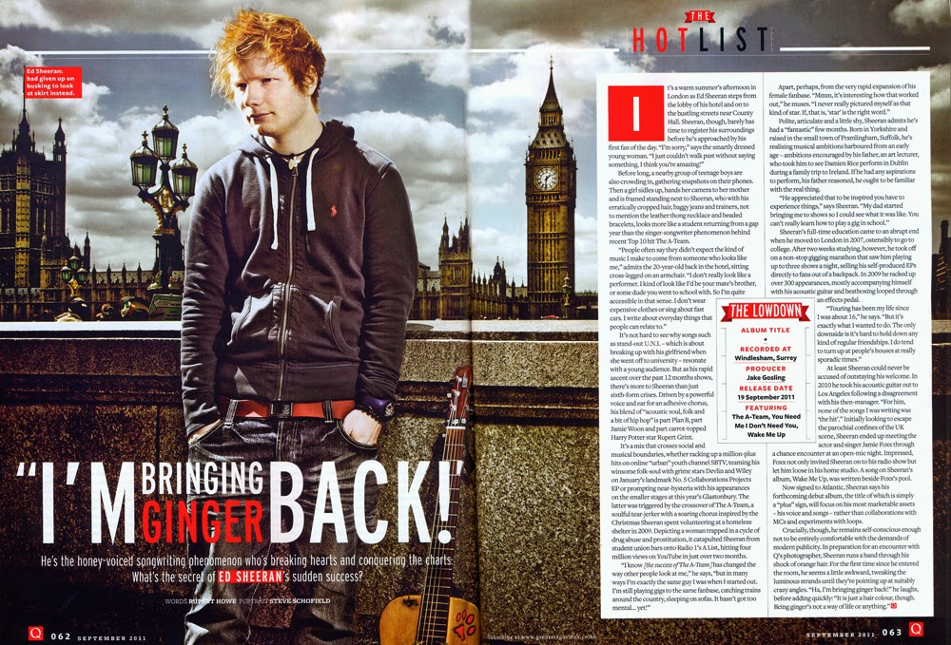
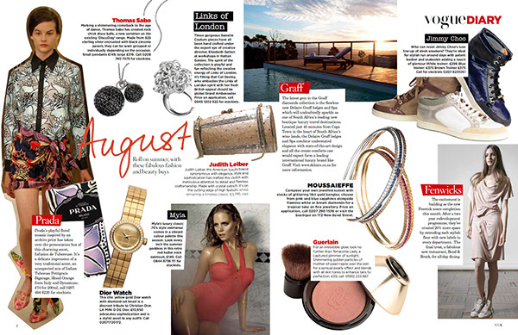
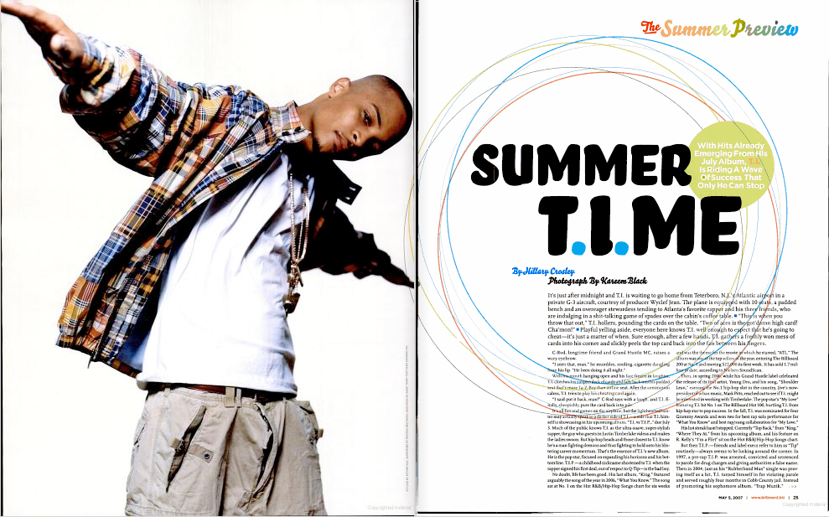
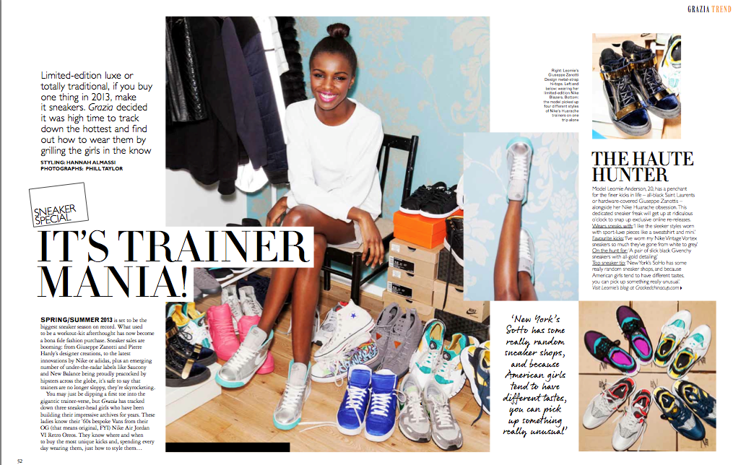
PLANNING FOR YOUR DOUBLE (OR SINGLE) PAGE
1. Decide what you want to write about:
Interview with a made up singer/sportsperson/actor/film director?
2. Look at other double-page spreads and get some ideas on what design elements you would like to include (look at the separate sheet to give you ideas)
3. Write your article
4. Take some pictures
5. Decide on your fonts/colours
6. Start your design – using Photoshop or Publisher (you may want to do a couple of draft designs first)

