Slide 1
Journalism Week 2
Last week, you said that you would like to know:-
x3 A better understanding of journalism and the process
Learn about the different types of journalism x5 (inc. sports, crime)
To learn how to write emotively about factual experiences x2
Potential future job x 3
How to get on to a journalism degree
What makes a good journalist
What it takes to be a good film critic
How to write columns and articles x3 (and have fun!)
Just curious

Slide 2
Journalism Week 2
Last Week...
What is news and where does it come from?
What did we decide?

Slide 3
Journalism Week 2
x3 A better understanding of journalism and the process
This Week
Is it your job to tell your readers the truth?
What makes a good journalist
Just curious about journalism
"In journalism 'mainly right' is like being half pregnant – it's an unsustainable condition." Richard Sambrook, former director of BBC news

Slide 4
Journalism Week 2
What does this story say about telling the truth?
July 22 2005 – TV news reported that Jean Charles de Menezes was killed by police officers at Stockwell tube station in London. Witnesses said they saw an Asian man in a bulky coat – maybe wearing a baseball cap, maybe carrying a rucksack – jump the ticket barrier, run like the wind and be chased on to tube train before being challenged and shot dead.
Official sources (police) said the same thing.
July 23rd 2005 – newspapers carried the same story. The Times: 'The suspect, described as being of Asian appearance and wearing a thick, bulky jacket, vaulted over a ticket barrier when challenged by the police and ran down the escalator and along the platform of the Northern line.'
July 25th, Times leader column: 'he was wearing a light denim jacket at the time of his death… CCTV footage shows him walking normally into the station, picking up a free newspaper and using his Oyster card to pass through the barrier. He allegedly began to run only when he saw a train pulling into the station, after which he boarded it and sat down in an ordinary fashion'
Actually?...
The man in the bulky jacket vaulting the ticket barrier and running towards the train was…
a police officer.

Slide 5
I am no longer sure about the notion of objectivity, which seems to me now to be something of an illusion… When I have reported from war zones, or anywhere else, I have done so with all the fairness and impartiality I could muster, and a scrupulous attention to the facts, but using my eyes and ears and mind and accumulated experience, which are surely the very essence of subjectivity.
Martin Bell, former BBC correspondent 1998
I have come to believe that objectivity means giving all sides a fair hearing, but not treating all sides equally. Once you treat all sides the same in a case such as Bosnia, you are drawing a moral equivalence between victim and aggressor. And from there is's a short step toward being neutral. And from there it's and even shorter step to becoming an accessory to all manners of evil; in Bosnia's case, genocide. So objectivity must go hand in hand with morality.
Christiane Amanpour of CNN 2002

Slide 6
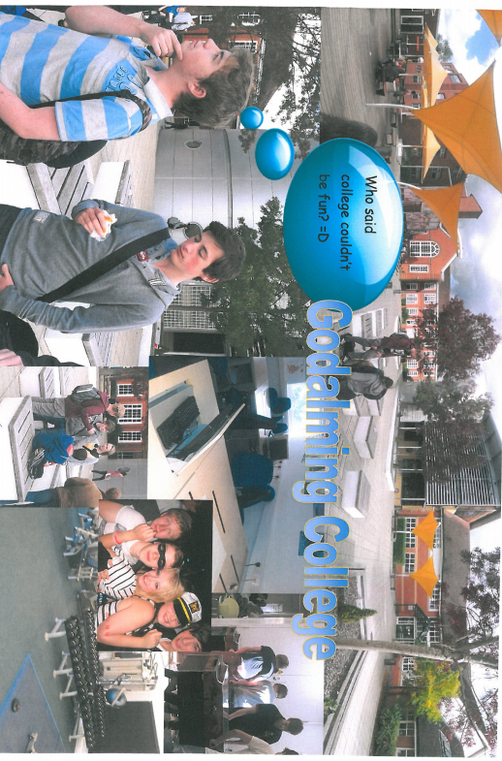
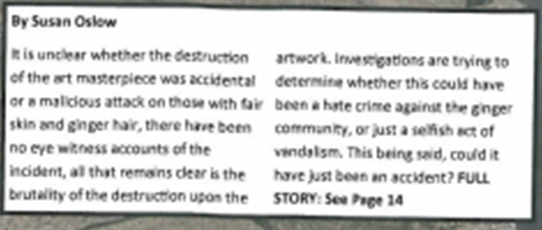
This was a student homework assignment.
It’s the same place, represented two ways.
How would you describe the two representations?

Slide 7
Your Task Today
In a pair
Take any of today's stories in the Daily Mail and do a bit of research on BBC news and the Guardian and report them from a different angle using the BBC/Guardian's sources.
Use a different headline, that makes a different person or institution the main 'actor' in the story
Use a different picture
Write a different introductory paragraph, summing up the whole story.
Quote different people to the Daily Mail near the top of the article and put their main source further down.
What have you come up with? Is it the truth?

Slide 8
Journalism Week 2
This Week
Is it your job to tell your readers the truth?
“Reporting is not stenography. It is the best obtainable version of the truth.”
Carl Bernstein

