Slide 1
Journalism Week 4
Last week:-
What makes a good interview?
Why do journalists interview people?
Why do people agree to be interviewed by journalists?
How can journalists prepare for interviews?
Who’s in charge, the interviewer or the interviewee?
Is it ever right to edit people’s quotes or soundbites?
What does it mean when someone says something 'off the record'?

Slide 2
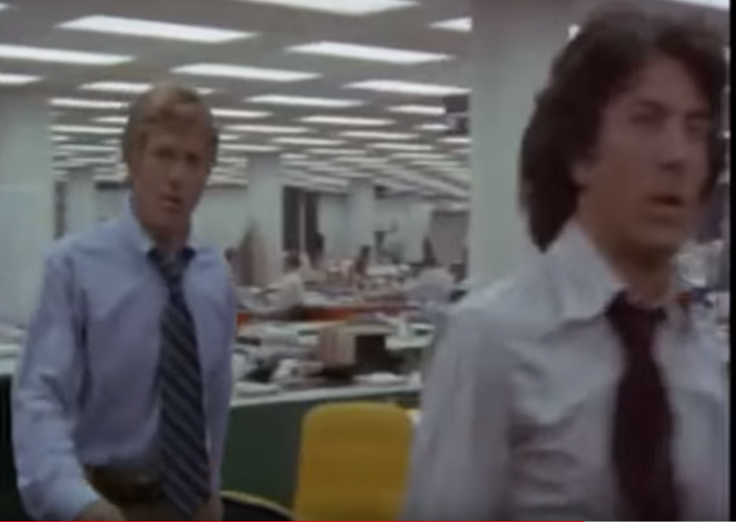
Journalism Week 4
This week:-
Investigative Journalism: Dead or Alive?
Watch this clip
What is 'investigative journalism' do you think?

Slide 3
Journalism Week 4
This week:-
Investigative Journalism: Dead or Alive?
What is 'investigative journalism' do you think?

Slide 4
Journalism Week 4
This week:-
Investigative Journalism: Dead or Alive?
https://youtu.be/JjKqibPnE5Y
https://youtu.be/jXCxZE0hZ40
https://youtu.be/cOwjLJA6R44

Slide 5
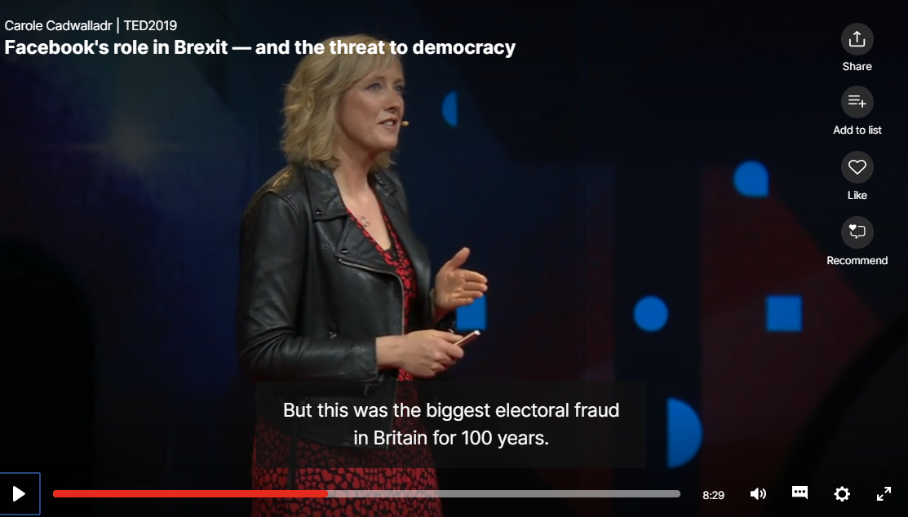
Journalism Week 4: Investigative Journalism
Play opening few minutes and then from 8.58

Slide 6
Journalism Week 4
This week:-
Investigative Journalism: Dead or Alive?
What is 'investigative journalism' do you think?

Slide 7
Journalism Week 4
This week:-
Investigative Journalism: Dead or Alive?
What is 'investigative journalism' do you think?
As Katherine Graham, the former publisher of the Washington Post, used to say: News is what someone wants suppressed. Everything else is advertising.

Slide 8
Journalism Week 4
This week:-
Your Task This Week (in pairs):-
You are journalists working for different newspapers. One of you works for The Washington Post (which broke the Watergate story). One of you works an online news outlet that supports the Trump administration.
You need to… find out the name of the whistleblower (the name is not difficult to find if you hunt a bit). Write a draft of the story, with a minimum of three sources to support it.
Decide what do with the information. Would you name him/her in print, for example? What's your headline?
Now… Would you publish? Will your editor publish? Be ready for a debate.

Slide 9
Journalism Week 4
This week:-
Investigative Journalism: Dead or Alive?
What is 'investigative journalism' do you think?
Paul Foot, who broke all sorts of stories that people wanted supressed, said this:-
It's a complete fraud the idea that there is a race apart called investigative journalists. An ordinary reporter doing a perfectly ordinary story carries out these functions. The difference would be the enthusiasm and the scepticism with which you approach something.
Or John Pilger
All journalism should be investigative, from football to cookery.

