Slide 1
Journalism Week 6
Last Week:-
Journalism: one title, many jobs
What comes under the general banner of ‘journalism’?
Politics – local first, national later!
Law – court reporting
Sports
Crime
Education
Environment
Health
Industry and Business
Financial
Your Patch (local news)
Churches/Mosques/Temples/Synagogues
Entertainment pieces
Features – cycling to college; training a guide-dog; I rented my house and they turned it into a cannabis farm
Columnists

Slide 2
Journalism Week 6
This Week:-
Writing A News Story
Last Week’s Task was...
Using 'A Story Every Ten Yards', plus the list of sources go out and about and get yourself a little story!
Share your story with someone else. If you didn’t get a story, please get your phone out and go on to Twitter to get one. Collect at least two sources to create your story – keep it as local as possible. UK-based, ideally. 5 minutes...

Slide 3
Journalism Week 6
This week:-
Writing A News Story (The Intro.)
What can we say about the following three introductory paragraphs of news stories? Look for what they have in common, as well as the ways in which they differ (in style, for example).
A boy of 15 was being quizzed last night after allegedly stabbing to death his teacher in class.
(MURDER IN CLASS, Paul Sims, April 29th 2014)
Giant waves driven by 91mph hurricane-force winds swept away sea defences yesterday – and left a vital railway line dangling in mid-air.
(91mph STORMS WASH AWAY RAILWAY TRACK, Piers Eady and Richard Smith, Daily Mirror, February 2014
Two Times journalists escaped over the Syrian border yesterday after being double-crossed, kidnapped, beaten and shot by a rebel gang in the north of the country.
(TIMES JOURNALIST SHOT IN SYRIA BY KIDNAP GANG, Foreign Staff, Times, May 15 2014)

Slide 4
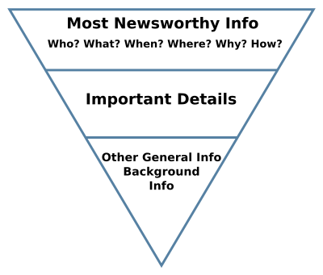
Journalism Week 6
This week:-
Writing A News Story
Look at this structure...
Two Times journalists escaped over the Syrian border yesterday after being double-crossed, kidnapped, beaten and shot by a rebel gang in the north of the country.
(TIMES JOURNALIST SHOT IN SYRIA BY KIDNAP GANG, Foreign Staff, Times, May 15 2014)

Slide 5
Journalism Week 6
This week:-
Writing A News Story
Let’s look closer...
A boy of 15 was being quizzed last night after allegedly stabbing to death his teacher in class.
(MURDER IN CLASS, Paul Sims, April 29th 2014)
Only 18 words long!
This word is crucial – otherwise you are condemning him before conviction!
Arranged so that the main ‘character’ in the story (goody or baddie?) comes at the beginning.
Two parts to the sentence (called ‘clauses’), but no comma.

Slide 6
Journalism Week 6
This week:-
Writing A News Story
Let’s look closer...
Still only 21 words
Giant waves driven by 91mph hurricane-force winds swept away sea defences yesterday – and left a vital railway line dangling in mid-air.
(91mph STORMS WASH AWAY RAILWAY TRACK, Piers Eady and Richard Smith, Daily Mirror, February 2014
Look at this well placed dash

Slide 7
Journalism Week 6
This week:-
Writing A News Story
Let’s look closer...
Still only 26 words
These well-placed commas give a sense of one horrendous ordeal after another...
Two Times journalists escaped over the Syrian border yesterday after being double-crossed, kidnapped, beaten and shot by a rebel gang in the north of the country.
(TIMES JOURNALIST SHOT IN SYRIA BY KIDNAP GANG, Foreign Staff, Times, May 15 2014)

Slide 8
Journalism Week 6
This week:-
Writing A News Story
What should an introduction have then?
Two Times journalists escaped over the Syrian border yesterday after being double-crossed, kidnapped, beaten and shot by a rebel gang in the north of the country.
(TIMES JOURNALIST SHOT IN SYRIA BY KIDNAP GANG, Foreign Staff, Times, May 15 2014)

Slide 9
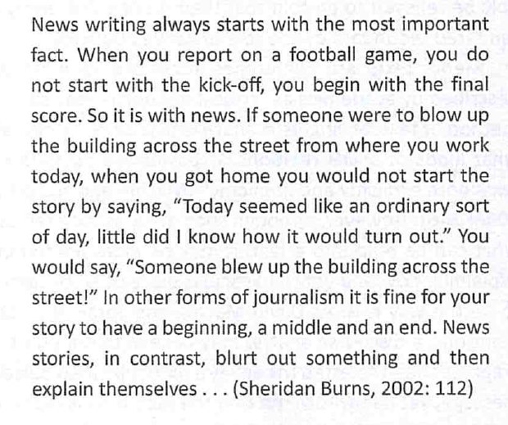
Journalism Week 6
This week:-
Writing A News Story
Look at this structure...

Slide 10
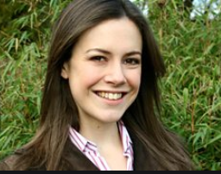
Journalism Week 6
This Week:-
Here’s what Isabel has to say about writing a news story and then writing a column (19:06 onwards)
The weblink is https://www.youtube.com/watch?v=mcYdhXGKRs0
You will need to sign in to view it the login details are;
Email: godalmingprivate@gmail.com
Password: god@lmingpriv@te
Isabel Hardman
Notes:
The weblink is https://www.youtube.com/watch?v=mcYdhXGKRs0
You will need to sign in to view it the login details are;
Email: godalmingprivate@gmail.com
Password: god@lmingpriv@te

Slide 11
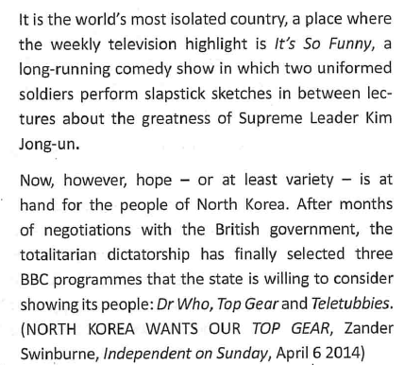
This week:-
Writing A News Story
What is going on with this intro?
Journalism Week 6
It’s called the ‘delayed drop’, often used for human interest, lighter stories

Slide 12
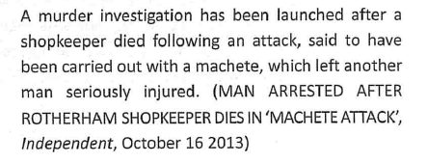
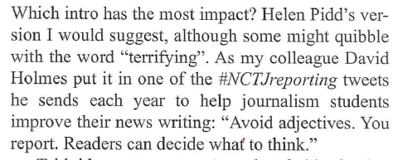
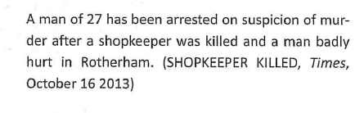
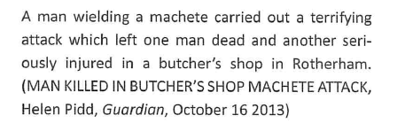
This week:-
Writing A News Story
Here are three intros, from different papers. Which is best?
Journalism Week 6

Slide 13

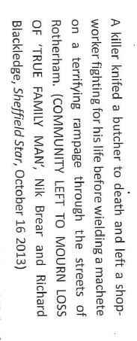
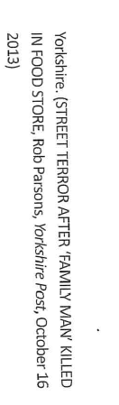
Journalism Week 6
This week:-
Writing A News Story
Same story but two more different intros. Why?

Slide 14
This week:-
Writing A News Story
Now you try... a 25 word intro to your story to make the ‘wall of fame’
Go to gospiral.ac and join a ‘Quickfire’ using the code KKWWR
Journalism Week 6
A 24 year old man has been rushed to Guildford hospital after a disagreement over a pre-booked taxi - and is left fighting for his life .

