Slide 1
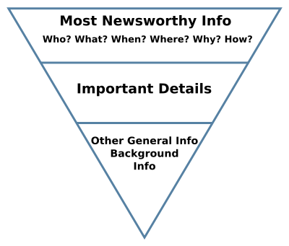
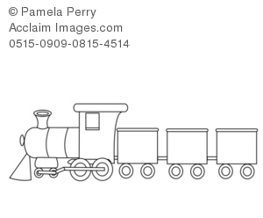
Journalism Week 8
Keep Them Guessing...
A Midthorpe schoolgirl is flying across the world for a night out with chart-topping mega-group Desert Penguins
Reader: Lucky girl. Do I know her? How did she manage that?
Gemma Gumley, 17, won the dream trip in a fanzine competition.
Reader: Dream trip? What's going to happen?
Last Week
Tricks of the Newsroom…
Four different
structures?
Introduction – short and sharp
Elaboration – other important angles (more WWWWWHWN) and best quotes
Chronology and detail
Loose ends
(From NCTJ Guide)
Standard
Passengers
VIPs
Introduction
Parcels

Slide 2
Local pregnant woman's near miss as bridge collapses
Here's a news article from two budding journalists from last week
What method can you see at work here?
Powell has confirmed both her and the baby are okay, after the hero of the moment, her dog, alerted her that something was wrong, by running for the river's banks.​
The incident happened in the afternoon of the 3rd of November, causing Surrey Fire and Rescue to be dispatched at 14:45 to close off the hazardous bridge and to assess casualties, later reporting that no one was injured.​
A woman's daily dog walk took a nasty turn when she was standing on Guildford Bridge as it collapsed and disappeared into the river beneath her.
Julie Powell, 34 and pregnant, was enjoying the quaint countryside scene when the footbridge at Millmead Lock gave way and nearly washed her and her dog into the rushing river under her.
Notes:
What method did these two budding journalists use last week?

Slide 3
After our first session you said:-
x3 A better understanding of journalism and the process
Learn about the different types of journalism x5 (inc. sports, crime)
To learn how to write emotively about factual experiences x2
Potential future job x 3
How to get on to a journalism degree
What makes a good journalist
What it takes to be a good film critic
How to write columns and articles x3 (and have fun!)
Just curious

Slide 4
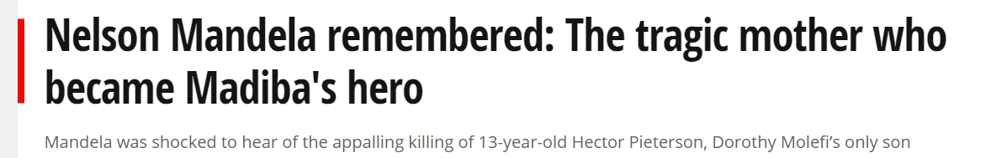
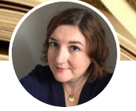
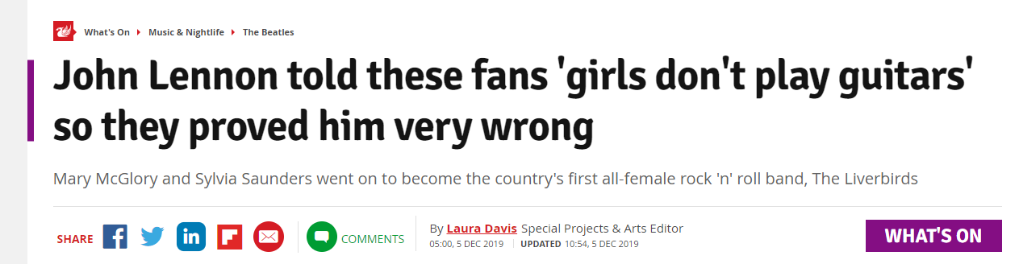
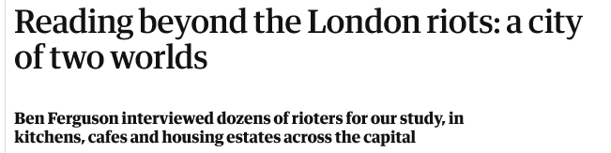
This Week
The Job of the Feature Writer
Journalism Week 8
“The best way to learn about features is to read, write and rewrite lots of features. Also, get other people to read your features...”
Tony Harcup, Journalism Principles and Practice, 2015
Laura Davis Feature Writer – Highly Commended in 2018 Regional Press Awards
Read one of these three feature articles and then look at the other two more briefly.
How does a feature article differ from a news article?

Slide 5
This Week
The work of the feature writer…
….is not that different from the work of any other journalist…
What is a feature article? How do you write one?
Journalism Week 8
Sally Adams (1999) suggest that you go out and get your story in the usual way, do your interviewing, do your research then ask yourself:-
what's the most startling fact you've discovered?
the best unearthed quote?
the most astonishing quote?
the most surprising event?
the item with the greatest "Hey did you know that…?" factor?
Officially: not 'news'
Some see it as news with a 'greater sense of adventure' (Randall, 2000)
Still sourced, still evidence based
Longer
Not front page
More in-depth
Can be personal or anecdotal
Offers background to front page news
The pronoun 'I' is allowed
Columns can count as features
Interviews and profiles count as features - ‘a feature interview’
Notes:
Students read the first line and, on mini-whiteboards, pose the reader's next question. Up comes the question and the answer and so on… then give them Tony Bullimore Change this story for second edition

Slide 6
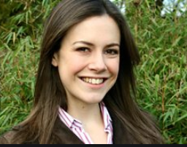
Journalism Week 8
Let's look at some introductions to feature articles…
Here’s what Isabel has to say about writing an introduction 22:51-
I have to sort out my introduction out two or three hours before I start writing the column, just because it frames the entire piece and…. I have to give people a reason to read it. (2015)
A drop intro is when you don't clearly set out what the piece is going to do straight away…. you might make a joke… you might present a statement that you then contradict… drop in a bit of what's called colour… start with a quote…
Isabel Hardman – ex Godalming College, Deputy Editor of the The Spectator
See link in notes, below
Notes:
The weblink is https://www.youtube.com/watch?v=mcYdhXGKRs0
You will need to sign in to view it the login details are;
Email: godalmingprivate@gmail.com
Password: god@lmingpriv@te

Slide 7
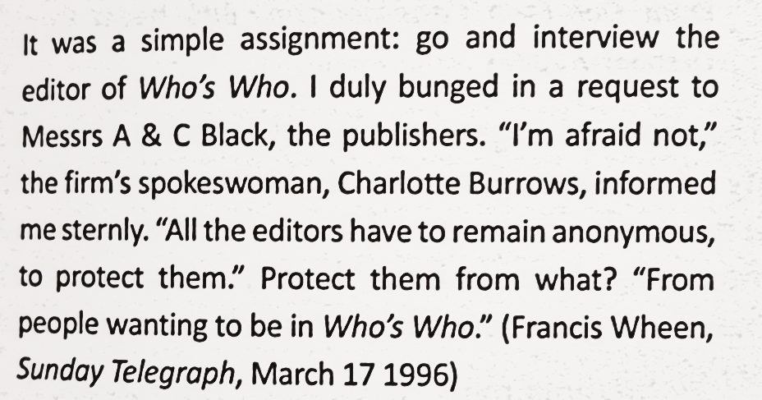
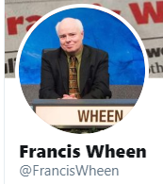
This Week
Writing features
How would you describe these different introductions to feature pieces?
What will the feature be about?
Journalism Week 8

Slide 8
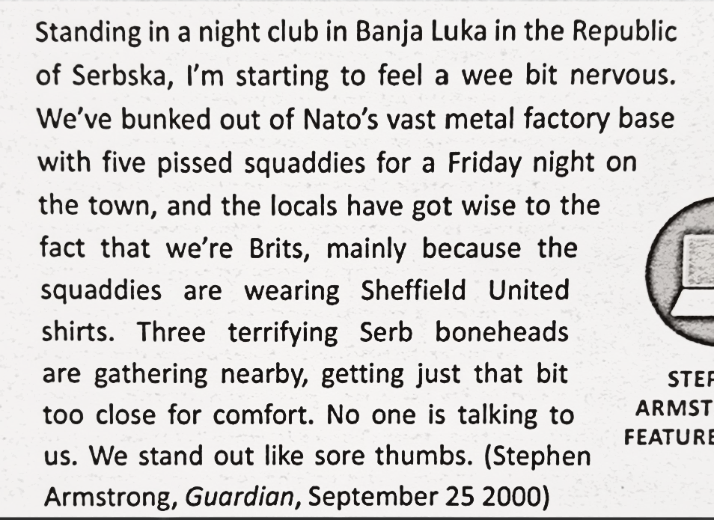
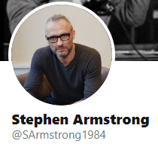
This Week
Writing features
How would you describe these different introductions to feature pieces?
What will the feature be about?
Journalism Week 8
"Yes, yes, Clubversive, I hear it on Oxsigen."
Notes:
All slides introductions are printed. Students get one in a pair. Prepare to discuss it. Up comes the slide and they must answer the two questions at the top.

Slide 9
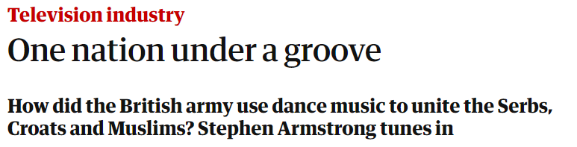
This Week
Writing features
How would you describe these different introductions to feature pieces?
What will the feature be about?
Journalism Week 8
"Yes, yes, Clubversive, I hear it on Oxsigen."
Notes:
All slides introductions are printed. Students get one in a pair. Prepare to discuss it. Up comes the slide and they must answer the two questions at the top.

Slide 10
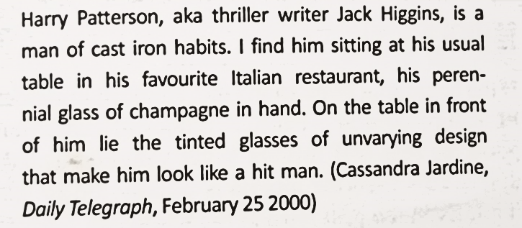

This Week
Writing Features
How would you describe this introduction to feature pieces?
What will the feature be about?
Journalism Week 8

Slide 11
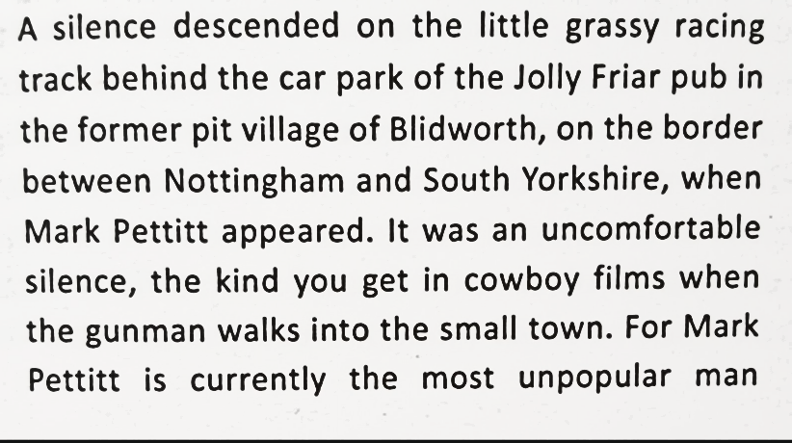
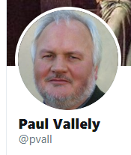
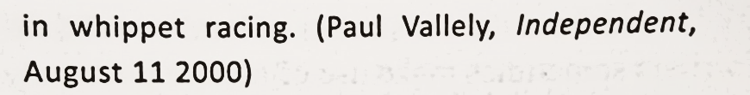
This Week
Writing Features
How would you describe this introduction to feature pieces?
What will the feature be about? (Use the pull quote to help you)
Journalism Week 8
"There's no doubt that Mark has been correct in everything he has said about the unfair way the sport is being run," said Irene Cunningham, a dog-trainer from Essex

Slide 12
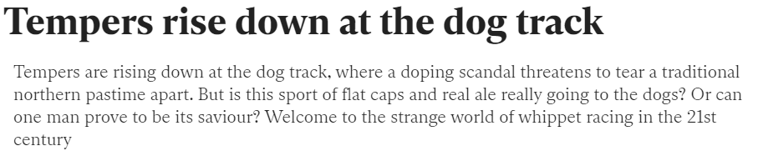
This Week
Writing Features
How would you describe this introduction to feature pieces?
What will the feature be about? (Use the pull quote to help you)
Journalism Week 8
"There's no doubt that Mark has been correct in everything he has said about the unfair way the sport is being run," said Irene Cunningham, a dog-trainer from Essex

Slide 13
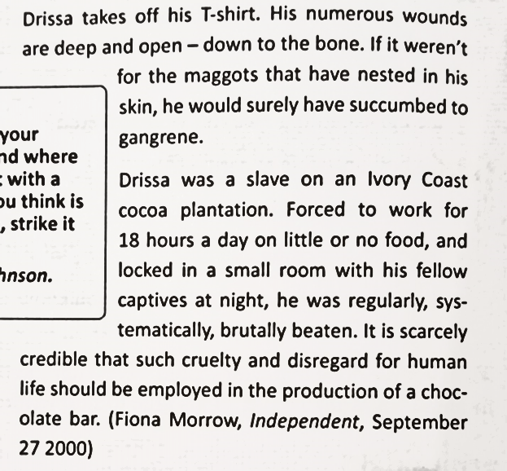
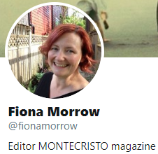
This Week
Writing Features
How would you describe this introduction to feature pieces?
What will the feature be about?
Journalism Week 8
"An awful lot of people who go into television," says Woods, "do so because they want to make a difference. But hardly anyone ever gets the chance,

Slide 14
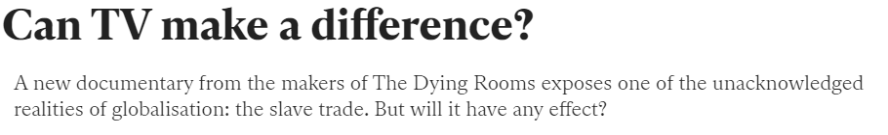
This Week
Writing Features
How would you describe this introduction to feature pieces?
What will the feature be about?
Journalism Week 8

Slide 15
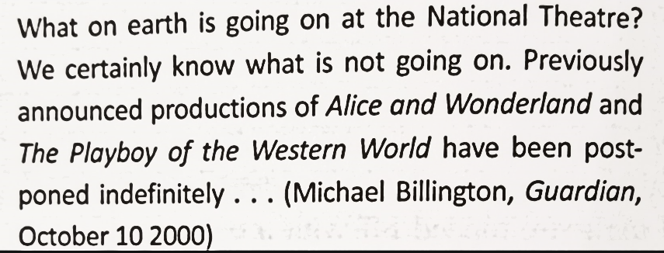
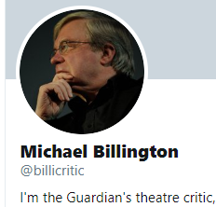
This Week
Writing Features
How would you describe this introduction to feature pieces?
What will the feature be about?
Journalism Week 8
"The National Theatre," [Richard Eyre] wrote, "exists to do work that, either by content or by execution or both, could not be performed or would not be initiated by the commercial sector."

Slide 16
This Week
Writing Features
How would you describe this introduction to feature pieces?
What will the feature be about?
Journalism Week 8
Stage fright
In April our theatre critic Michael Billington damned Trevor Nunn's National for its lack of imagination and 'saturation' diet of musicals. Now, with productions being indefinitely postponed and a growing sense of crisis, he outlines a plan to save Britain's flagship theatre
"The National Theatre," [Richard Eyre] wrote, "exists to do work that, either by content or by execution or both, could not be performed or would not be initiated by the commercial sector."

Slide 17
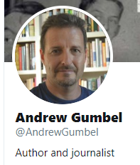
This Week
Writing Features
How would you describe this introduction to feature pieces?
What will the feature be about?
Journalism Week 8
Mental illness has never been much of a mitigating factor in the great retributive machine that is the US criminal justice system. Earlier this week, it did not stop the state of Georgia from executing Tracy Housel, a 43-year-old man with joint US and British citizenship, whose psychotic month-long crime spree in 1986 was almost certainly provoked by a rare form of hypoglycaemia.
"It's ludicrous – this woman shouldn't even be standing trial," Cyndie Aquilina, a social worker who served as a jury expert for the defence, told reporters outside the courthouse afterwards. "You can look at her eyes in the mug shot. That woman was on another planet."

Slide 18
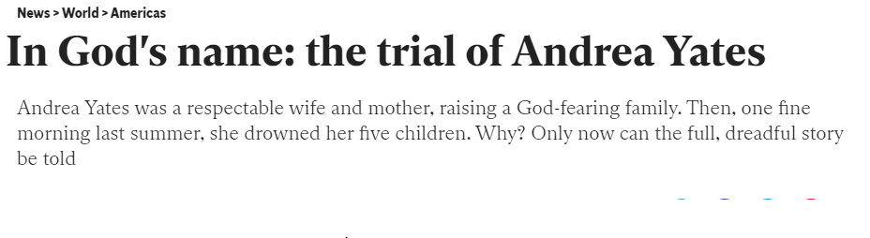
This Week
Writing Features
How would you describe this introduction to feature pieces?
What will the feature be about?
Journalism Week 8
Mental illness has never been much of a mitigating factor in the great retributive machine that is the US criminal justice system. Earlier this week, it did not stop the state of Georgia from executing Tracy Housel, a 43-year-old man with joint US and British citizenship, whose psychotic month-long crime spree in 1986 was almost certainly provoked by a rare form of hypoglycaemia.
"It's ludicrous – this woman shouldn't even be standing trial," Cyndie Aquilina, a social worker who served as a jury expert for the defence, told reporters outside the courthouse afterwards. "You can look at her eyes in the mug shot. That woman was on another planet."

Slide 19
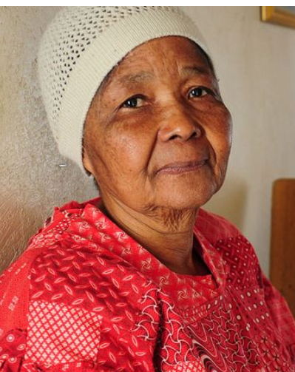
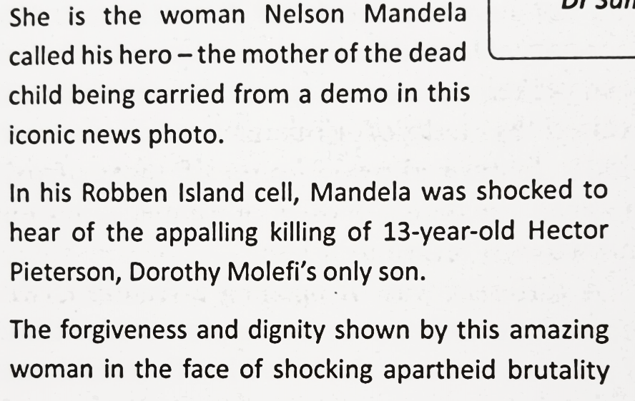
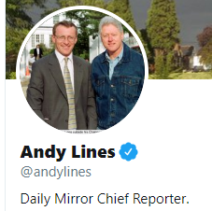
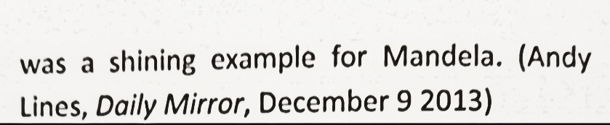
This Week
Writing Features
How would you describe this introduction to feature pieces?
What will the feature be about?
Journalism Week 8
“I said he couldn’t and off he went. The next thing I knew, he had been shot dead. You can see him wearing his short trousers in the photo.”

Slide 20
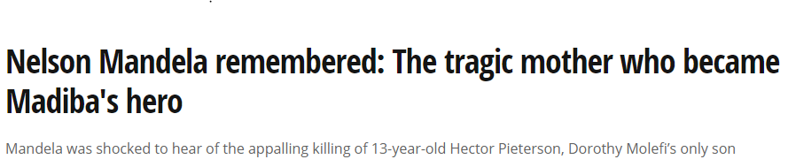
This Week
Writing Features
How would you describe this introduction to feature pieces?
What will the feature be about?
Journalism Week 8
“I said he couldn’t and off he went. The next thing I knew, he had been shot dead. You can see him wearing his short trousers in the photo.”

Slide 21
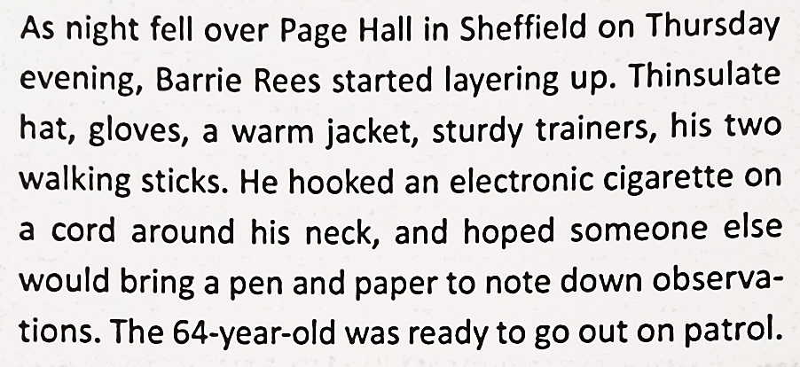
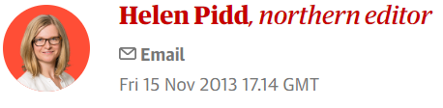
This Week
Writing Features
How would you describe this introduction to feature pieces?
What will the feature be about?
Journalism Week 8

Slide 22
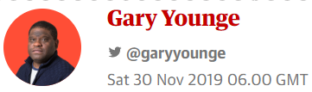
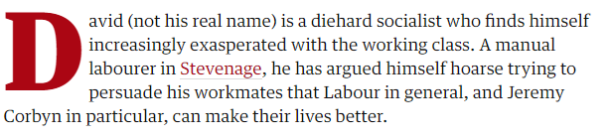
This Week
Writing Features
How would you describe this introduction to feature pieces?
What will the feature be about?
Journalism Week 8

Slide 23
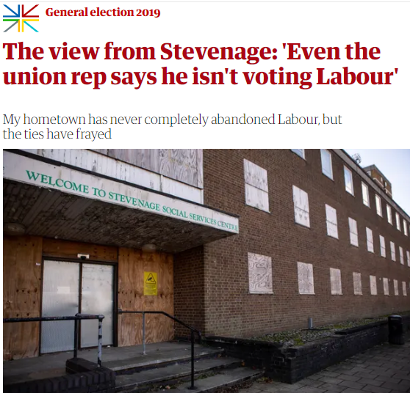
This Week
Writing Features
How would you describe this introduction to feature pieces?
What will the feature be about?
Journalism Week 8

Slide 24
This Week
Writing Features
You are a local journalist and the editor wants a feature…
Journalism Week 8
In your pair for today… between you, you need to come up with a feature. One of you might have an experience that the other could write up. Start there.
Answer some of Sally Adams’ 5 questions (see below).
The ‘feature’ could the interview you are having with this person.
If you can’t get anywhere with that, you can research something else, but you must have the ‘most astonishing quote’ – the one that would catch the eye.
Go to gospiral.ac and join a ‘Quickfire’ using the code given to you and then type in your introduction. In a separate box, put a pull quote – the quote which would be the first quote to appear in the article.
Tip – go local… just because it's not national news doesn't mean it's not interesting. You can win awards with good local features
Sally Adams (1999) suggest that you go out and get your story in the usual way, do your interviewing, do your research then ask yourself:-
what's the most startling fact you've discovered?
the best unearthed quote?
the most astonishing quote?
the most surprising event?
the item with the greatest "Hey did you know that…?" factor?
Laura Davis Feature Writer – Highly Commended in 2018 Regional Press Awards working on the Liverpool Echo

Slide 25
Journalism Week 9
Next Week… Isabel takes questions about how to get in to journalism
The most important thing is work experience, particularly local papers
Potential future job x 3
How to get on to a journalism degree
Quite a few of my friends are sports journalists so hopefully I can give you some advice on that
Isabel Hardman – ex Godalming College, Deputy Editor of the The Spectator
See link in notes, below
Notes:
The weblink is https://www.youtube.com/watch?v=mcYdhXGKRs0
You will need to sign in to view it the login details are;
Email: godalmingprivate@gmail.com
Password: god@lmingpriv@te

