Slide 1
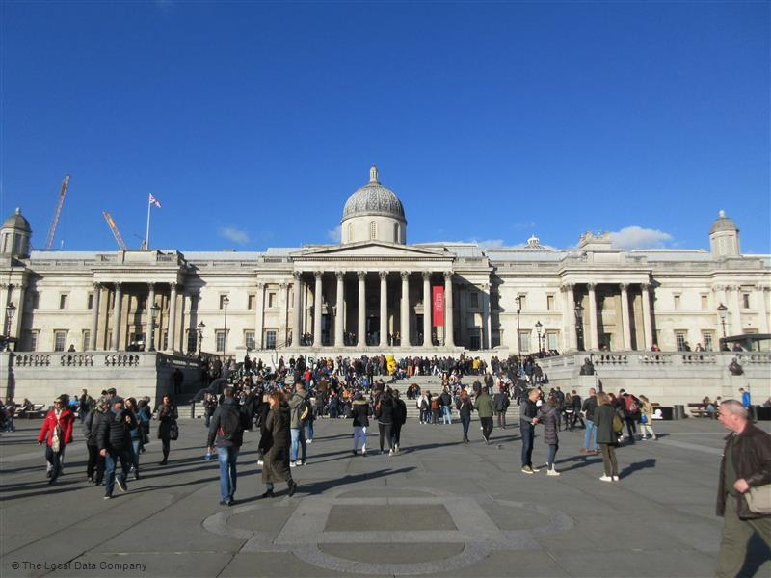

Slide 21
1814 The Pepperpot is built - Warden Thomas Haines, Architect John Perry £783 7s 2d raised by public subscription £81 19s 6d raised by sale of the old Market Hall.
1815 A new Town Clock, ordered from London, is set up in the Pepperpot by Richard Stedman. This is the clock now in the Museum.
1818 George Chennell and William Chalcraft appear before the Magistrates’ court at the Pepperpot and are committed for trial at Guildford for the murder of George Chennell senior and Elizabeth Wilson. They are found guilty and hanged on the Lammas Land, the last public hanging in Godalming.
1837 The Market Place and High Street are lit by gas, supplied by the new Godalming Gas Works on the Wharf.
1881 The world’s first public electricity supply switched on at the Pepperpot, powered by the water wheel at Westbrook Mill.
1904 “Perhaps it is not exactly beautiful, but its slender-pillared little clock tower and copper sheathed cupola are distinctly good, and I believe it to be the latest building in Godalming that has that precious quality of character.” (source: Gertrude Jekyll)
1918 Soldiers who had been injured in the First World War sold toys they had made on market stalls beneath the Pepperpot

Slide 23
Your task:
Design an extension for The Pepperpot, which respects the identity of both the original structure and its place in the town, but also facilitates its new function - to house an ecological and environmental marketplace to suit the changing demands of the community as a result of the 21st century climate crisis.
In line with Godalming’s leading position on the innovation of power, please make sure that your new structure is efficiently powered in line with the overall ambitions of this scheme.

