Slide 1
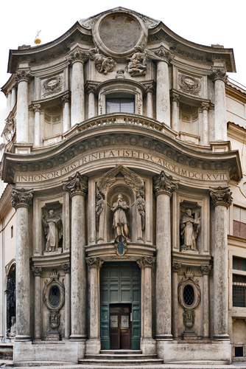
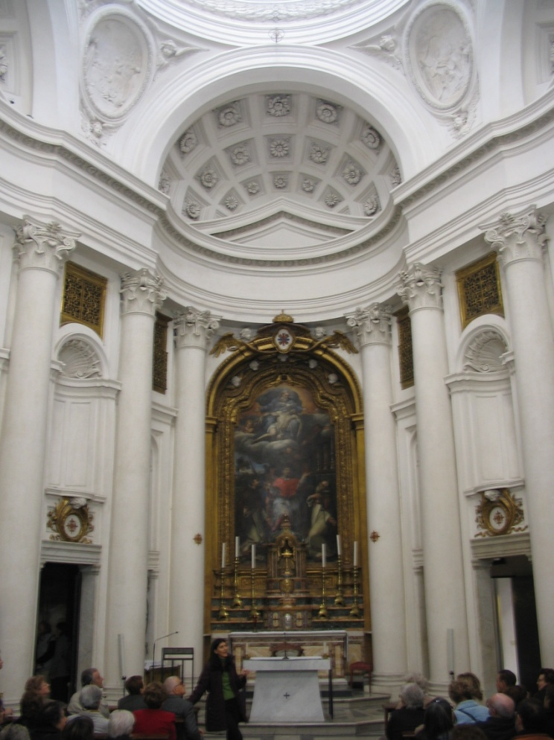

Slide 2
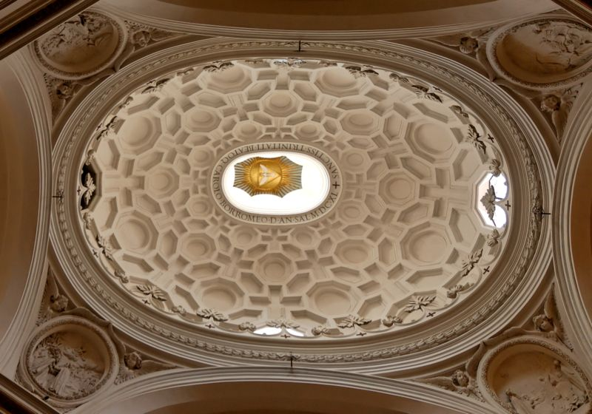

Slide 3
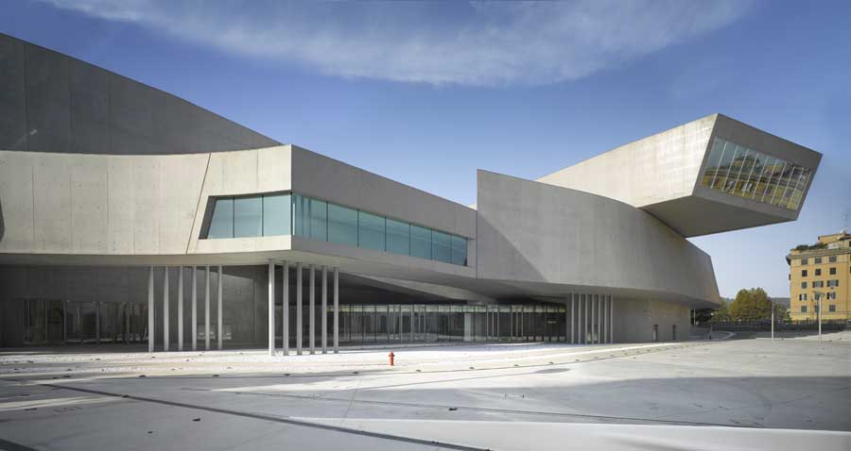
Zaha Hadid MAXXI, Rome “la Borromina”

Slide 4
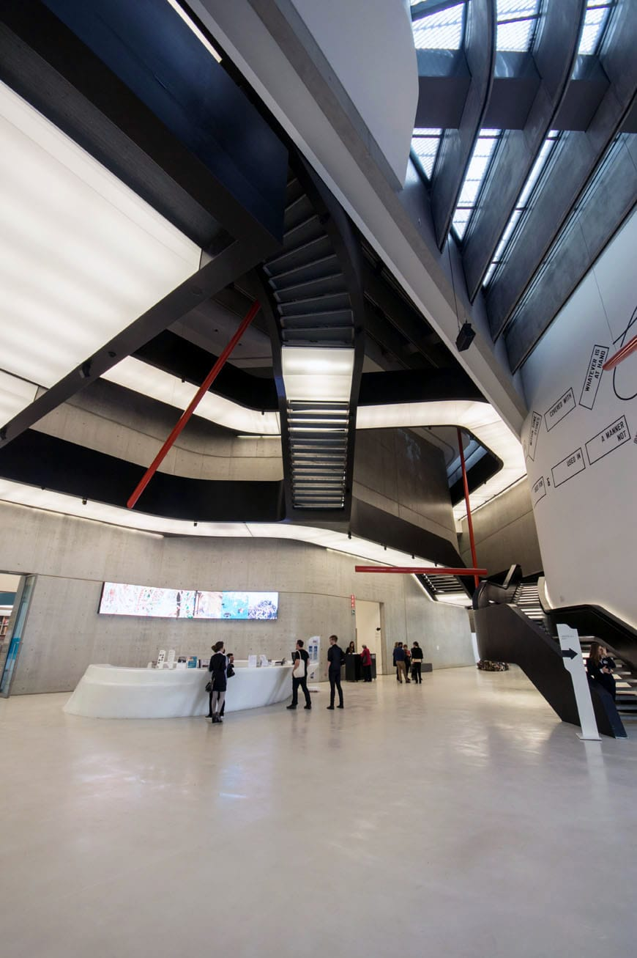
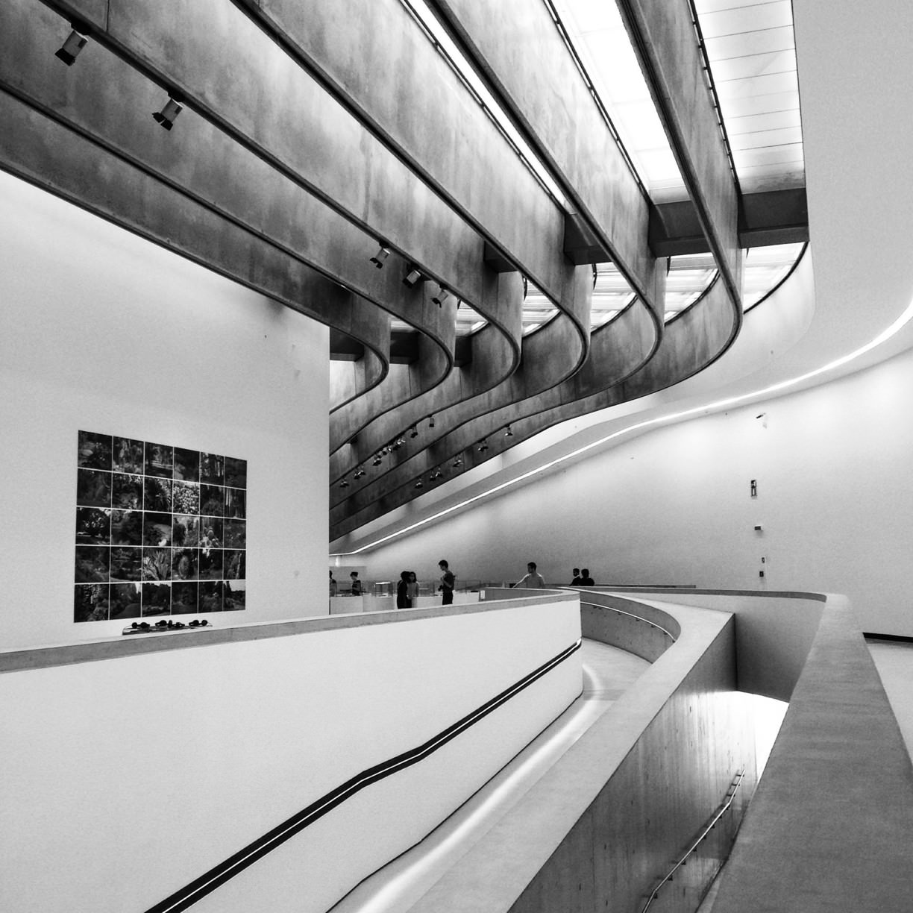

Slide 5
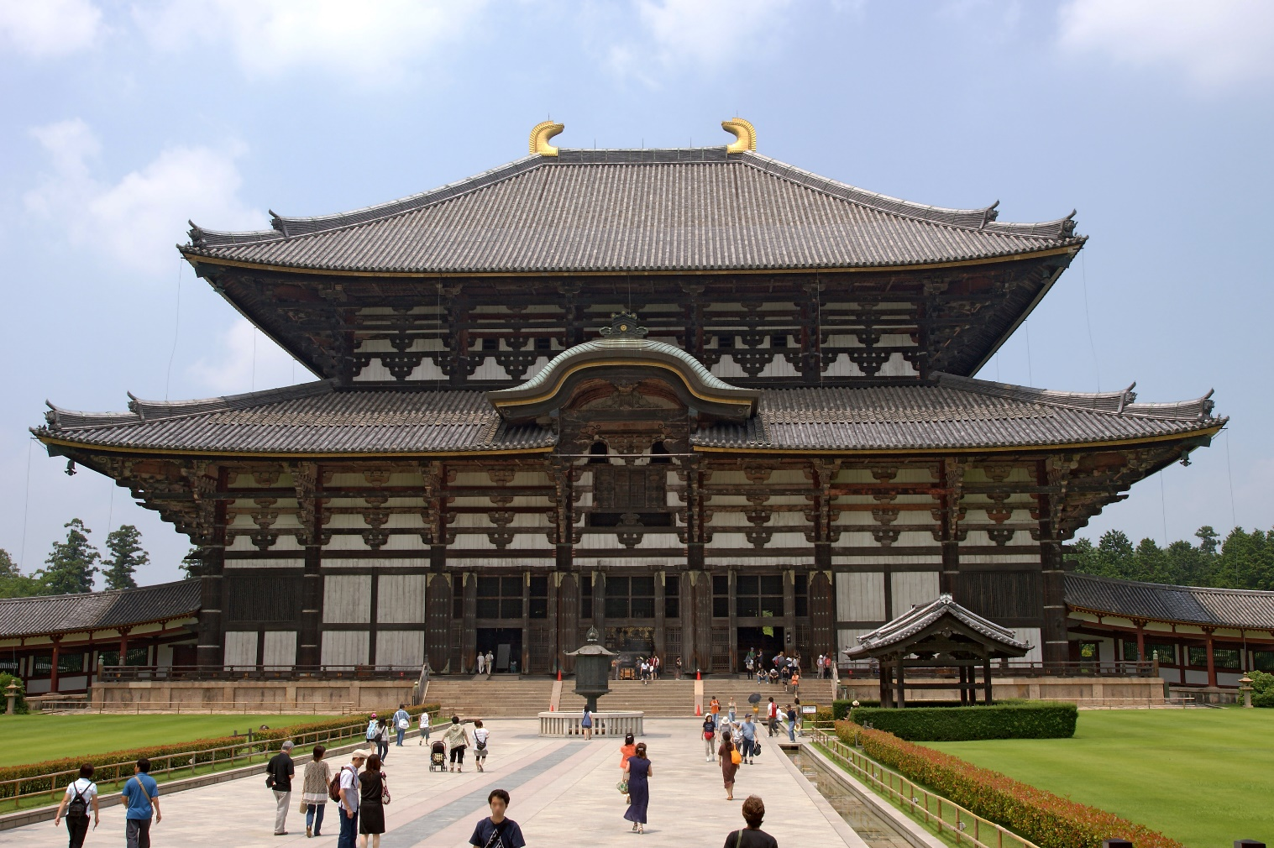
Toda-ji, Nara, Japan

Slide 6
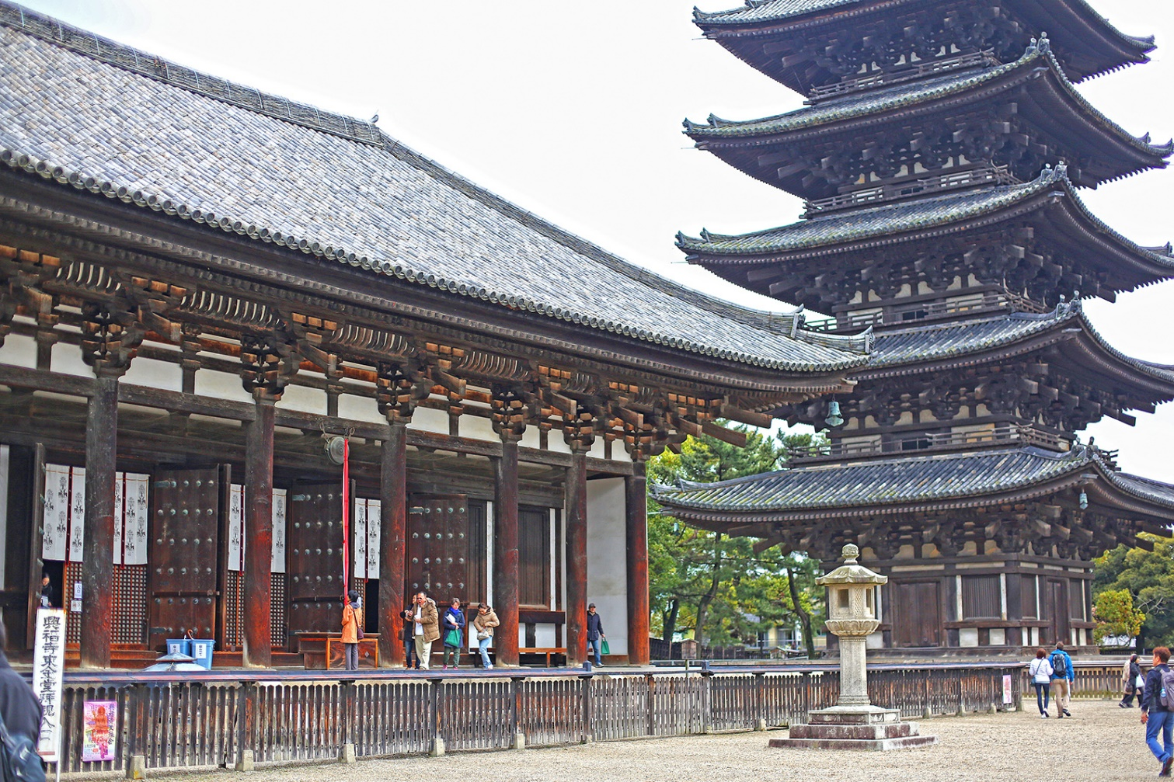
The largest wooden construction in the world:
Originally built in the 8th century, with two seven storey pagodas, each 100m high

Slide 7
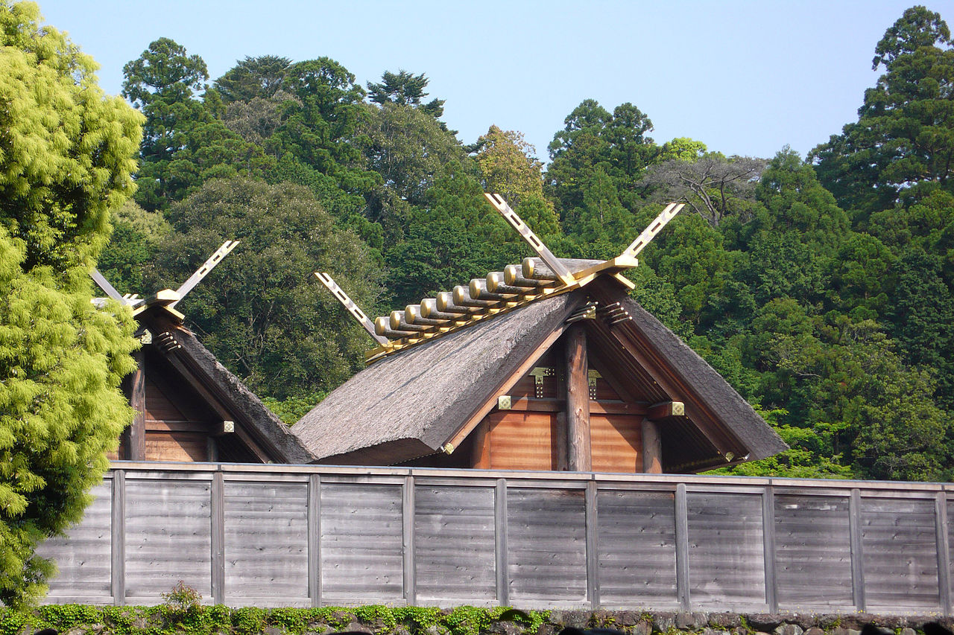
Ise Grand Shrine
Dedicated to the Shinto sun goddess, Ameseratu, built from cypress wood without using nails.
The architectural style of the Ise shrine is known as shinmei-zukuri, characterized by extreme simplicity and antiquity: which mimics the architectural features of early rice granaries. Its basic principles date back to the Kofun period (250-538 C.E.).
The old shrines are dismantled and new ones built on an adjacent site to exacting specifications every 20 years at exorbitant expense, so that the buildings will be forever new and forever ancient and original. The present buildings, dating from 2013, are the 62nd iteration to date and are scheduled for rebuilding in 2033.

Slide 8
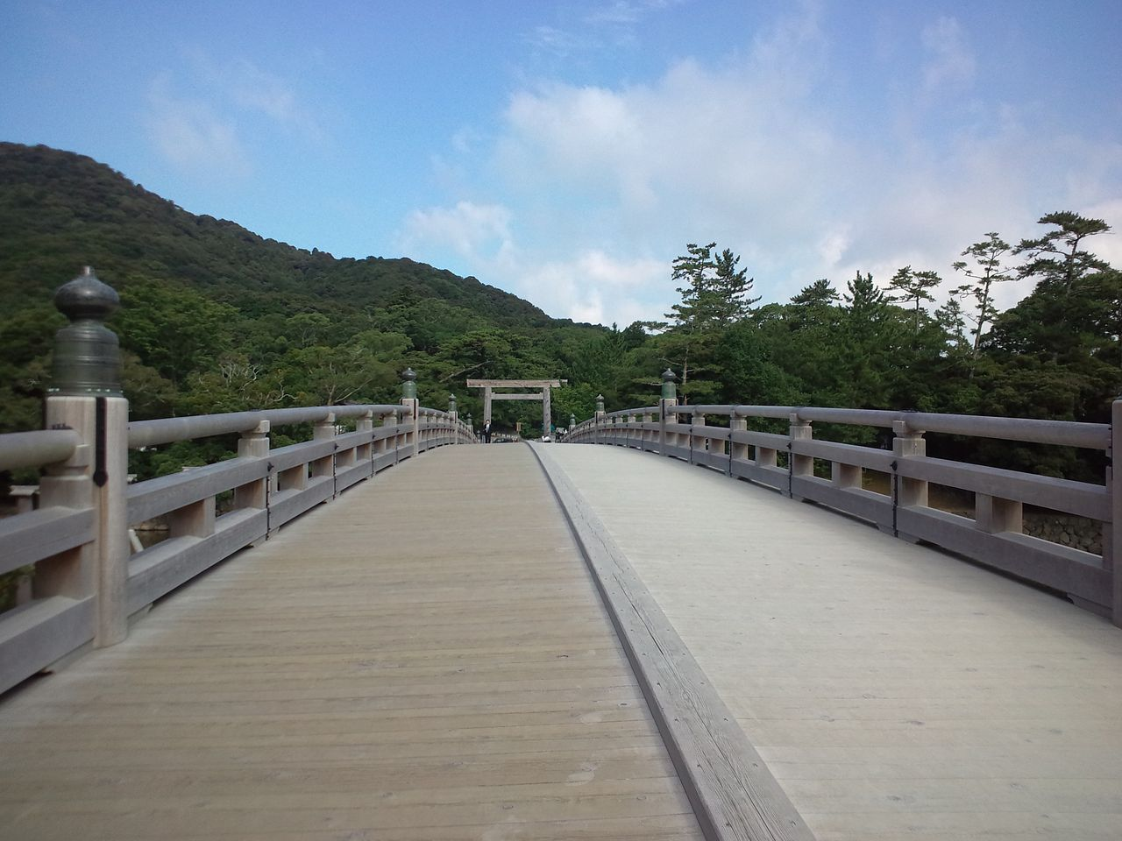
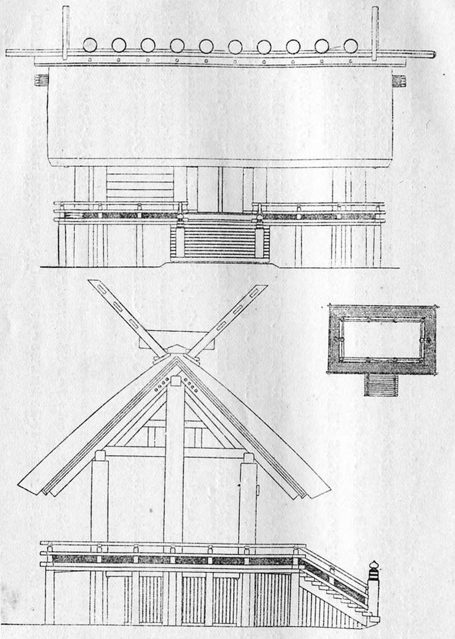
The Uji Bridge 2012

Slide 9

https://www.ted.com/talks/michael_murphy_architecture_that_s_built_to_heal

Slide 10

https://www.ted.com/talks/shigeru_ban_emergency_shelters_made_from_paper

Slide 11


Future options for architecture and related options:
Through UCAS:
377 courses via 96 different institutions

Slide 12


Slide 13
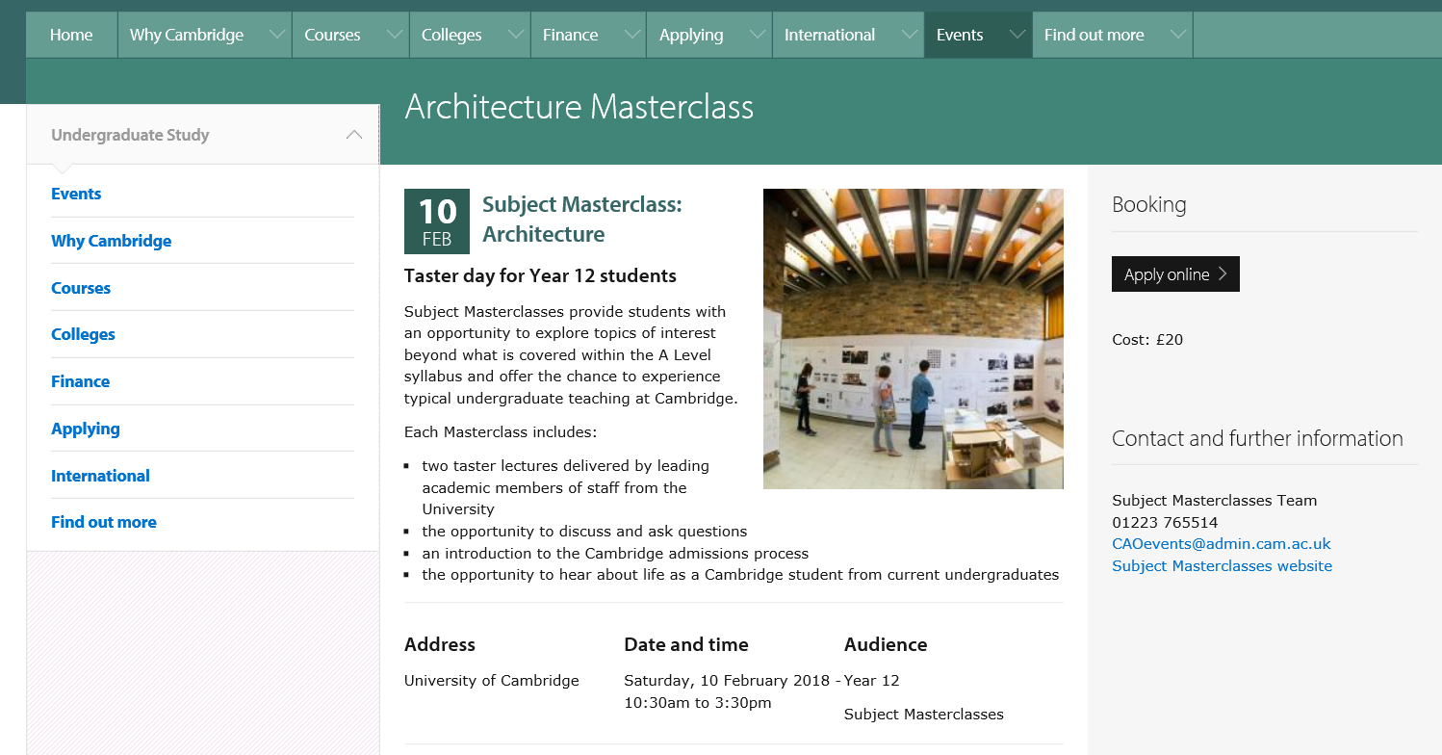
Dates for 2019/20 not published yet but be aware!

