Slide 2
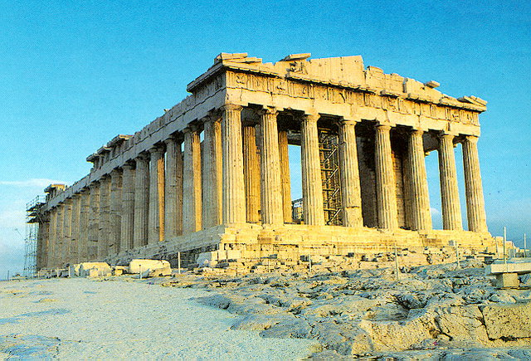

Slide 3
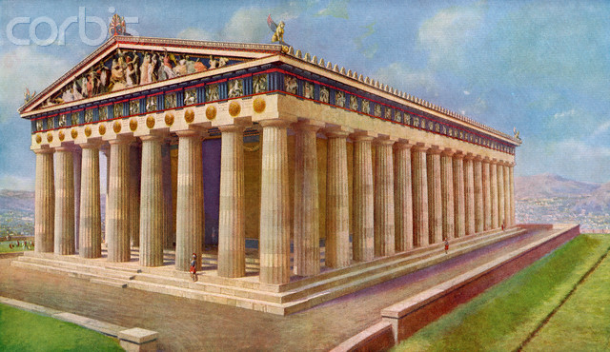

Slide 4
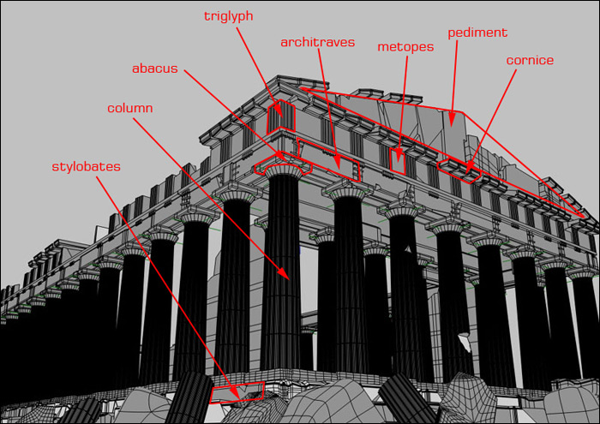

Slide 5
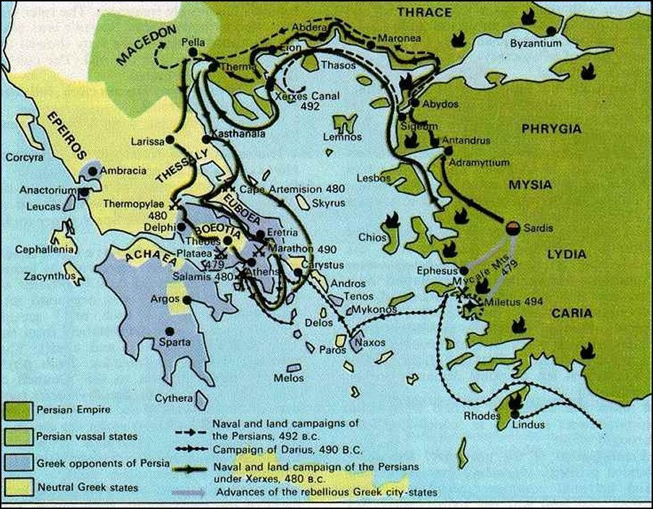

Slide 6
Form: location on Acropolis

Slide 7
Form: Structure and layout
A doric peripteral temple:
Rectangular floor plan
Low steps on every side
Colonnade around the entire structure
Entrances have 6 additional columns in front
8x17 Doric columns on a stylobate

Slide 8
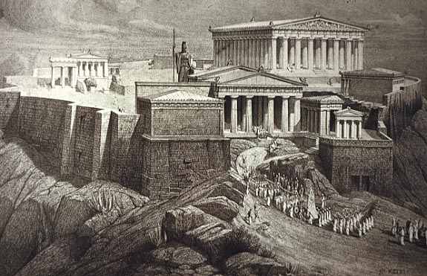
Form: location on Acropolis
designed to be viewed from a distance
located on top of a hill as the largest and most imposing of a range of buildings.
The Parthenon was a monument celebrating the power of Athens constantly in view for Athenians to see.

Slide 9
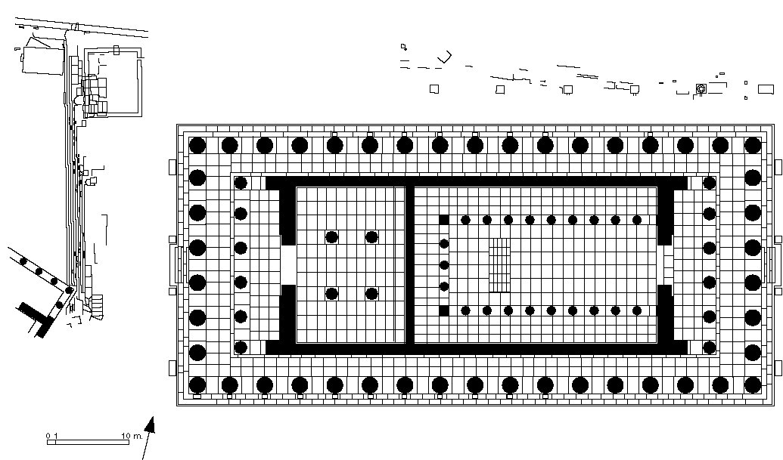
Floor plan of Parthenon
Sculpted frieze around cella
Statue of Athena
Ionic columns in the western cella

Slide 10
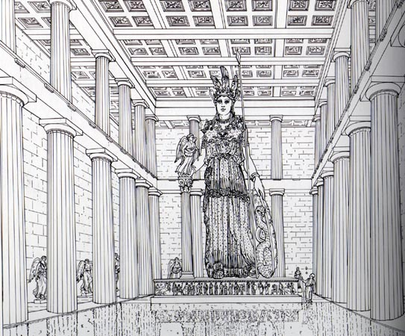
Interior
http://www.youtube.com/watch?v=TSYoPGhyy_o part 2

Slide 11
Form: the 4:9 ratio – the golden section
8 columns at ends – 17 on sides
Width of platform to length – 4:9
The height of the columns up to the horizontal cornice relative to the temple’s width is 4 to 9
The diameter of the columns relative to the inter-axial distance is 4 to 9
The Parthenon has a mathematical logic to it which seems to have created a perfectly proportioned building
= Perfect balance, proportions – perfection & purity
Relationship between verticals, horizontals, as well as height and spacing of columns

Slide 12
Form: decoration and sculpture
The Parthenon is an architectural setting for sculptural decoration which is a unique feature
Statue of Athena – 12 ms tall at back of eastern chamber of cella – not survived.
92 sculpted metopes and elaborate sculpture on pediments
Metre-high frieze in relief around the walls of the cella
Significant part of the sculpture in the British museum.

Slide 13
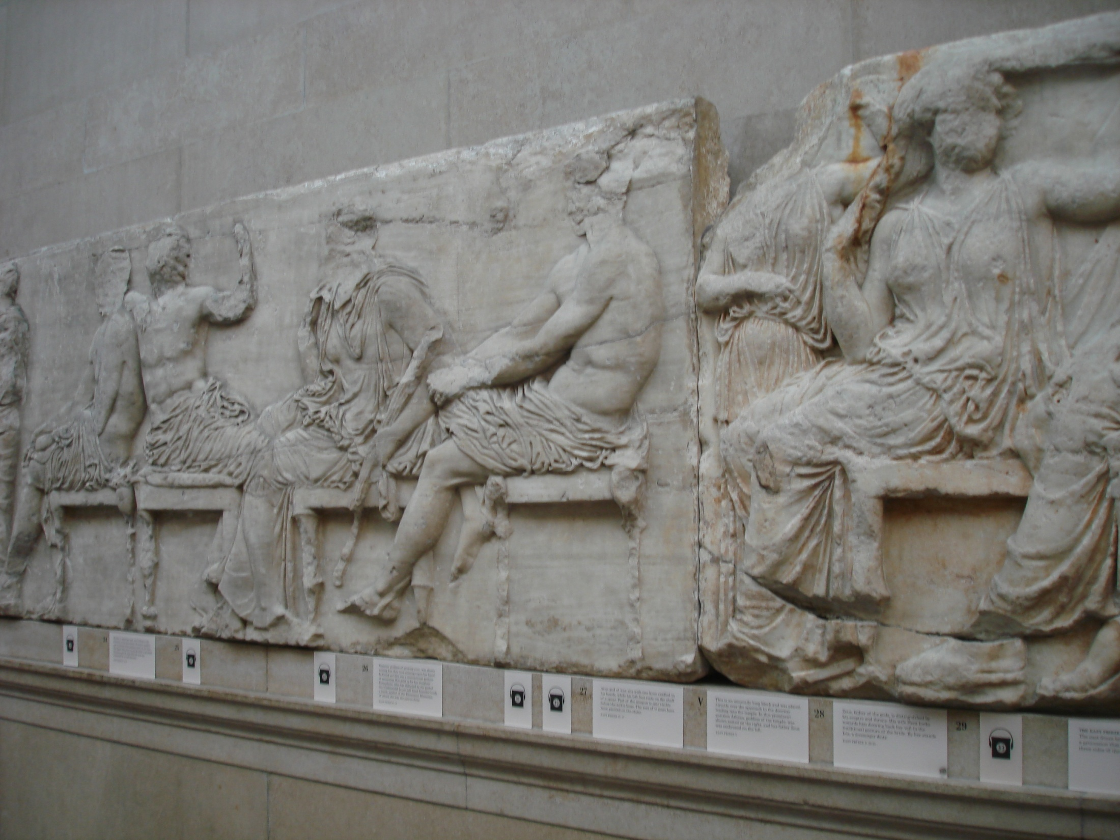

Slide 14
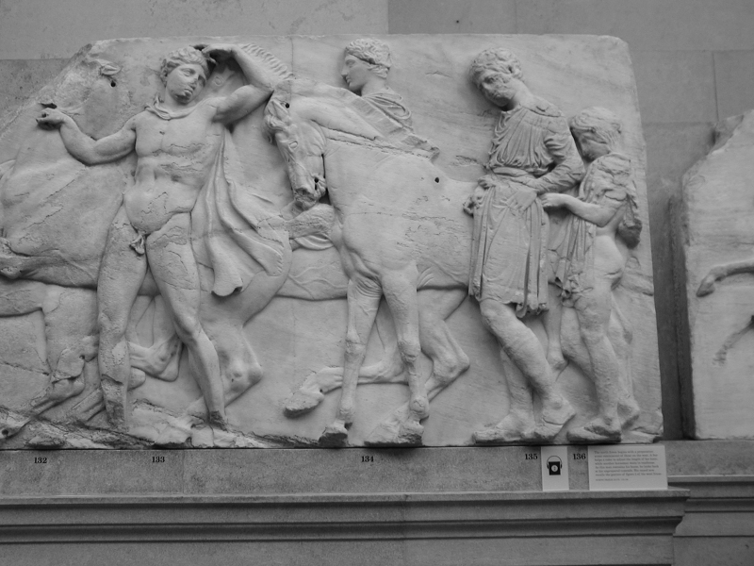

Slide 15
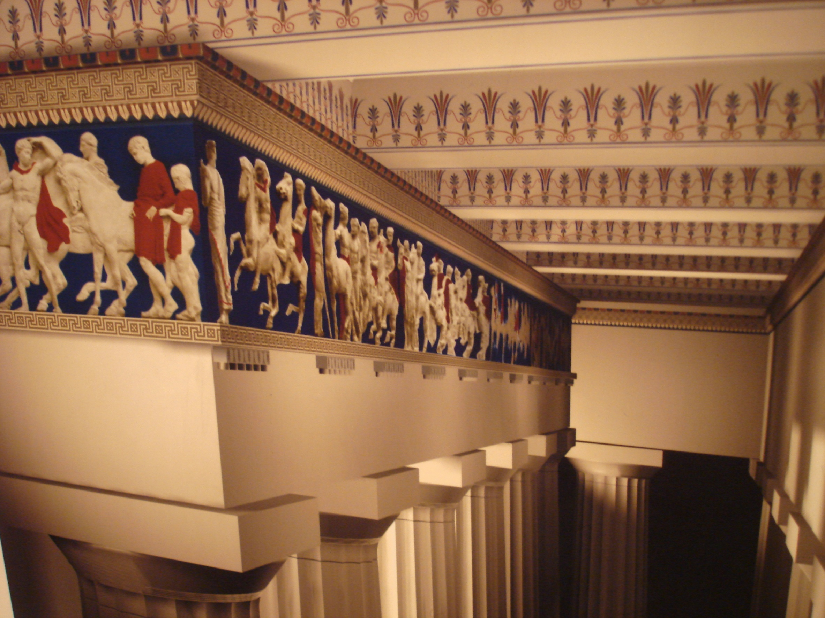

Slide 16
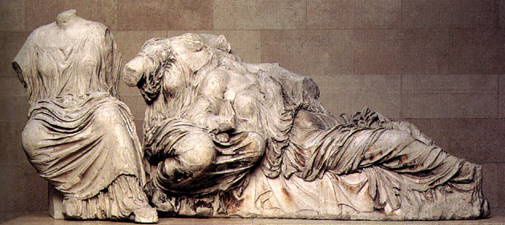
Pediments on Parthenon

