Slide 1
Production

Slide 2
By now you should have completed:
Research and Planning
Statement of Aims
Next we start
3) Production

Slide 3
Production:
There is quite a lot to do for the brief.
Before you go out and take photos you need to have a draft template in place

Slide 4
Magazine: DPS & Front Page (Go to Canva)

Slide 5
Text
Start writing the main body of text
Coverlines
Title/Masthead
Main Story (300 words approx.)

Slide 6
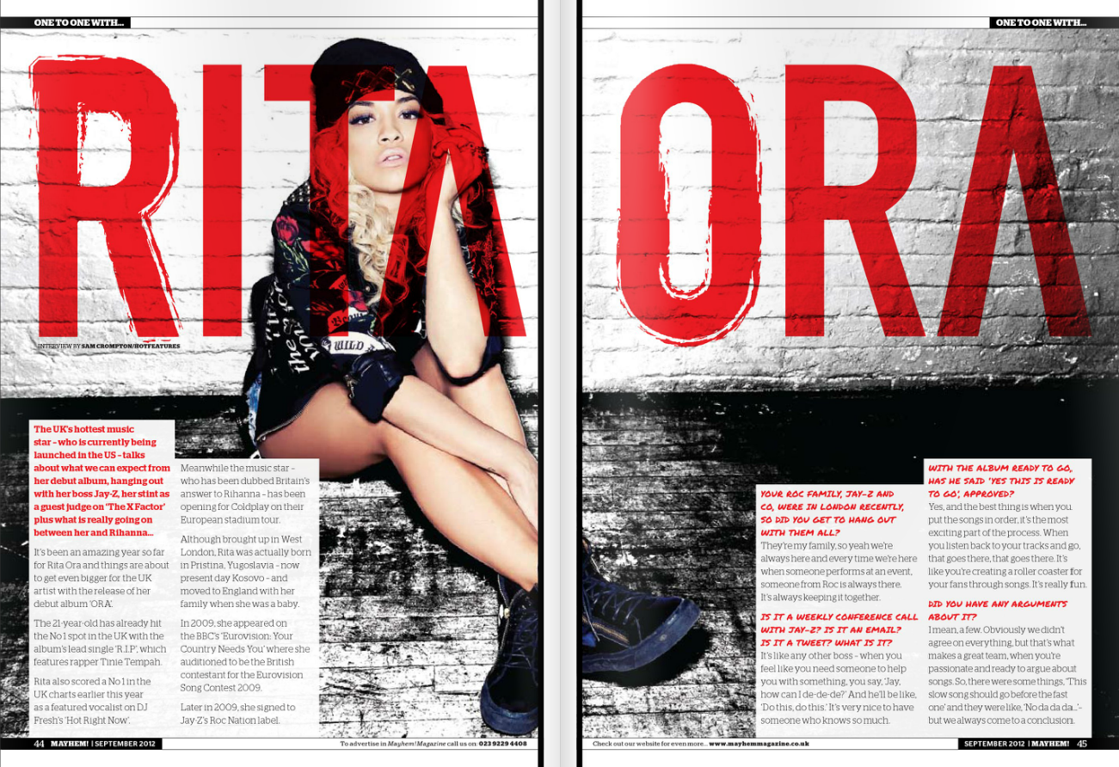

Slide 7
Week Beginning | Monday | Tuesday | Wednesday | Thursday | Friday
09th Jan | Writing Article/Synopsis | Writing Article/Synopsis |  | Photoshoot | Photoshoot
16th Jan | Putting it together FRONT COVER | Putting it together |  | Putting it together ARTICLE | Putting it together ARTICLE
23rd Jan | Putting it together | Final Polish |  | Final Adjustments | HAND IN

Slide 8
Today’s Lesson:
You SHOULD have finished your article (300 words) or Synopsis by now.
Start by putting the Title (Masthead) in using your desired font.
Then add the Coverlines and Main Article Headline
Start Constructing the Contents Page & Article Page

Slide 9
Remember the details!
Music or Film
Magazines
at least 6 original images in total.
Front cover:
Original title and masthead for the magazine
Strapline
Cover price and barcode
Main cover image plus additional images if appropriate (all original)
At least four cover lines

Slide 10
Double page feature article:
Headline and sub-headings
A standfirst
One main image plus additional images (all original and different from
those used on the front cover and contents page)
Feature article (approximately 300 words, complete article or extract) relating to one of the cover lines on the front cover of the magazine
Pull quotes

Slide 11
Coverlines (at least 3)
Title/Masthead
Main Story (300 words approx.)
Price
Barcode
Pull Quotes
At least 6 original images

Slide 13
Putting it all together
Now open Canva
Start to experiment and consider layout for you main features.
Once happy with the layout, start entering the real features.

Slide 14
Photography Planning: Original images (at least 8)
Consider the practicalities of taking your images, and give details of your plans here, alongside a sketch/digital plan of the intended image. Focus on your requirements in the following areas:
Models
Locations
Props
Costumes
Equipment
Date(s) / Time(s)
You can add extra slides to plan more than eight images.

Slide 15
Photography:
This needs to be done this week!
You can use lesson time, but you will have more time and creative freedom if you rent a camera and use your spare time.
Consider going in groups and helping each other.
Make sure you have a plan. It never works if you just click away.
Your camera phones are fine but consider using the DSLRs for experience and higher quality images.

