Slide 1
Ethology 2019
A brief guide to why we behave the way we do

Slide 2
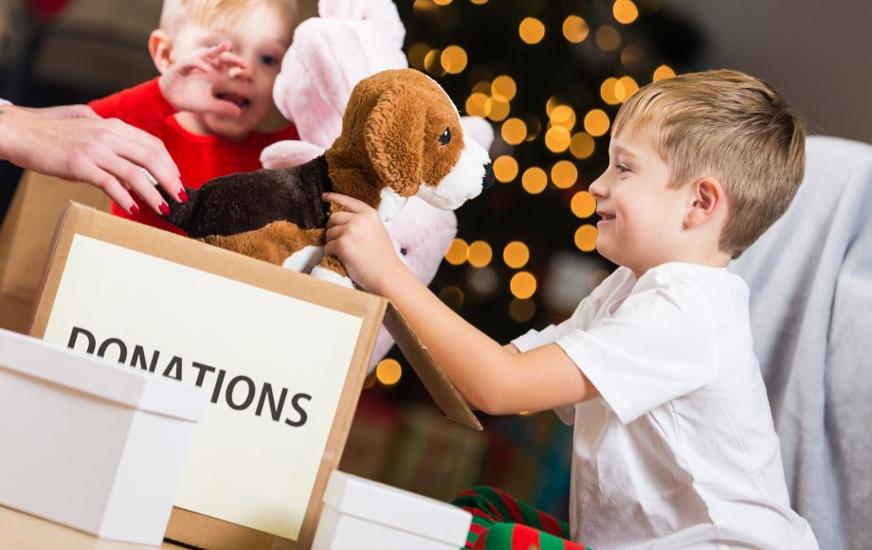
Unpicking the Biology behind the Season of Goodwill

Slide 3
Is behaviour genetic?
Evidence from animal kingdom:
Migratory routes – called fixed action patterns, seem to show heritability

Slide 4
Other examples?
Sign stimuli and releasers
Function: Serve to trigger the FAP
Example: Attack behavior in stickleback males
https://www.youtube.com/watch?v=ZfcGZCGdGVE

Slide 5
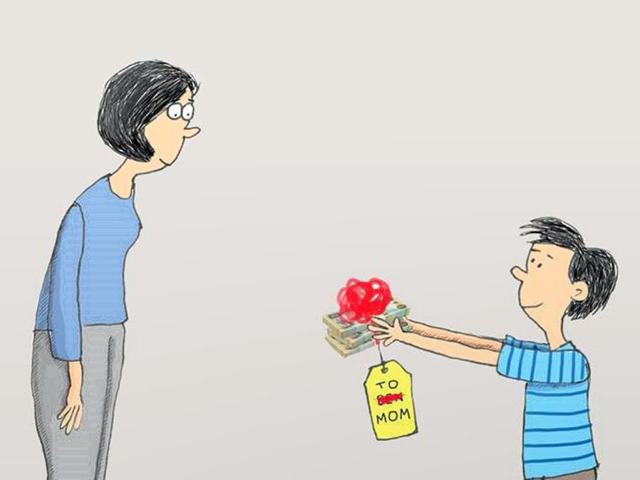
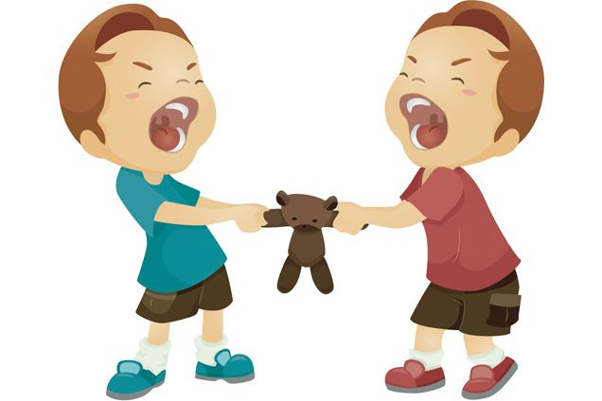
Can we explain generosity and selfishness in genetic terms?

Slide 6
Altruism; the ultimate unselfish behaviour When would you run in?
Stranger?
Partner?
Nephew?
Neighbour?
Parent?
4 nephews?
Pet?
Child?

Slide 8
Learning Outcomes.
At the end of this session you should be able to:
1. Explain what is meant by the terms ‘kin selection’ and ‘reciprocal altruism’.
2. Discuss kin selection and reciprocation explanations for human and animal cooperative / altruistic behaviours.

Slide 9
Altruism.
Altruism refers to an individual acting in a way that will decrease its own survival chances, but improve the survival chances of another individual.
The Darwinian perspective emphasising ‘survival of the fittest’ gave the impression that selfishness was the norm.
Pioneering work involving the study of animals living in social groups in fact revealed that co-operation and altruism are just as ‘natural’ as selfishness.
If co-operation and altruism have evolved, then they must have some adaptive benefits, researchers have analysed the conditions under which adaptations for engaging in such behaviour can be expected to evolve.

Slide 10
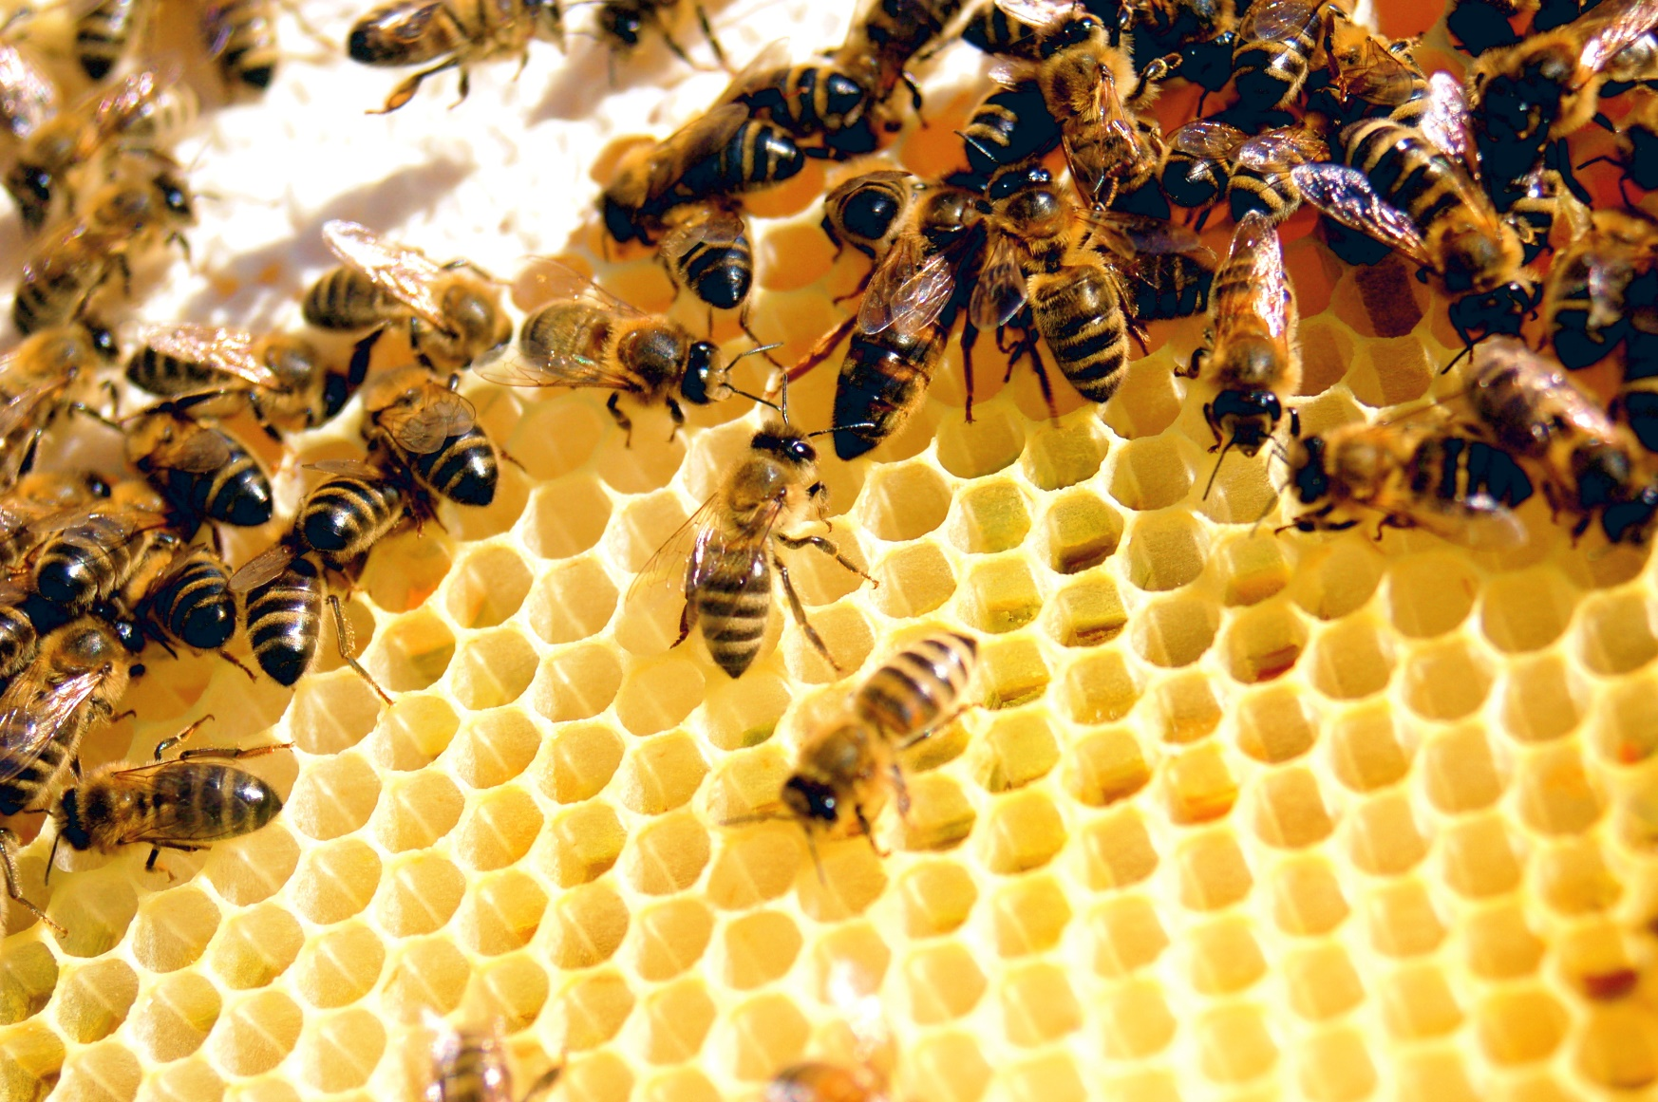
Odd animal Behaviours – altruism in bees

Slide 11
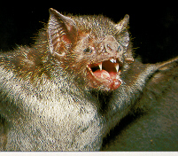
Examples of Animal Altruism.
Vampire bats will regurgitate and feed blood that they have collected from their prey to a hungry conspecific (Wilkinson, 1990).
Ground squirrels will warn others of the presence of a predator, even though making such a call may draw the attention of the predator to itself (Sherman, 1977).
In many species of social insects, workers forgo reproduction entirely (they are sterile) in order to help raise their sisters (Wilson, 1971).

Slide 12
Theories of Altruism.
1. Kin Selection (Proposed by Hamilton, 1964).
By helping relatives to reproduce (even at the cost to your own reproductive success) then your shared genes can spread. Assisting a close relative thereby increases one’s ‘Inclusive Fitness’.
Using mathematical modelling, Hamilton showed that an altruistic gene can spread through the population if it causes an individual to help a relative, whenever the cost to the individual is offset by the reproductive benefit gained by the receiver.
‘Hamilton’s Rule’ = r B>c
where r=coefficient of relatedness, B = benefit to the recipient, c = cost to the giver.

Slide 13
Kin Selection in Humans.
Studies amongst diverse human populations consistently support the existence of kin selection, some examples (cited in Barrett et al., 2002) are as follows:
Food sharing is more common amongst close relatives.
Political alliances between kin are more stable than those formed between distantly related, or unrelated individuals and involve less preconditions.
The passing on of wealth to lineal descendants (excluding spouses) is far more common than giving to less closely related or unrelated individuals.
Close relatives are preferentially sought out in times of need and such help is less likely to be reciprocal.
Relatives typically receive more expensive presents.

Slide 14
How Much Pain Will You Suffer For Your Kin?
In an interesting experiment Fieldman et al., (cited in Barrett et al., 2002) asked participants to maintain a painful position. The longer they held the position the more money they would earn.
In different conditions participants could earn money for individuals differing in relatedness:
Themselves.
Parent or sibling.
Grandparent / niece / nephew, a cousin.
Unrelated friend.
The duration of maintaining the painful position varied as a direct proportion of relatedness, with more pain being sustained for closer relatives.

Slide 15
Problems for Kin Selection.
Kin selection does not explain observed incidences of animals helping non-relatives for example:
Unrelated chimpanzees come to one another’s aid when threatened (de Waal & Luttrell, 1988).
Vampire bats will feed non-relatives (Wilkinson, 1990).
Humans often engage in apparently altruistic acts such as:
Giving blood.
Donating to charity.
Forgoing reproduction.
Rescuing unrelated individuals (and even animals).
Sacrificing their lives for moral or ethical principles.
How can such behaviours be explained?

Slide 16
2. Reciprocal Altruism.
Proposed by Trivers (1971).
Natural Selection may create psychological mechanisms designed to deliver benefits even to non-relatives, provided that such actions lead to reciprocal beneficial actions in the future.
‘you scratch my back…’.
This is not necessarily limited to the same species e.g. cleaner fish.
If the benefit received is larger than the cost incurred, then individuals who engage in such behaviour will out-reproduce those who do not.
Eg, in vampire bats, an individual will share food with a conspecific (whether related or not) if the other has shared food with that individual in the past (Wilkinson, 1990).

Slide 17
Conditions Under Which Reciprocation Flourishes.
1. Individuals must associate for long-enough periods of time to develop reciprocal interactions.
2. The likelihood of one individual performing some social exchange with another should be predicted on the basis of their past associations.
3. The roles of giver and receiver should reverse at least once.
4. The short-term benefits to the recipient are greater than the costs to the donor.
5. Givers should be able to recognise and expel cheaters from the system.
Do such conditions apply to human social interactions?

Slide 18
Prisoners’ Dilemma
Scenario:
You and an accomplice are arrested on suspicion of committing some nasty crime
The District Attorney and the police have been unable to produce enough evidence to convict you of that offense

Slide 19
Prisoners’ Dilemma
We do have enough evidence to convict you of some lesser charge
The only way the DA can nail you for the more serious offense is if one of you rats out the other
Conversely, you and your partner can largely elude prosecution if you both stay silent
You and your partner are placed in separate holding cells and are unable to communicate with each other
DA enters and offers you the following:

Slide 20
Rat
Hang Tough
Rat
Hang Tough
Prisoners’ Dilemma

Slide 21
From your perspective, you and your accomplice are faced with the following:
Don’t Cooperate with each other
(rat)
Cooperate with each other
(hang tough)
Don’t Cooperate
with each other
(rat)
Cooperate with each other
(hang tough)
Prisoners’ Dilemma

Slide 22
Rat
Hang Tough
0, 10
Rat
Hang Tough
Prisoners’ Dilemma

Slide 23
Rat
Hang Tough
10, 0
0, 10
Rat
Hang Tough
Prisoners’ Dilemma

Slide 24
Column Player
Rat
Hang Tough
0 , 10
Rat
Row
Player
Hang Tough
10 , 0
Prisoners’ Dilemma

Slide 25
Rat
Hang Tough
5, 5
0, 10
Rat
Hang Tough
10, 0
Prisoners’ Dilemma

Slide 26
Rat
Hang Tough
5, 5
0, 10
Rat
Hang Tough
10, 0
1, 1
Prisoners’ Dilemma

Slide 27
What to do? Which strategy should you select?
Rat
Hang Tough
5, 5
0, 10
Rat
Hang Tough
10, 0
1, 1
Prisoners’ Dilemma

Slide 28
Dominant
Strategy
Rat
Hang Tough
Dominant
Strategy
5, 5
0, 10
Rat
Hang Tough
10, 0
1, 1
Prisoners’ Dilemma

Slide 29
Dominant
Strategy
Rat
Hang Tough
Dominant
Strategy
5, 5
0, 10
Rat
Hang Tough
10, 0
1, 1
Prisoners’ Dilemma

Slide 30
Prisoner’s Dilemma.
Described by Axelrod & Hamilton (1981). It is a game in which mutual co-operation benefits both players, but a ‘cheat’ can gain a higher pay-off.
It is often described as a hypothetical situation in which two individuals have committed a crime, and are being held for questioning in separate cells, they are unable to communicate.
It is in the best interests of both to say nothing, as the evidence is such that both may only receive a light sentence.
However, they are being questioned separately, and the lawyer offers both freedom if they implicate the other in the crime.
When the game is played once or only a few times then the best strategy is to inform on the other (rat).

Slide 31
Which Strategy is Best?
Real life social exchanges may occur more than once and individuals will probably remember those who have defected (cheated) in the past.
Axelrod (1984) organised a tournament in which various computer programs played repeated prisoners dilemma games. A program called 'tit for tat' was a clear winner. This simple strategy always cooperated on the first move, and then copied its opponents move on every subsequent move.
This is an ‘Evolutionary Stable Strategy’ (ESS) - i.e. once established it cannot be displaced by another strategy.
In real life it pays to cheat in a one-off exchange encounter but if there is a likelihood that you will encounter the same person more than once, then mutual cooperation will serve both parties the best.

Slide 32
Real life lessons:
Give the best presents to your closest relatives
Only give to charity if someone is looking
Give decent presents to friends if you are likely to see them again a lot
Distant relatives or friends you don’t see much should get socks for Christmas.

Slide 33
