Slide 1
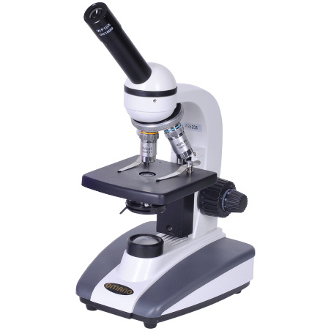
Introduction to Syntax
Language under the Microscope: 1b)
Phrases: A combination of words together that have a specific meaning

Slide 2
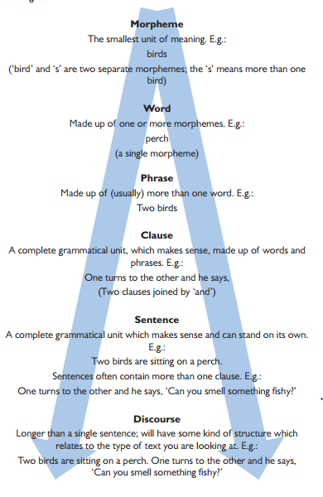
Hierarchy of Grammar

Slide 3
1. Noun Phrase
A group of words located around a head noun:
e.g. a tall penguin with black, webbed feet
In the example above, the head noun ‘penguin’ is modified/described with ‘a tall’ which comes before it (pre-modification) and ‘with black, webbed feet’ after it (post-modification).
NB. The minute you identify a verb is when you have moved past the noun phrase.

Slide 4
2. Verb Phrase
A group of words centred around a main verb:
e.g. ran quickly and manically
In this example, ‘ran’ is the main verb accompanied with the adverbs ‘quickly’ and ‘manically’ as this section has been identified as something the writer wants to focus on.

Slide 5
3. Prepositional Phrase
A group of words that begin with a preposition:
e.g. by his own admission/in the air

Slide 6
4. Adjectival Phrase
A group of adjectives located together excluding a noun:
e.g. hard-hitting and heinous
This is useful when zooming in on a text that includes a lot of modification.

Slide 7
5. Adverbial Phrase
A group of adverbs located together excluding a verb:
e.g. slowly, terrifying and urgently
The function of this again is to zoom into the modification of the verb processes.

