Slide 1
Introduction to Syntax
Clauses

Slide 2
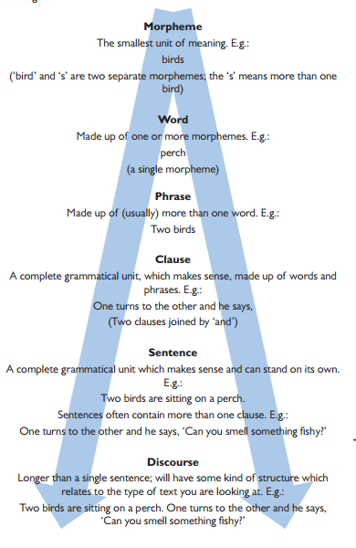
Hierarchy of Grammar

Slide 3
Clause Elements:
S – Subject: The person/thing doing the verb process
V – Verb: An action, process or state of being
O – Object: The person/thing receiving the effect of the verb process
A – Adverbial: Provides more information about how the verb process was carried out
C – Complement: Provides more information about the subject and/or object

Slide 4
Form vs. function
So far, we have unpicked sentences according to form (in other words, dividing it up into different word class labels). With syntax, we have a wider lens and instead focus on function to understand clauses and sentence types (looking more widely at context).

Slide 5
Example: Form vs. function
A man in green shot Tanya in the eye.
Form:
Determiner + Noun + Preposition + Adjective + Verb + Proper Noun + Preposition + Determiner + Noun
Function:
Subject (A man) + Complement (in green) + Verb (shot) + Object (Tanya) + Adverbial (in the eye)

Slide 6
1. Main Clause (aka Simple Sentence)
A main clause is an independent clause (in other words, it can stand on its own). It will usually have a SVO structure which is also the structure of a simple sentence e.g. I have a goat.
The simplest main clause has only V and will be imperative in nature (e.g. Run!) as will VO (e.g. Run over there!) Any clause/sentence that begins with a verb is an imperative.
Equally, you can have SV constructions (intransitive verbs e.g. He jumped) or SVC constructions (in this case, the verb will be copular e.g. She was happy).

Slide 7
2. Coordinate Clause
A coordinate clause is a dependent clause because it depends on a main clause being present before it. This is why beginning a sentence with ‘and’ or ‘but’ is seen as non-standard. All coordinate clauses begin with a coordinating conjunction.
Example: and he waited

Slide 8
3. Subordinate Clause (incl. Conditional)
A subordinate clause is another dependent clause as it can’t stand on its own. It will usually begin with a subordinating conjunction (e.g. Despite Ian working alone,) but not always. Instead, it can start with a verb (e.g. Running down the road,). Because the verb has no subject before it in this case, we call it a non-finite subordinate clause.
A form of subordinate clause that begins with ‘if’ is called a conditional clause. This is because of its hypothetical condition.

Slide 9
4. Embedded (incl. Relative)
An embedded clause is just a clause located within parenthesis (commas, brackets – this right now is an example). You could have an embedded subordinate clause (e.g. realising his umbrella wouldn’t last any longer) or an embedded relative clause which begins with a relative pronoun (e.g. who is located on the fourth floor).

