Slide 1
Introduction to Syntax
Sentence Types

Slide 2
Clauses: The foundation of all sentences
It’s important that you get your head around clauses in order to understand sentence types. Usually, the easiest way of being able to deduce what sentence type is present, is to count the number of different clauses present. To assist, count the number of main verb processes.
Cheat! If in doubt, you can use the term multi-clausal if there is clearly more than one clause present.

Slide 3
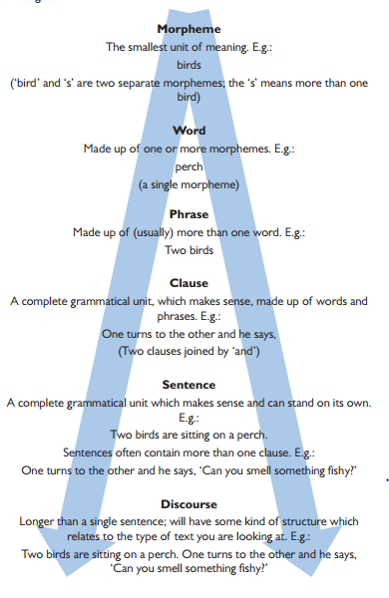
Hierarchy of Grammar

Slide 4
1. Minor
A minor sentence is one without a verb process present and usually has pragmatic meaning. They are usually found in spoken language and would be a marker of the spoken mode in a text.
Example: Hello.

Slide 5
2. Simple Sentence (aka Main Clause)
A simple sentence has to have a verb process present. The simplest simple sentence will just have the verb present; this will be an imperative e.g. Go! Usually, a simple sentence will have a SVO structure but there are variations including SV, VO and SVC.

Slide 6
3. Compound
A compound sentence has a main clause connected to a coordinate clause by a coordinating conjunction.
Example: I wanted some cake so went to the shop.

Slide 7
4. Complex
A complex sentence has a main clause connected to a subordinate clause.
Example: Despite wanting to go to bed, he stayed up.

Slide 8
5. Compound-Complex
A compound-complex sentence has at least three clauses including a main clause, subordinate clause and coordinate clause. There could be multiple examples of each present.
Example: If I were you, I would run to the shops immediately and buy a doughnut.

Slide 9
As well as identifying sentences by their clauses…
We can also identify sentence types by where different clause types are positioned.

Slide 10
6. Left-branching
A left-branching sentence means that the main clause is located at the end after a subordinate clause(s) first.
Example: Although he was ill, and he really was very ill, he decided to party all night long.

Slide 11
7. Right-branching
A right-branching sentence is the opposite. The main clause is first followed by the subordinate clause(s).
Example: Ian was fed up, fed up from the lack of attention, fed up from the disdain.

Slide 12
8. Periodic
A periodic sentence is a complex sentence in which the main clause is saved until the end. It is therefore similar to a left-branching sentence with the exception that the main clause is split.
Example: The minister, who was usually late in the mornings, except on those occasions when she had been working all night, was already at her desk.

