Slide 1
Sustainable Approaches to Coastal Flood Risk and Coastal Erosion Management along the Holderness, UK
You have begun your research on the Holderness coastline as your local scale case study in the UK. You should be able to use the information gathered so far, and below:
to understand human intervention in coastal landscapes
to understand sustainable approaches to flood risk and erosion management
to understand challenges represented in sustainable management at the Holderness Coast
Key words:
Hard engineering
Soft engineering
Cost-benefit analysis
Integrated Coastal Zone Management
Coastal system
Concept Checker:
The concept of the coastal system at the local scale
The concept of sustainable management

Slide 2
Coastal management issues
Holderness Coast Local Scale Case Study

Slide 3
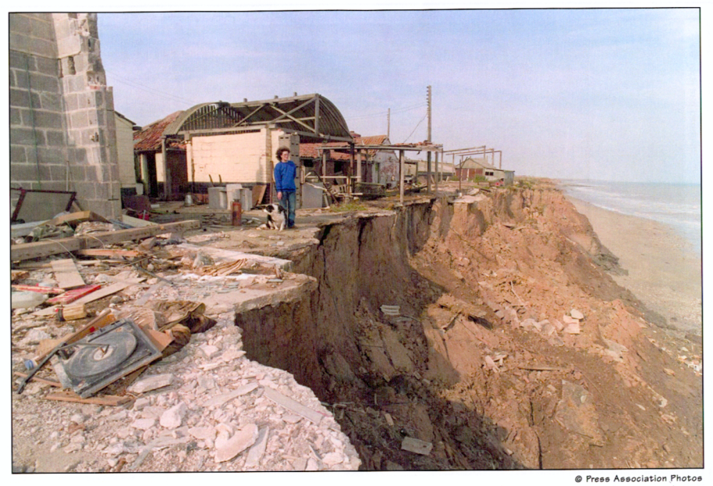

Slide 4
Human intervention in coastal landscapes
Why should we manage the coastlines?
Why might some stretches of coastline be managed differently?
What techniques could be used to manage different coastlines?

Slide 5
Coastal Management – Issues

Slide 6
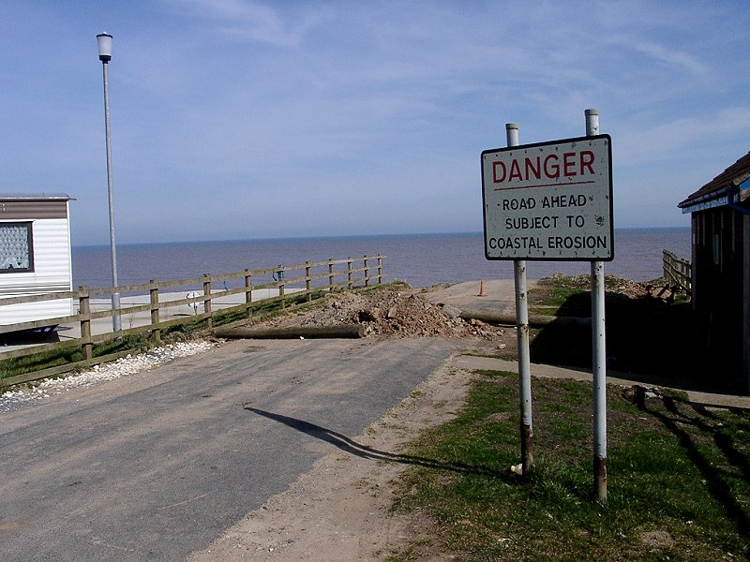
What social, economic and environmental problems might result from coastal erosion issues?

Slide 7
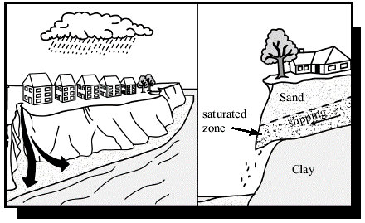
Holderness Coast – challenges
The Holderness Coast has been long recognised as Europe’s fastest eroding. (> 4km over the last 2000 years)
The presence of people - Increasing population levels due to retirement and the development of leisure and holiday facilities have occurred around Bridlington and Hornsea, especially caravan parks.
Interfering with natural processes such as longshore drift. Groynes at Hornsea, Mappleton and Withernsea mean that sediment is being prevented from building beaches elsewhere.
Global warming creating a rise in sea level and increasing storminess combined with the strong, prevailing NE wind. The medium prediction for sea level rise along the Holderness coast is about 30 cm in the next fifty years (6 mm/year). This rate is significantly higher than 1-2 mm/years that have occurred in the previous 100 years.
Processes at work on the Holderness cliffs.

Slide 8
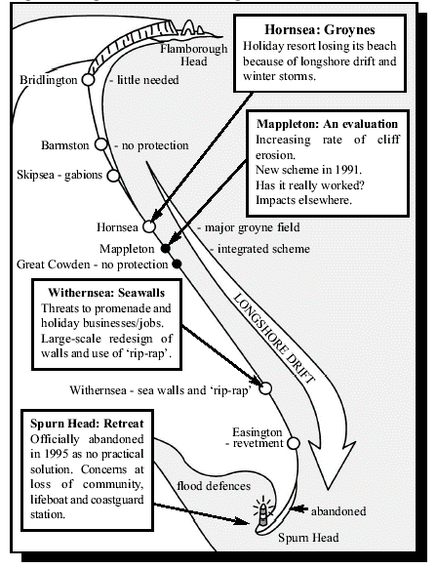
Holderness coast: Coastal Management Approaches
A range of hard engineering has been used.
Most of the erosion and removal by longshore drift takes place south of Hornsea.
At Hornsea groynes have been repaired and new ones built at a cost of over £5.2 million and the old seawall has been raised slightly. Sand dunes in the south beach are being planted with trees.
At Withernsea –groynes and a sea wall.
A new wave return wall prevents wave erosion. The wall is further protected by rip-rap and beach nourishment. This all cost £6.3 million but it will be good value if it can halt the fall in local property prices.
Management schemes along Holderness

Slide 9
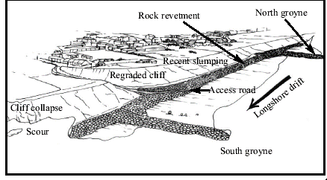
Holderness coast Watch part 3 of the video: Defending the coast (11.49 min) http://estream.godalming.ac.uk/View.aspx?ID=4586~4x~8zS48MtV
How successful are these schemes? Are they sustainable?
In 1786 Mappleton was 3.5km from the sea. By 1988 the sea was on its doorstep.
In 1991 a scheme was implemented at a cost of £2.1 million which involved two rock groynes to trap beach sediment and a rock revetment to prevent erosion of the cliffs. The cliffs were re-graded to reduce slumping and there was some nourishment of the beach to encourage deposition.
12 years later and the cliffs started to show early signs of slumping. Beyond the second groyne the large rocks are being undermined and the cliff face
below the car park has begun to erode.
More worrying is the very rapid erosion of beaches, cliffs and farm buildings at Great Cowden 3 km to the south which may be linked to Mappleton’s growing
beach. http://www.bbc.co.uk/education/clips/z8jfb9q -

Slide 10
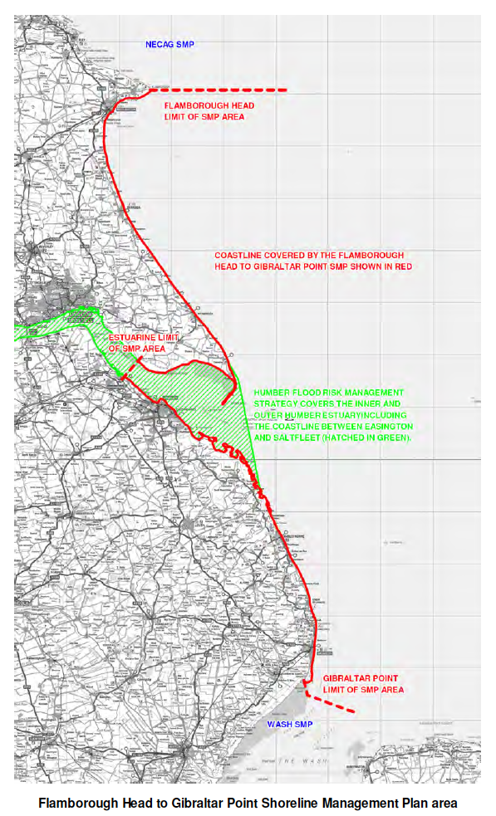
Sustainable Approaches: A Shoreline Management Plan
Coastal management issues and decisions
More recent concerns at Mappleton (wave refraction on headland area), for example, require decisions to be made about coastal protection at a strategic level http://www.bbc.co.uk/news/uk-england-humber-33939525 - more recent issues 2015
The Flamborough Head to Gibraltor Point Shoreline Management Plan sets out the policy for managing the coastline and responding to coastal erosion (and flood risks) over the next 100 years.
It assesses the potential erosion and flood risks along sections of the coast, and then identifies sustainable coastal defence and management options, which take into account the influences and needs of the human, natural and historic environments (including existing defences and adjacent coastal areas).

Slide 11
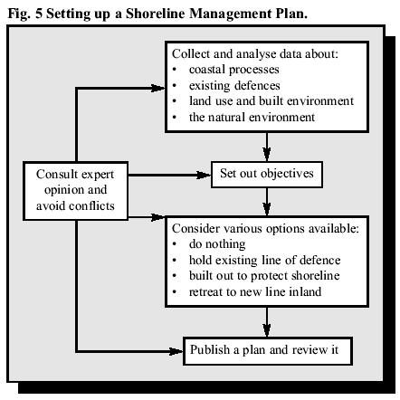
Holderness Coast: Shoreline Management Plan
Coastal management decisions for the SMP
Decisions can be taken using various types of assessments:
• Cost-benefit analysis considers the social and economic aspects of a strategy. The benefits of a scheme (new businesses or jobs and savings in lives and property) are divided by the costs of building and maintaining it.
• Environmental impact assessments try to assess the effects upon an area.
• Feasibility studies look at the technical merits of a particular scheme and site. Is the engineering planned suited to the local geology or coastal processes?
• Risk assessment involves taking decisions in the light of the likely recurrence interval and what is at risk.
Setting up a shoreline management plan.
Shoreline management plans try to decide the most appropriate scheme in discussion with all parties.

Slide 12
Holderness Coast: Shoreline Management Plan
SMPs are reviewed every five to 10 years; the first round SMPs are now being reviewed to take into account updated information and changing circumstances.
These plans allow for the use of hard engineering in strategic areas, alongside the use of soft engineering. Stretches of coast are divided into ‘management units’, and for each of these one of four different management policies are agreed, as follows:
No active intervention – There is no planned investment in defending against flooding or erosion, whether or not an artificial defence has existed previously.
Hold the (existing defence) line – An aspiration to build or maintain artificial defences so that the position of the shoreline remains. Sometimes, the type or method of defence may change to achieve this result.
Managed realignment – Allowing the shoreline to move naturally, but managing the process to direct it in certain areas. This is usually done in low-lying areas, but may occasionally apply to cliffs.
Advance the line – New defences are built on the seaward side.
There are challenges for all schemes: carry out the group task to find out for yourselves!

Slide 13
Sustainable management: shoreline management plan
Holderness Coast Local Scale Case Study: DME exercise

Slide 14
YOUR TURN ->
Safeguarding Our Coast
The aim of this exercise is to develop ideas for a Shoreline Management Plan for your section on the Holderness Coast whilst considering:
existing coastal defence and the use of the land being protected
coastal processes in operation
current research into sediment movement

Slide 15
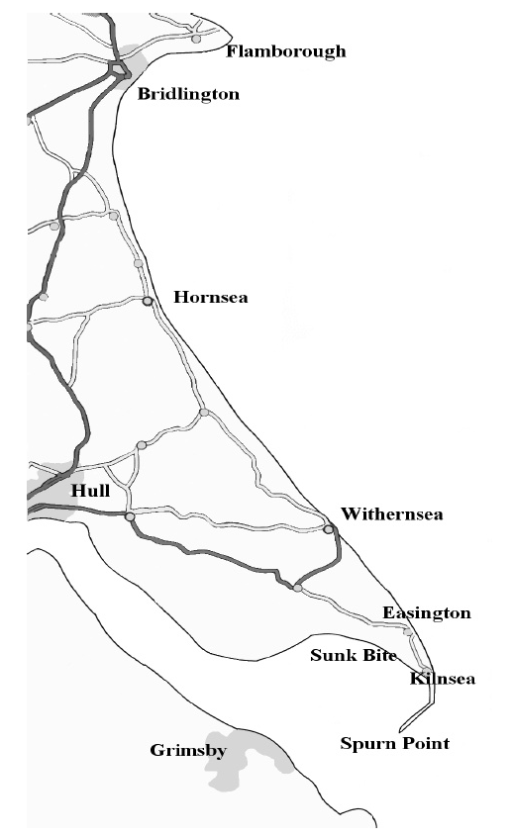
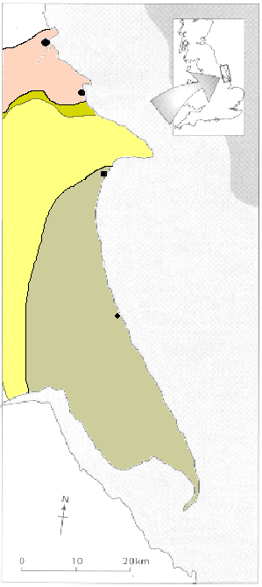
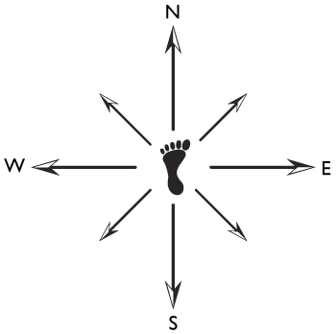
Holderness Coastline
Scarborough
Jurassic Rocks
Filey
Speeton Clay
Flamborough Head
Chalk
Bridlington
Mappleton
Hornsea
Mappleton
Boulder Clay
Great Cowden
Withernsea
Easington
Sunk Bight
Humber
Estuary
Spurn
Point

Slide 16
GROUP TASK
Your need to put forward your recommendation for managing the coastline in the future to the council at the next meeting. You will do this after completing a:
Information Sorting – getting the information together for your allocated section of coastline
Complete a mind map of the social, economic, environmental considerations for your bit of coastline to present your arguments
Complete the Conflict Matrix (your final outcome)

Slide 17
Local
Government
Benefits of the scheme e.g. homes, farmland, roads and lives
Residents
Cost of the scheme and up keep costs
Factors & Conflict
Conservationists
What effect will it have on other areas
How effective is the scheme
Tourists
Local
People
What will it look like
Who pays. The government will give a grant if it accepts that the scheme is needed.
Can we still access the coast? Tourism, etc

Slide 18
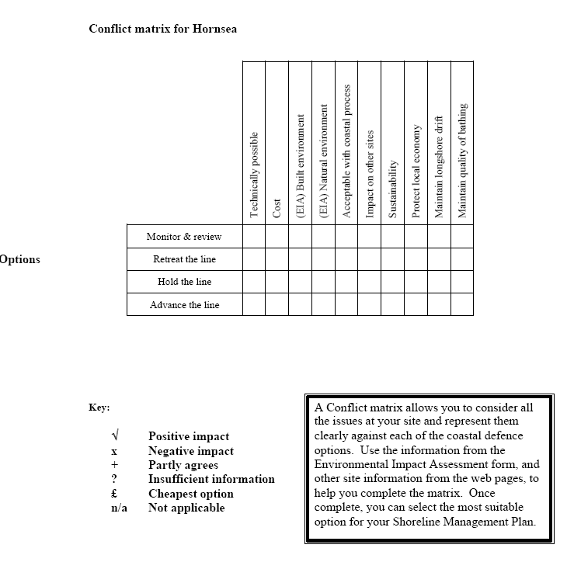

Slide 19
Coastal management decision making is complex – you can see that there are a range of issues that should be addressed

Slide 20
GROUP TASK
You will need to discuss your allocated section of coastline and state which of the 4 management options (or a combination) you would recommend for your area based on the 3 activities above.
You can suggest one approach or a combination of options. Make sure you give reasons for your decisions and why you rejected the alternative strategies for each area.
It is likely that hard defences will be used for at least one area, so make sure you state the initial costs involved as well as any future maintenance.
If there are any practical limitations that need to be taken into account with your chosen option(s) then also make this clear. If it helps, diagrams may be used.
Your final statement:

Slide 21
Outcomes of the real smp
Holderness Coast Case Study: SMP

Slide 22
Case study Holderness: Watch the remaining part 3 of the video: Sustainable Strategies (23 min) http://estream.godalming.ac.uk/View.aspx?ID=4586~4x~8zS48MtV
Climate Change: What if?
“Continue as normal”
“Make changes to existing hard structures”
“Employ active sustainable management strategies”

Slide 24
Case study Holderness: reflection
Why might traditional approaches to coastal management, such as some of the hard management strategies, be important in management of the coast?
What do you understand by the term ‘sustainable approaches’ to coastal management?
With the greatest challenge of climate change - what are the most important approaches to coastal management and why?

Slide 25
Holderness Homework
Complete the 20 mark question: “With reference to a case study, evaluate strategies used to defend the coast” (20 marks)
EXTEND YOURSELF:
Additional case study notes on Holderness can be taken from: https://www.alevelgeography.com/mappleton/
Read the article ‘Managing the Coastline’ taken from the Geography Review, April 2015
Answer Questions 1-5
Watch:https://www.bbc.co.uk/iplayer/episode/p083cd51/on-the-ground-coastal-erosion-the-homes-lost-to-the-sea

