Slide 1
3.1.3.11: Case study of contrasting coastal landscape beyond the UK
Learning Objectives
To understand how a contrasting coastal location can present risks and opportunities for human occupation and development
To understand how humans build up resilience in their coastal environment
To evaluate how humans mitigate and adapt to their coastal environment
Concept Checker:
The concept of the coastal system at the local scale in a contrasting location to the UK
The concept of human response to coastal management – resilience, mitigation and adaptation
Key words:
Shoreline Change
Resilience
Mitigation
Adaptation
Integrated Coastal Zone Management

Slide 2
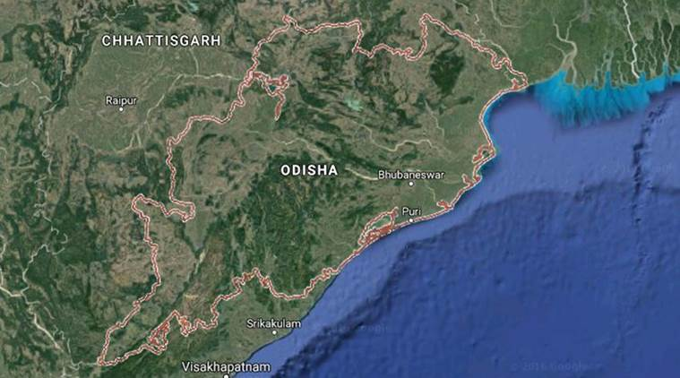
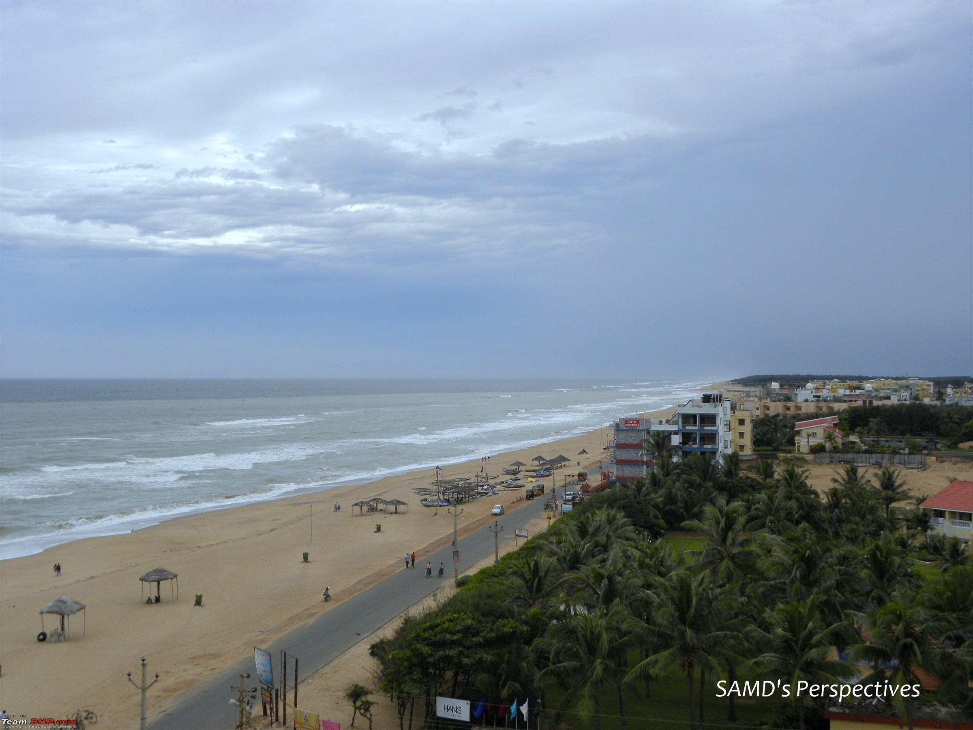
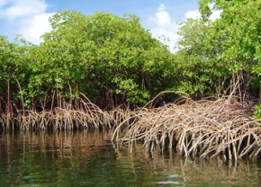
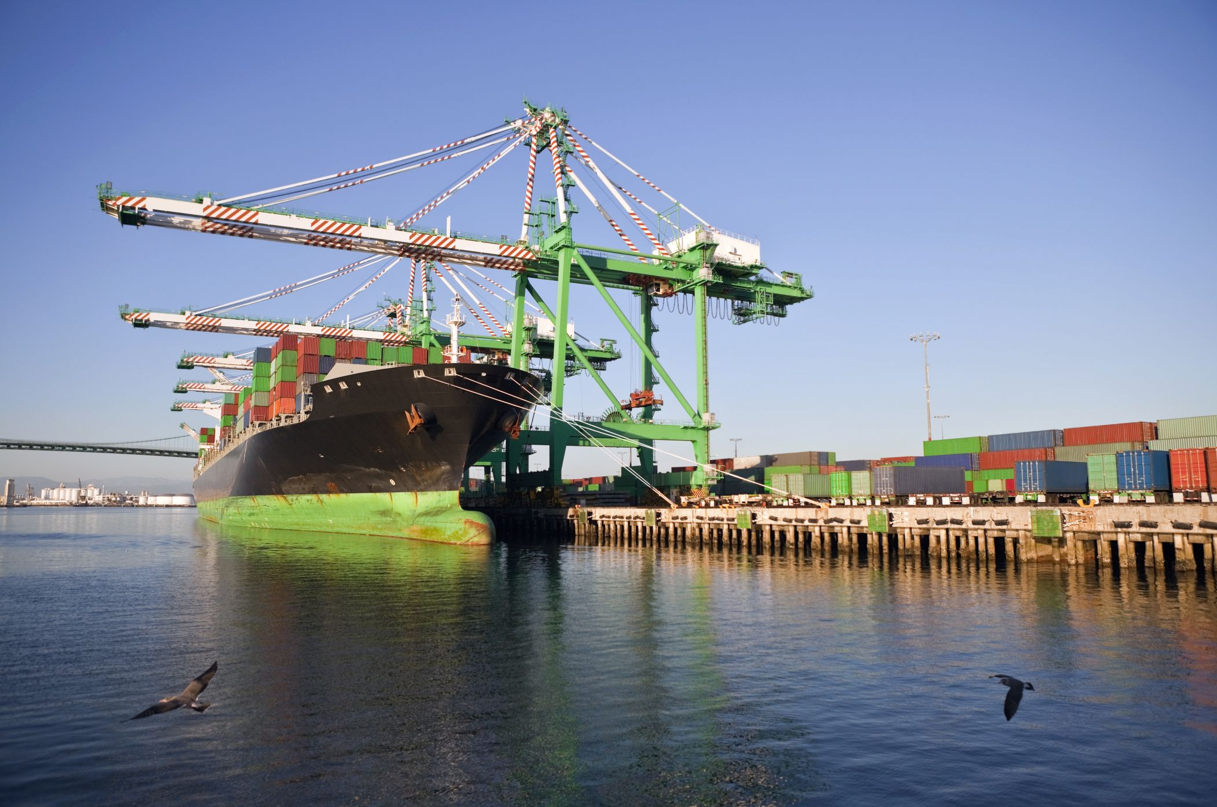
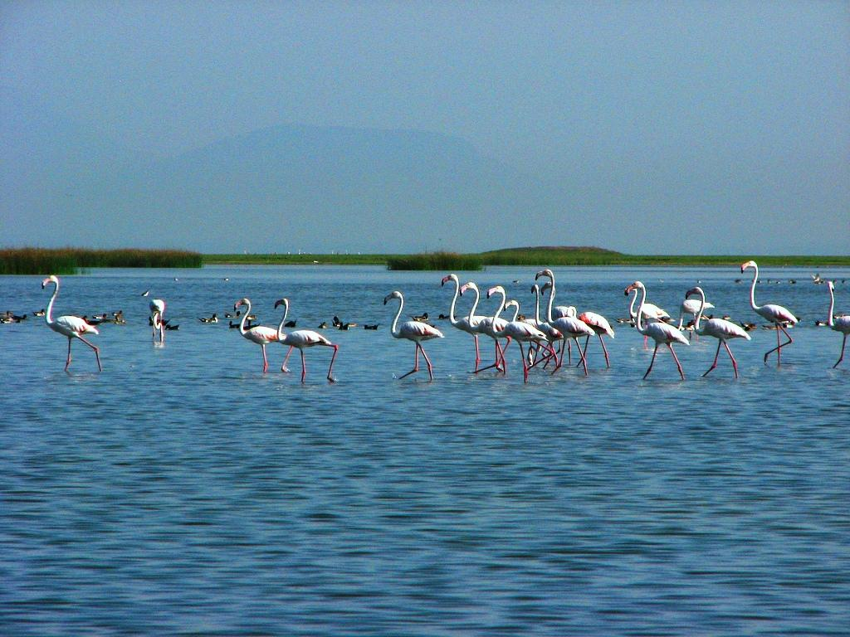

Slide 3
Odisha: A distinctive & contrasting landscape
Location
India’s 9th largest state by area and 11th by population
Odisha – relatively straight coastline (480km)
Contains 3 important habitats – 6 major deltas, Chilika Lake and mangroves
TASK 1:
In your handout, read and highlight key facts and figures from the article.
How is Odisha different to the Holderness Coast? (on paper)
What are the three main habitats? (on paper)

Slide 4
Risk and Opportunity in Odisha
Odisha presents risks and opportunities for human occupation
The human population of Odisha interact with their coastal landscape in different ways:
  what are the coastal processes that combine to create this unique coastal landscape?
  what are the challenges and risks of living in Odisha?
  what are the opportunities offered by living in Odisha?
TASK 2:
Watch the videos and complete the mind maps
Draw a basic map to show where accretion is occurring in Odisha and where erosion is occurring.
What percentage od Odisha’s coast is accreting, eroding and remaining stable? Add these figures to the table.
https://www.youtube.com/watch?v=rAMGt76-sxo - Opportunities
https://www.youtube.com/watch?v=fwjtjyY-3EI - Risks

Slide 5
Opportunities
Risks

Slide 6
Managing the Odisha coast
What do you think is meant by the following terms?
Resilience
Mitigation
Adaptation
Resilience – The psychological quality of strength of character, of being able to respond positively to adversity.
Mitigation – Reducing or alleviating the impacts or severity of adverse conditions or events.
Adaptation – Fitting into the natural system and local way of life, which may involve changing behaviour.
https://www.youtube.com/watch?v=QDTasdIXBdM - 26 minute video on ICZM Odisha

Slide 7
Watch the following video clip and read through the information p150-152. Make detailed notes to show examples of resilience, mitigation and adaptation in Odisha.
https://www.youtube.com/watch?v=QDTasdIXBdM - 26 minute video on ICZM Odisha

Slide 8
Answer the following questions
What were the aims of ICZM in Odisha?
Suggest the criteria that will be used to judge whether it has been successful in achieving its aims.
Who were the organisations and local communities involved?
Examine the role of mangroves in reducing the threat from flooding.
To what extent is the replanting of mangroves a sustainable solution to the problem of flooding in India and Bangladesh?

Slide 9
Exam question
To what extent does climate change present risks and opportunities for human occupation in a named coastal landscape beyond the UK? (20 marks) Hodder workbook

