Slide 1
Audio editing
Component 2-Manipulating Audio

Slide 2
Aims and objective
Explore audio editing tools in Logic Pro X
Assign left-click and command-click tools
Understand destructive and nondestructive editing
Use the Audio file editor and the workspace to edit audio
RELEVANCE
Essential mixing skills for Component 1
Manipulating Audio(assessed criteria) for Component 2
Examined skill in Component 4
Super Student Stuff
The SSS
Use the Flex tool and Flex time to manipulate audio

Slide 3
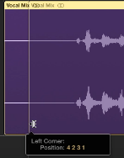
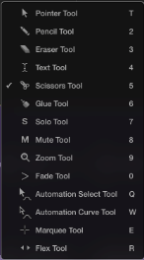
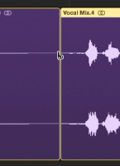
Editing Audio in the workspace
Editing audio regions in the workspace is non-destructive . Regions are merely pointers that identify parts of an audio file. No processing is applied to the original audio files, which remains untouched on your hard disk.
Trim Regions using the Resize Tool
Move your pointer to the bottom corner of the region
The pointer turns into the Resize tool, you can click and drag left or right to determine where the region starts or ends
Splitting a region using the Scissor Tool
Press T
The Tools Menu appears
Select the Scissor Tool or press 5
The pointer turns into the Scissor Tool
Click on the part of the region you want to split
Press T twice to get back to the Pointer Tool

Slide 4
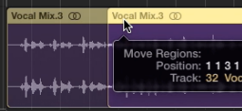
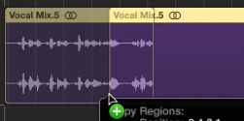
Deleting, Moving and copying regions
Moving, copying and deleted regions
To delete a region, simply click of the region and press backspace. The region disappears from your workspace but the audio file is still available in your browser section
To move a region, click and drag the region with the Pointer tool
To copy a region, Option-drag the region with the Pointer Tool
Marquee Tool
You can select a section of an audio region with the Marquee Tool( Command-click) and move or copy that selection using the Pointer Tool(Left-click)
Ensure the Pointer Tool is selected from the Left-click Tool menu and the Marquee Tool is selected from the Command-Click menu
Command-drag over a section of the audio region
Press Backspace to delete selection
Click and drag to move selection
Option-drag to copy the selection
Pointer Tool
(Left-Click)
Marquee Tool
(Command-Click)

Slide 5
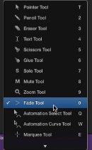
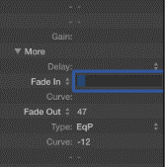
Adding Fades and Crossfades
When editing audio, you want to avoid abrupt transitions on edit points. You can use fades in the workspace to create smooth transitions
Adding a Fade-In, Fade-Out and Crossfade using the Fade Tool
Press T to open the Tool Menu
Click the Fade tool, or Press 0(zero)
Drag the Fade tool over the start of the region for a Fade-In and the end of the region for a Fade-Out
Drag the Fade tool over a junction between 2 regions to create a Crossfade
Fade Out
Crossfade
Adding a Fade-In, Fade-Out and Crossfade in the Inspector section
Click on a region
In the Inspector section(press I), select the More option to display the fade parameters
Double-click to the right of the Fade In or Fade Out parameters and enter a value( the value is measured in milliseconds i.e 1000=1 sec)
Fade In

Slide 6
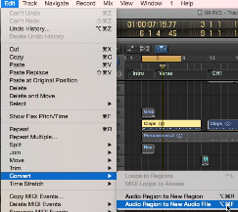
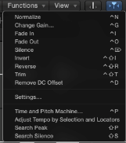
Editing Files in the Audio File Editor
The Audio File Editor allows you to perform destructive audio editing. Processing an audio file in the Audio File Editor modifies the data contained in the audio file.
Converting a region to a New Audio File
To avoid modifying the original audio file you will have to convert the region before editing
Copy the region by Option-dragging to a new track
Select the new region, choose Edit>Convert>Audio Region to New Audio File
Normalising Audio
Normalising automatically adjusts level of an audio file to peak at 0dB
To open the Audio File Editor double click on the region
At the top of the Audio Editor click File
Choose Function>Normalize

Slide 7
Task 1 Cutting up your audio nondestructive editing
Task 2 destructive editing using the audio file editor
Copy the 8MT02-2019-Sample1 to you desktop by dragging it from AS Music Tech>0_Resources>Component 2
Open a new Logic Project and import the vocal sample from your desktop into the Arrange window
NB: Save your Project into the LOCAL folder by selecting Save As and navigating to the Local folder on your hard drive . If you don’t do this, destructive editing(task 2) is disabled.
Set the tempo of your project at 71bpm and make sure the sample starts at bar 1 and plays in time with the metronome.
Using the Scissors or Marquee tool cut out the following phrases 1. Everything that glitters 2.you’ve gotta 3. gold
Apply short fades to your edits using the fade tool
Arrange the samples as Beat 1 Everything that glitters Beat 3 you’ve gotta for the 3 bars. Bar 4 Beat 1 Everything that glitters Beat 3 gold
Create a stutter effect leading into Bar 2 everything
Make a copy of your guitar and vocal tracks.
Select the new region, choose Edit>Convert>Audio Region to New Audio File
-To open the Audio File Editor double click on the region
-At the top of the Audio Editor click File
-Choose Function>Normalize
-Reverse the Gold

Slide 8
Pen and pad time write it up… Explain the difference between destructive and nondestructive editing.
Destructive editing modifies the original audio file. The file is therefore changed on the hard disk and cannot be converted back to its original form. You can use the Audio File editor to apply destructive audio editing like normalise and reverse.
Nondestructive editing does not change the original audio file. This type of editing is usually applied in the workspace and it allows you to split files in audio regions. You can use various Logic tools like the marquee, scissor, pointer, etc. to edit audio regions.

Slide 9
FLEXing logic’s muscle
Flex Time Flex Time allows you to change time stretch audio waveforms for timing purposes and special FX
-click the Flex button in the Track area menu bar -each track has a Flex button and Flex pop-up menu Monophonic mode is intended for instruments that produce one note at a time (vocals, flute) Polyphonic mode for instruments that play chords( piano, guitar) Slicing mode for moving notes without time-stretching( drums)
Component 2
Manipulating Audio
Flex Tool The Flex Tool allows you to move individual notes in an audio region without dividing the region.
-Press T for your tool menu -Choose the Flex Tool -Find the note/chord that you want to move and drag it left or right to move it.

Slide 10
FLEX PITCHperfect-TUNING THOSE VOCALs
Aca-mazing!!!
On your vocal track click on the Flex button
Choose Flex Pitch from the Flex pop-up menu
You will see vertical bars of various heights that represent the pitches detected for each note:
-A line in the center of the waveform indicates a perfect pitch
-A bar going up indicates that the note is sharp
-A bar going down indicates that the note is flat
Analyse your vocal track and adjust the bars for the perfect pitch

Slide 11
Flex Task
Enable Flex time on the sample track
Choose Monophonic
Increase the tempo to 120bpm( the sample should playback faster but the pitch should remain the same)
Solo the track and set you left and right locators around the sample and Bounce in Place with the new tempo. Name it Vocal Sample 120bpm
Duplicate your track and create a copy of your new 120bpm sample
Enable Flex-pitch on the track and create a harmony track

