Slide 1
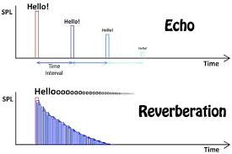
Reverberation(reverb)
Definition:
Reverb consists of multiple, blended sound images( not individually discernable echoes) caused by reflections of walls, floors, ceilings and other surfaces which do not absorb all sound. Reverb occurs naturally in most indoor environments, and is more prominent with hard surfaced environments. Natural and artificial reverb can be used as an effect for live sound and recording.
Reverb is added to recordings that uses close-mic techniques. Reverb is often added as a SEND FX( Aux )

Slide 2


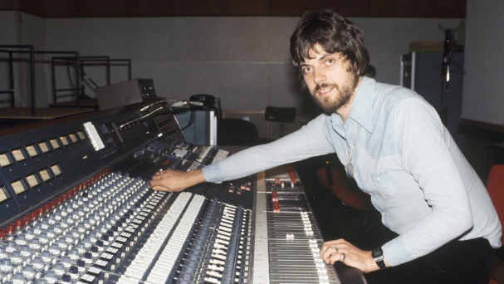

Don’t take my word for it…let’s ask alan
Grab your popcorn, sit back and let the learning happen

Slide 3
Historical context
1920s | Natural reverb of rooms and halls used. Single microphone placed in the room to pick up the reflections of surfaces. The bigger the room the longer the reverb time. Later post 1940s stereo mic techniques were used.
1939 | Hammond company uses springs to created delays to liven the dry sound of the Hammond organ. The technology was developed by Bell Labs’ experimentation with delay on telephone lines.
1947 | Bill Putnam Sr. was the first to use artificial reverb on a recording by using an echo chamber( the studio’s bathroom). The result was a huge hit and being able to control the reverb was a major breakthrough in music production. He later went onto to build dedicated chambers for his studios in Chicago and LA.
1957 | German company EMT releases the first plate reverb, EMT-140 Reverberation Unit. This became an industry standard as it was cheaper than building an echo chamber.
1960s | Leo Fender added Hammond spring reverb into his guitar amp combo and was followed by Marshall and Peavey
1976 | EMT and Dynatron releases the first commercial digital reverb unit, EMT-250
1978 | Lexicon releases the now legendary 224 digital reverb unit.
1999 | Sony releases the DRE S777 convolution reverb using samples of real spaces(impulse responses)
Today | Increased processing power allows a vast variety of software plug-ins( packaged with DAWs) using both algorithmic and convolution techniques.

Slide 4
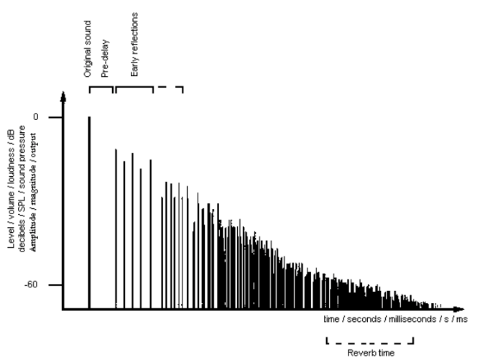
Anatomy of reverb
https://www.youtube.com/watch?v=g1qIcfzhLeQ
Direct Sound-the original dry signal
Pre-delay-the time difference between the direct sound and the very first reflection
Early reflections- the initial reflections that bounces off one or two surfaces
Reverb Time(RT₆₀)-the time the reverb sound decays to 60dB

Slide 5
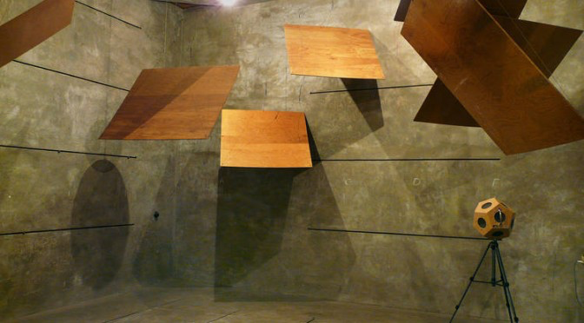
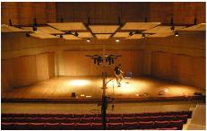
Types of reverb
Echo Chamber
The dry signal is played into a room using a speaker and the microphone placement would be adjusted to control the amount of reverb. The room would be made of various reflective materials and panels( stone, concrete, wood etc.). Some studios used stairwells and garages.
Natural Reverb
An early method was to use an ambient microphone to capture the reflections of the room. More reverb is captured the further the microphone from the sound source.
Later stereo mic techniques were used:
XY coincident, ORTF, Blumlein Pair, Decca Tree, AB spaced pair.
Ambient mic techniques were often blended with close mic techniques

Slide 6
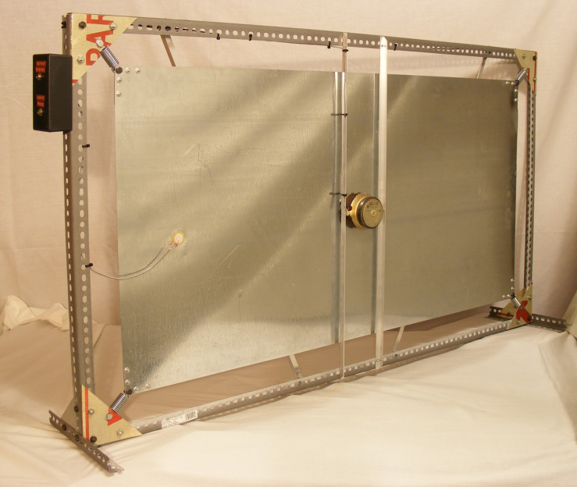
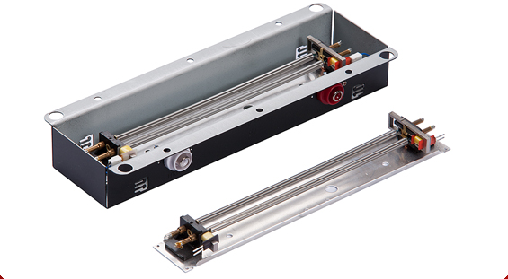
Types of reverb https://www.youtube.com/watch?v=DraJZCQcJfw
Plate Reverb
Consists of a large metal sheet. The audio signal would be sent a “speaker-like” transducer attached to the metal sheet. The vibration would be picked up by a microphone-styled pick-up transducer at the edge of the metal sheet( or plate). The reverb time is controlled by a damping pad which was used to absorb reflections.
Spring Reverb
The audio signal is passed through a spring with a speaker styled transducer on one end and a microphone styled pick up transducer on the other end. It’s a lot smaller and cheaper than plate reverbs and echo chambers. It produced a “twangy” sound and has a mid range boost. Reverb time is controlled by the tension in the spring.

Slide 7
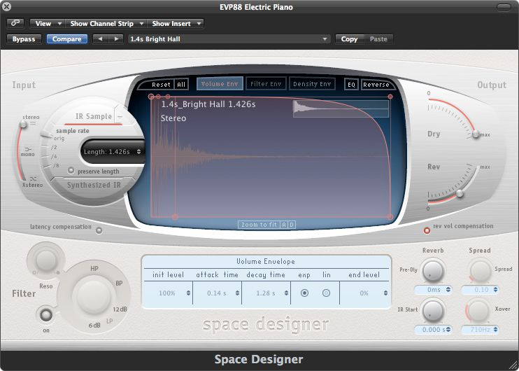
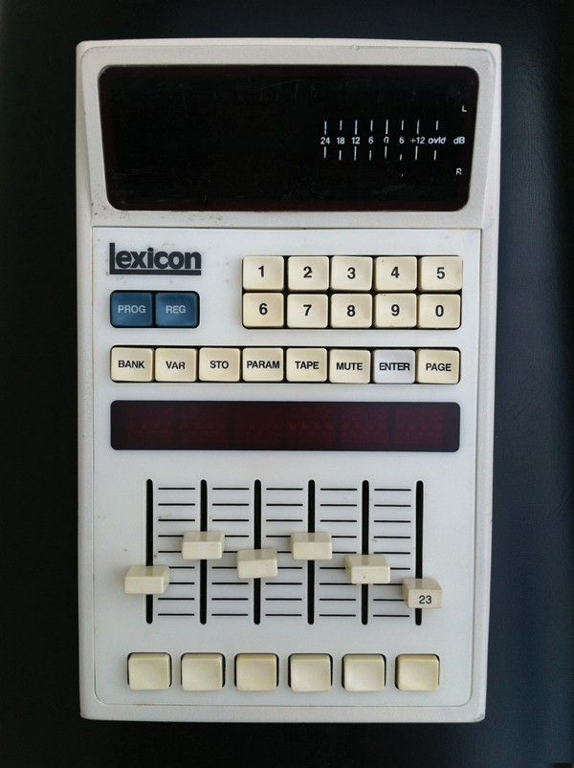
Types of reverb https://www.youtube.com/watch?v=jo4dMGqOhJ8
Convolution Reverb
Convolution reverb takes a sample of a space called an impulse response. This is created by emitting a stimulus(sine wave, sweep, gun shot, clap) into the room.
In theory, you can place your sound into any venue without having to visit or record in it. Takes up a huge amount of processing power.
Digital Reverb
Computer algorithms are used to emulate the characteristics of a real space. The algorithms consisted of many delays with feedback and filters. The main advantage is that all parameters can be easily adjusted. CPU is processor intensive but in the late 90s computers were fast enough to handle the complex algorithms and they were implemented into DAWs.

Slide 8
Write your first paragraph to the following exam question
ESSAY OPENER
Describe the different techniques and technologies that have been used to apply reverb to recordings from 1920s to present day.

Slide 9
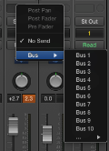

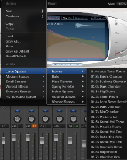
Adding Reverb using Aux Sends
You could insert a reverb plug-in directly into the channel strip of an instrument. However, when you use reverb to simulate a room, you can use aux sends to route some of the signal from a channel strip to a new auxiliary channel strip. You then set up the Aux Track with the desired reverb plug-in, which allows you to add reverb to any instrument by sending its signal to the Aux Track.
Using a bus send to create an Aux Track
You will use a bus send to route a specific instrument to an aux, and insert a reverb plug-in on the Aux Track
On any instrument channel strip, click the Send slot and choose Bus>Bus 1
A new Aux Track is added to the Mixer
On the Aux Track, click the Format button to change it from mono to stereo
On the Aux channel strip, click in the Audio FX section, and choose Reverb>Space Designer
In the Space Designer plug-in header choose one of the PRESETS(Large Space, Medium Space, Small Space etc.)
On the instrument channel strip, click and drag the send level for the desired amount of reverb
Format Button

