Slide 1
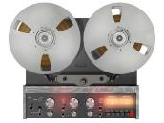
Magnetic tape recording
Experiments in magnetic tape recording had been taking place in Germany since the late 1920s. In 1935 BASF/AEG introduced the ‘Magnetophone’, which recorded and played back magnetic tape. It was originally conceived as a business device for recording dictation.
Recording onto tape allowed producers to cut and splice different takes to produce a ‘perfect’ recording. By 1949 Hi fidelity magnetic tape became the industry standard for recording studios.
Benefits :
Revolutionised the recording industry
Before tape all recordings used the direct(to disc) recording process
Edits can be made by splicing sections and choosing your best take
Multi-track recording started to emerge
New production techniques and effects

Slide 2
MULTI-TRACK RECORDING
Experimenting with multi-track recording led to the following recording techniques:
Overdubbing-layering of multiple parts
Concept albums, where music was composed using the technology as inspiration and part of the musical process e.g. Sergeant Peppers Lonely Heart Club Band-Beatles
Multiple takes of the same material allowed comping of the same part i.e. choosing the best section of a performance and splicing it together
New exciting effects were created e.g. delay, phaser, flanger, chorus etc.
1950s onwards engineers started exploiting tape technology in pop music e.g. Elvis Presley’s “Heartbreak Hotel” slap back echo effect
Musicians and engineers like Les Paul started experiment with overdubbing techniques to isolate and enhance the voice. It was done using multiple stereo(2-tracks) tape machines
NB: All recordings were released in mono(single track) and first stereo recording was in 1958
In the early 1960s 4-track recorders were available
From the late 1960s onwards the technology quickly developed into 8 track, 16 track and 24 track

Slide 3
History of magnetic tape
1930s | Fritz Pfluemer invents magnetic tape German company AEG developed the Magnetaphon K1 using the Pfluemer’s invention. It was demonstrated in 1935 but recording quality was poor.
1940s | Walter Weber develops AC bias which ushers in high fidelity tape recording Jack Mullin used the high-fidelity tape technology to develop his own versions for Ampex 1948 ABC uses an Ampex Model 200 tape recorder for the first delayed radio broadcast of the Bing Crosby show
1950s | Les Paul experimented with this model and discovered by adding a separate playback head you could record alongside previously recorded material, “sound on sound” or Overdubbing Up until 1966 most tape recorders used were 4-track
1960s | APEX MM-1000 first professional 8-track recorder(1966) Updated APEX MM-1000 first professional 16-track recorder(1967) MCI released a 24 track on 2inch tape in 1968 which became the professional standard in the 70s and 80s

Slide 4
Tape machine hall of fame
Studer J37
1964
Studer A800 Multichannel Tape Recorder
Early 80s
A800 MkII 1983
A800 MkII 1986
Ampex ATR-102 Mastering Tape recorder 1976
Notes:
https://www.youtube.com/watch?v=0BFWvku7jxs

Slide 5
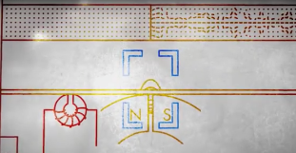
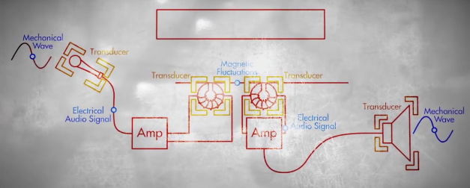
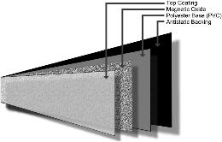
How does it work?
Magnetic coating(iron oxide) placed between 2 plastic strips(analogue tape/magnetic tape) and this is magnetised by the magnetic heads(transducers) of the tape machine. The tape stores a magnetic representation of the changes in electrical current.

Slide 6
Supply Reel
Storage depositary for tape that is ready to be recorded or played
Take –up Reel
Depositary for recorded tape
Parts of the Tape Machine
9. Pinch Roller
Forces the tape against the capstan to achieve even grip by the capstan and therefore even tape speed
1.Tension Arm
Keeps the supply-reel tape taut
2. Idle Roller
Positions the tape at the correct angle for the guide
8. Capstan
Controls the speed of the tape past the tape record and play heads
3. Guide
Lines the tape up for the erase head
4.Erase head
Clears any previous magnetic changes
6.Record head
Realigns the magnetic data on the tape to match the analogue(electronic voltage changes) signal that receives or writes the analogue material to tape.
7.Play head
Reads the magnetic changes on the tape and converts them back to tape recorder circuitry as changes in electronic voltages
5.Tape lifters
Raise the tape away from the tape heads(to prevent wear), only on fast forward and rewind

Slide 7
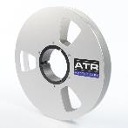
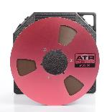
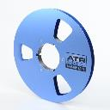
IPS (Inches per second)
The measurement by which the speed of the tape recorder is set.
The speed of the a tape recorder is controlled by the capstan, which turns at a constant speed. The speed of the tape recorder is set and measured by IPS. A typical open reel tape machine runs at 30 IPS, 15 IPS, 7 ½ IPS or 3 ¾ IPS( compact cassette tapes run at 1 7/8 inches). The faster the speed, the higher the quality of high frequency presence in a recording and the lower the background noise.
Tape width, tape properties, binder formulation and thickness are other factors that affect quality
Track count
The number of tracks that can be recorded onto tape is dependent on the width of the tape and the number of record heads on a tape machine.
Standard tape widths:
2 inch tape 16-24 tracks
1 inch 4-16tracks
½ inch 2-16tracks
¼ 2-8 tracks

Slide 8
WOW and Flutter
Zenith
Is a head adjustment to ensure that the head does not lean forward or backwards, but matches the vertical orientation of the tape.
If the capstan turns unevenly on its axis or if the motor varies in speed, wow and flutter will be introduced to the recording. The effect of wow and flutter is a change in pitch for all recorded music on that part of the tape. Cheap tape recorders introduce wow and flutter during recordings, however, better quality tape machines that are not serviced regular suffer from the same issue.
https://www.youtube.com/watch?v=kubz3eSOOVM
Azimuth
Is the angle of the head gap relative to the tape, and should be exactly perpendicular.
Tape saturation
The overload of magnetic tape due to an input signal that is too loud passing from the record head to the tape. Mild saturation often results in a rich warm sound and is associated with the best quality recording.
https://www.youtube.com/watch?v=Fx9PY7AZL7M
bias
A high frequency (typically between 150kHz and 280kHz depending on recorder type and model) signal that is added to the record signal to compensate for the irregularities in the ability of tape to hold flux uniformly.

Slide 9
Group task: Hardware vs software https://www.youtube.com/watch?v=qNkCWJbFDRU
UAD develop the Studer A800 and the AMPEX ATR-102 plug-in to emulate the legendary tape machines.
Group 2-Software
Group 1-Hardware
List the benefits of the hardware devices
Justify why the hardware equipment is better than the software equivalents
List the benefits of the software plug-ins
Justify why software plug-ins and digital emulations are better than the original hardware units.

Slide 10
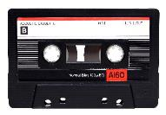
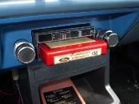
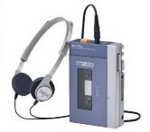
Home Tape market
1969
Dolby Noise reduction was introduced to cassette tapes and it dominated the market and 8 tracks were no more
1964
The first compact audio cassette machines were sold by Phillips. They were originally intended for dictation purposes.
1979
The Sony Walkman became the most popular portable player
1966
Soon afterwards 8 track cartridges appeared in cars

