Slide 1
DIGITAL AUDIO
A system where information is stored in a series of discrete numeric values that can processed, manipulated and stored by a computer system

Slide 2
What is Digital Audio?
Digital audio is a way computers represent sound. Digital is system where information is stored as a series of discrete numeric values that can processed, manipulated and stored by a computer system. Digital audio is therefore as numerical representation of sound waves.
BUT First, we need to convert sound waves to an audio signal(electrical current) using a transducer. This signal traces back and forth motion of an acoustic soundwave so it’s an analogy of the soundwave i.e analogue
Digital sound is stored as numerical values on a hard disk
Analogue sound can be recorded direct-to-disk(vinyl) pre-1940s or magnetic tape

Slide 3
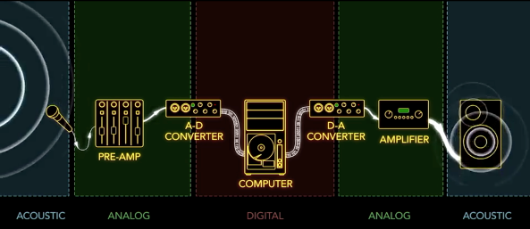
Analogue to digital converter(ADC)
Translates an audio signal and stores it as discrete steps of a numeric value.
Digital to Analogue converter(ADC)
Digital to analogue converter. Takes digital information and translates it back into analogue form

Slide 4
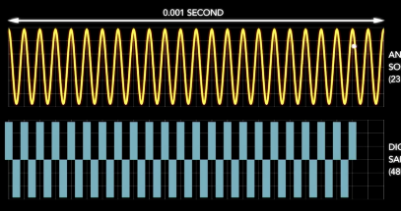
Sample rate
The number of samples of a sound that are taken per second to represent the event digitally.
Common sample rates are 44.1kHz, 48kHz, 96kHz, 192kHz
Nyquist theorem states that a signal must be sampled at a rate greater than twice the highest frequency component of the signal to accurately reconstruct the waveform; otherwise, the high-frequency content will alias at a frequency inside the spectrum of interest.
ALIASING It occurs when a signal above half the sample rate is allowed into, or created within, a digital system. The effect produces unwanted frequencies. That’s why most quality ADCs have an anti-aliasing filter

Slide 5
Bit depth
Describes the potential accuracy of a particular piece of hardware or software that processes audio data. In general, the more bits that are available, the more accurate the resulting output from the data being processed.
Common bit depths 16 bit, 24 bit
Quantisation Noise
The difference between the actual analog value and quantized digital value is called quantization error or quantization distortion. This error is either due to rounding or truncation. The error signal is sometimes modeled as an additional random signal

Slide 6
SAMPLE RATE AND BIT DEPTH
Sample rate refers to the number of samples taken per second (measured in Hz or kHz)
Bit depth refers to the number of possible amplitude measurements.
A 4-bit system has 2⁴ possible measurements
An increase in both sample rate and bit depth will improve the quality of the sample / audio capture
Notes:
Sample rate refers to the number of samples taken per second (measured in Hz or kHz)
Bit depth refers to the number of possible amplitude measurements.
A 4-bit system has 24 possible measurements
An increase in both sample rate and bit depth will improve the quality of the sample / audio capture
Graph adapted under license as Creative Commons Attribution-Share Alike 3.0 Unported. (Source: http://commons.wikimedia.org/wiki/File:4-bit-linear-PCM.svg)

Slide 7
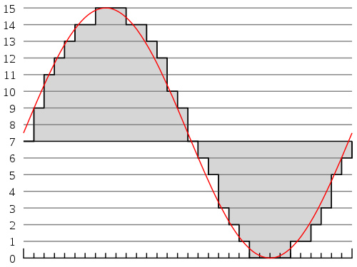
Task-Draw a graph representing a 4bit 24hZ sample rate digital waveform
Table 1 | Table 2 | Table 3 | Table 4
1Hz Sine Wave | 2Hz Sine Wave | 3Hz Sine Wave | 4Hz Sine Wave
Example of a 4 bit 33Hz Sample Rate
1Hz Sine Wave

Slide 8
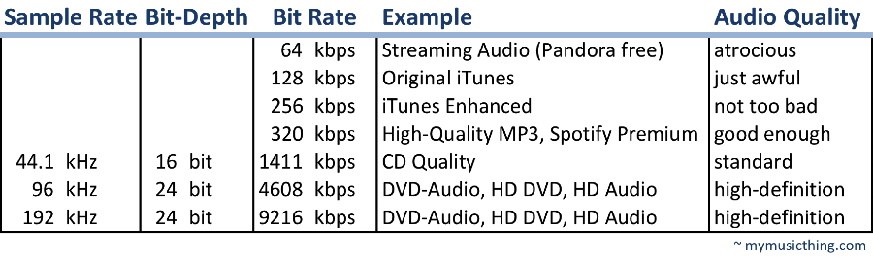
File FORMATs
Uncompressed
wav
Aiff
Lossy compression
Throws away information for example the quieter frequencies to reduce the file size. Good for streaming services
MP3
AAC
WMA
Ogg VORBIS
LosslessLY compression
Like a zip file
FLAC-Free LosslESS AUDIO CODEC
Comrpessor/
decompressor

Slide 9
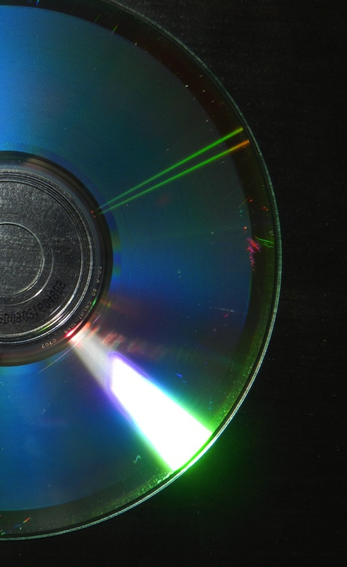
THE RED BOOK STANDARD
This is the specification that CD audio must fulfil
It states that CDs must utilise 16-bit linear PCM sampled at 44100 Hz (44.1kHz).
This standard satisfies Nyquist’s criteria.
Pulse Code Modulation(PCM)
A method used to digitally represent sampled analog signals. It is the standard form of digital audio in computers, Compact Discs, digital telephony and other digital audio applications.
Notes:
This is the specification that CD audio must fulfil
It states that CDs must utilise 16-bit linear PCM sampled at 44100 Hz (44.1kHz).
This standard satisfies Nyquist’s criteria.
CD image licensed under the Creative Commons Attribution-Share Alike 3.0 Unported license (Source: http://commons.wikimedia.org/wiki/File:CD_Diagra.001.jpg)

Slide 10
Analogue vs digital
The following is a quote from Peter Franco & Mick Guzauski, the recording and
mixing engineers who worked on the Random Access Memories album by Daft
Punk.
“We were doing lots of tests with analogue tape… We wanted to see what the
different combinations did; what and how tape could get us certain sounds…
We recorded [parts] both to analogue [tape] and directly to Pro Tools [digital audio
workstation], and later loaded the tape material in the same Pro Tools sessions, so we
could choose what we liked the best… The analogue and digital versions were very
similar but subtly different.”
Describe how the analogue tape and digital recordings would sound different.
Explain why editing in a digital audio workstation is preferred to editing using
analogue tape.

Slide 11
Signal to noise ratio
Analogue tape:
Lower signal to noise ratio(1) resulting in noise such as hiss(1) to being present in recordings.
Noise reduced by using Dolby (1), boosts high frequencies during recording (1) and attenuates them on play back.
Digital:
Better signal to noise ratio / less noise .No credit is given as it links to the analogue tape point, however, the comparison must be made.
Bit depth (1) 16/20/24 (1). More bits gives better the signal to noise ratio (1). Each bit gives (approximately) 6dB higher signal to noise ratio (1). A DIAGRAM OF A GRAPH CAN BE USED TO SUPPORT YOUR ANSWER(A04)

Slide 12
Frequency response
Analogue tape:
Continuous waveform (1) which has a reduced high frequency response and a reduced transient response. This is often describes as warm sound of analogue tape
Digital:
Flat frequency response (1). Sample rate (1) of 44.1 / 48 / 88.2 / 96kHz (1). The higher the sample rate, the higher the frequency response (1).
COMPARATIVE WAVEFORM DIAGRAM IS ACCEPTABLE FOR A04

Slide 13
DISTORTION
Analogue tape:
Saturation (1) is gradual distortion also know as soft clipping (1). This is a desirable distortion which is less harsh than digital clipping(1). Non-linear response to amplitude gives a soft / subtle compression (1).
Digital:
Hard clipping is a harsh and unwanted distortion (1).
COMPARATIVE WAVEFORM DIAGRAM IS ACCEPTABLE FOR A04
Other attributes
Analogue | Digital
Bleed / crosstalk (1). Every time the tape is played, quality reduces / deteriorates over time (1). Wow and flutter (1) slight variations in pitch and speed (1). Print through (1) which is where the music is heard as an echo before it should play (1). Better sound quality with higher tape speed (1). | Quicker / cheaper / possible to transmit via internet / home studio / back up / easy to save (1).

Slide 14
Editing
Digital
Analogue
More tracks / takes (1).
Non-destructive / undoable (1).
Copy and paste (1).
Crossfades / automation (1).
DAW allows user to edit and mix simultaneously (1).
Flex time / audio quantise (1) tightens up timing (1) works best with percussive / rhythmic parts / parts with clear transients (1).
Flex pitch / melodyne / correcting pitch errors (1) draw correct pitches on screen (1).
Clicks/glitches can be edited out by re-drawing the waveform (1).
Razor blade and splicing tape / cut up tape (1), diagonally for a cross fade (1). All tracks would need have same edit point / couldn’t edit tracks individually (1).
Bouncing (1) reducing sound quality / because adds noise / reduces high frequencies (1).
Cueing tape takes longer (1).

Slide 15

Pen and pad time
write it up…
The vocal was digitally recorded using a sample rate of 44.1kHz. Explain why, according to Nyquist’s theorem, this recording quality is sufficient to record this
vocal performance. (4 marks)
The human hearing range is up to 20kHz (1). Nyquist’s theorem states that the sample rate must be at least double the highest frequency in the source audio (1). 44.1kHz is more than double 20kHz (1). Needs a high sample rate to capture the brightness of the vocal (1). The sample rate wouldn’t need to be converted when mastering for CD (1).

