Slide 1
DAW Digital audio workstations
Aims and Objectives
-To be able to identify key studio equipment
-To understand signal flow
-To understand how the equipment connects and work together

Slide 2
Enter the DAW…..
Digital Audio Workstations roots are in digital sampling. 1979 Fairlight released the the CMI(Computer Music Instrument) which was a sampler and synthesizer with a CRT monitor. It ran on a basic operating system and has a step sequencer
In the early 80s with Apple II, Atari ST and Commodore Amiga had better processing power which could handle digital audio editing. Digidesign launched Sound Designer(1984) which was software used to edit samples for samplers such as the E-mu Emulator II and the Akai S900. It eventually was bundled with Mac-compatible hardware to form Sound Tools(1986). Pro Tools 1.0 was released in 1991 and in 1995 Digidesign merged with Avid. Pro Tools 5(1999) was the first version to integrate a MIDI sequencer
Steinberg Research start in 1984 and was one of the first to adopt the new MIDI protocol. The first release called Multitrack recorder was unsuccessful, however, the Pro 16 with a 16 track sequencer and real-time recording was a powerful package for its time. In 1986, Pro 24 added 8 more tracks and more sequencing features. Pro 24 came to an end in 1989 with the release of Cubit but later renamed Cubase. In 1992, Cubase Audio arrived and integrated MIDI sequencing and Audio recording.
C-Labs( also known as Emagic) released a MIDI sequencing package called Notator in 1988. Emagic releases a cross-platform version in 1993 called Notator Logic. They decided to drop the Notator and just called in Logic. In 1995, Emagic releases a PC version of Logic and continued to release PC/Mac versions until 2002 when Apple bought Emagic. At the time Logic version 6 was released.

Slide 3
POPULAR MUSIC PRODUCTION SOFTWARE

Slide 4
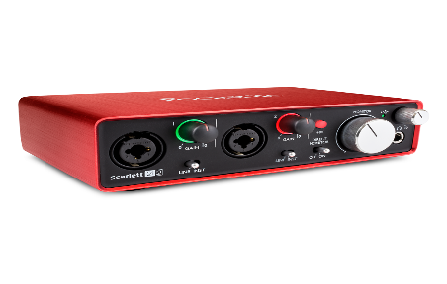
Audio Interface
Converts audio signals( electrical) into digital signals( binary) and back again
Has both analogue connectors( to connect to microphones, monitors and mixers) and digital connectors( to connect to the computer)
Connects to the computer via USB, Firewire or Thunderbolt
ADC( analogue-to-digital convertors) determines the quality of the recording
DAC( digital-to analogue convertors)
Key Specifications
Bit Depth
Sample Rate
Inputs/Outputs
Example: Focusrite Scarlett 2i2
24bit 192kHz 2 input 2 outputs
MOTU, Focusrite, M-Audio, Apogee, Universal Audio, RME, Roland

Slide 5
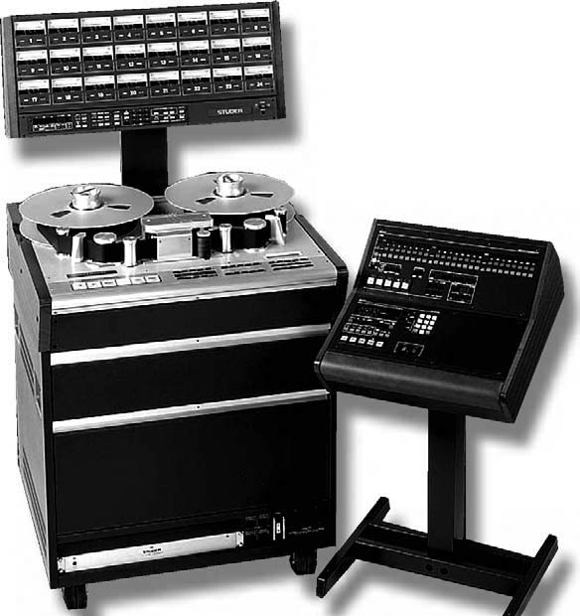
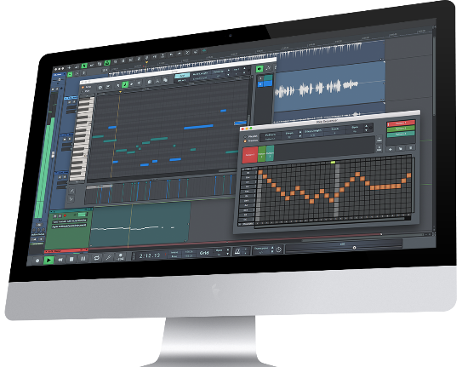
Multi-track recorder
A recording device that captures, stores and playback multiple layers of sound
Today multi-track recording is a combination of a computer( Mac or PC) running music production software( Reason, Pro Tools, Cubase,Logic Pro etc.)
Music Production software(like Logic) allows you to record multiple sound sources at the same time or you can layer them one at a time(overdubbing)
Tracks can then be edited and manipulated to create a polished final mix
SEQUENCER: Records MIDI data( not to be confused with digital audio) and is integrated in most music production software.
Pro Tools, Cubase, Nuendo, Sonar, Digital Performer, Ableton, Reason….

Slide 6
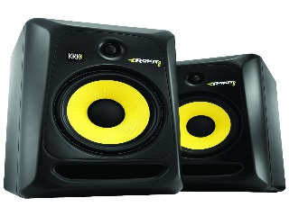
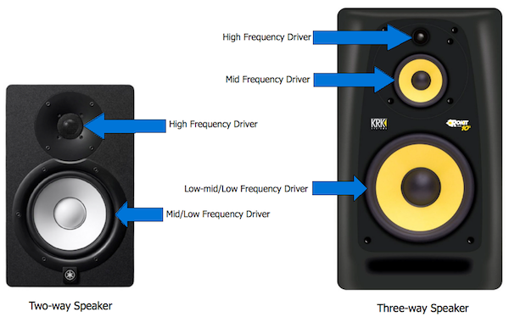
Studio Monitors
Unlike loudspeakers, studio monitors are for detailed listening in close proximity to mix engineer. A flat frequency response( no colouration of sound) is a requirement for a good monitor speaker
Nearfield Monitors – Optimum range 1-2 metres
Midfield Monitors – Optimum range 2-4 metres
Full Range - reproduces as much of the audible frequency range as possible
Frequency Response - Level of Frequency in Hz (hertz) needed for a Response in Db (decibel) – same as for a microphone but in terms of output!
Two Way – Tweeter and Woofer
Three Way – Tweeter, Mid and Woofer
Passive – not powered
Active – powered i.e Kettle Leads to individual speakers
Power Rating - electrical power transferred from an audio amplifier to a loudspeaker - measured in watts
Genelec, KRK, Adam, Mackie, Dynaudio, Focal, Yamaha….

Slide 7
Mixer Sections
What is a mixer? also known as “Mixing Desks”or “Mixing Console”
An electronic device that combines and blends various audio signals
Mixers have input and output sections
The bigger the mixer the more inputs and outputs it has which gives the user more flexibility
Channel Sections:
A collection of channel strips. Usually identical and offers mono inputs
Master Section
Central control where you find global functions.
e.g. Control room level, Headphone level, Master Aux Sends etc.
Digital vs Analogue
Professional analogue mixer are generally larger and each channel has a physical channel strip which is replicated depending the amount of input channels
Analogue circuitry is generally high quality and can be “driven” more. Saturation rather than distortion.
Easier to see all channels and fader position
Requires a high quality audio interface if you using a DAW
Digital mixer will have significantly( i.e dynamic processors on every channel, parametric EQ and digital FX) more features in a smaller, more compact format.
Usually has firewire and USB connectivity to act as an audio interface( no extra equipment required)
Neve, Solid State Logic(SSL), Audient, Midas, Yamaha, Allen and Heath, Soundcraft…..

Slide 8
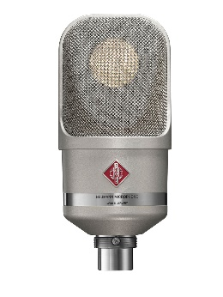
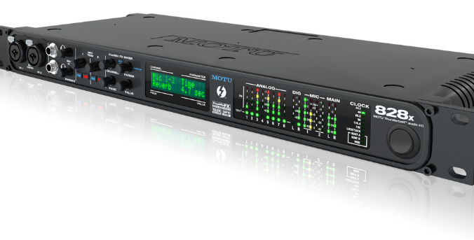
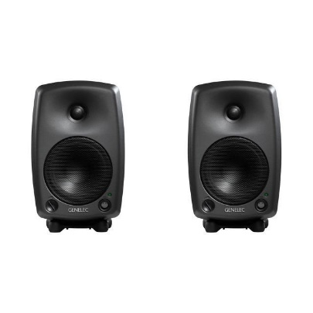
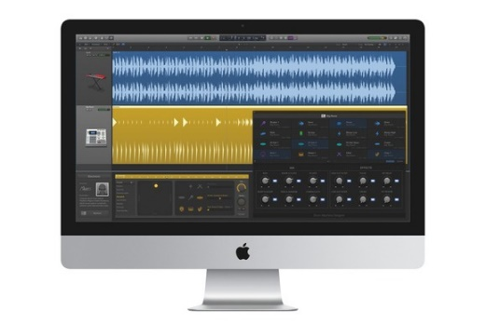
Signal flow diagram
Task 1
Draw a signal flow diagram using the following equipment. Make sure you label all your cabling as well as arrows for the direction of the signal.
Nuemann TLM 107 condenser
Genelec 8030A
iMac running Logic Pro
MOTU 828 thunderbolt audio interface
Extension: add a DI and 24 channel analogue mixer to the set up

Slide 9
TASK 1 -Signal flow diagram
Draw a signal flow diagram using the following equipment. Make sure you label all your cabling as well as arrows for the direction of the signal.
Nuemann TLM 107 condenser
Genelec 8030A
iMac running Logic Pro
MOTU 828 thunderbolt audio interface
XLR
XLR
XLR
Thunderbolt
Extension: add a DI and 24 channel analogue mixer to the set up

Slide 10
Task 2
Daw set up
Scenario
You have been asked by a singer/songwriter to set up a home studio to allow her to record her songs at demo quality. She has a Mac Pro but is relying on you to advise her on the software. Your budget is £3000.
Make a list of the equipment you will need and price it up by checking the online retailers.
https://www.thomann.de/gb/
https://www.andertons.co.uk/
https://www.studiospares.com/
https://www.studiospares.com/
Extension: make an alternative suggestion with reasons why she should increase her budget

Slide 11
Analyse this set up
How is all the equipment set up?
What do you think is the main purpose/application of the set up?
Discuss the room and recording environment.

