Slide 1
Mastering
What is it?
It is the final stage of the production process before the recording is sent for distribution.
Mastering engineers must ensure that the final mix has a good level and tone, and that all material on the album is consistent, In addition to this, he needs to ensure it is consistent with other commercial material
( usually of the same genre or style)
What do they do?
The most common scenario for a mastering engineer is to make the mix louder. Everyone wants their music to be as loud as music played on radio. Why? Because the listener perceives softer music as inferior quality, which we know as sound engineers are not always the case.
Enhance a good mix with some subtle EQ and dynamic processing. The ideal situation for a mastering engineer, making some that’s good, better
Fixing a problem in the mix. Worst case scenario. Only the exceptional can pull this off. Often the track has to be returned the mix stage.

Slide 2
Brief history https://www.youtube.com/watch?v=mcK4cShDhIE
Transfer Engineers developing into Mastering Engineers
Too much bass on a vinyl will cause the styli to jump out of the groove. Engineers would have to apply filters to soften the bass load at specific points while still maintaining a decent level.
The simple process of applying EQ and repairing(or preparing) material for a specific medium(or format) became a highly skilled and creative process.
The early days of recording….Direct-to-disc
( pre-magnetic tape)
Performances were recorded using a single microphone captured direct to disc, along with all the vibrancy and imperfections of the original performance. The recording process was undertaken by the recording( or cutting) engineer. It was a singular process.
Magnetic Tape
The invention of magnetic tape in 40s created a shift in the recording process. There was 2 distinct stages, the capturing of the performance and cutting the performance to disc. The recording engineer was responsible for capturing the performance. The transfer engineer(or mastering engineer), ensured that the music on tape was transferred to disc( master copy), retaining the sonic qualities of the original source recording.
Multi-track Recording
As tape developed, multi-track recording forced the recording process to evolve into 3 stages in the 70s and 80s, all requiring highly skilled sound engineers for each process:
Capturing the performance-Recording engineer
Balancing the all the tracks- Mixing engineer
Cutting music to disc-Mastering engineer
Digital Age( The CD)
In the late 80s CD became the medium of choice. This presented new challenges for the mastering engineer. Digital had a limit that could not be exceeded 0dBu. Downsampling causes quantisation errors for quiet levels. This led to new techniques to ensuring the music was at its maximum level

Slide 3
File FORMATs
Uncompressed
wav
Aiff
Lossy compression
Throws away information for example the quieter frequencies to reduce the file size. Good for streaming services and sharing
MP3
AAC
WMA
Ogg VORBIS
LosslessLY compression
Like a zip file
FLAC-Free LosslESS AUDIO CODEC
Comrpessor/
decompressor

Slide 4
Your product…Compact disc
THE RED BOOK STANDARD
This is the specification that CD audio must fulfil
It states that CDs must utilise 16-bit linear PCM sampled at 44100 Hz (44.1kHz).
This standard satisfies Nyquist’s criteria.
Pulse Code Modulation(PCM)
A method used to digitally represent sampled analog signals. It is the standard form of digital audio in computers, Compact Discs, digital telephony and other digital audio applications.
Notes:
This is the specification that CD audio must fulfil
It states that CDs must utilise 16-bit linear PCM sampled at 44100 Hz (44.1kHz).
This standard satisfies Nyquist’s criteria.
CD image licensed under the Creative Commons Attribution-Share Alike 3.0 Unported license (Source: http://commons.wikimedia.org/wiki/File:CD_Diagra.001.jpg)

Slide 5
dither
Noise Shaping minimizes the side effects caused by bit reduction (downsampling), by moving the quantization noise spectrum to the frequency range above 10 kHz (the least sensitive part of the range of human hearing). This process is technically known as spectral displacement).
When bouncing your 24 bit recording to the 16 bit Red Book standard( downsampling), the change of resolution will result in quantisation errors.
Dithering is essential to reduce the errors caused by downsampling.
Logic’s dithering solutions
Apogee uv22hr
Apogee is a well established manufacturer of A/D convertors and digital interface. This dithering algorithm offers the best resolution from 24bit to 16 bit. Used for material with a wide dynamic range, as it is very accurate at low levels e.g. classical
POW-r( Psychoacoustically Optimized Wordlength Reduction) algorithm
Considered one of the best available dithering algorithms and widely used by mastering engineers.
POWr #3 (Noise Shaping): Additional, optimized noise shaping is used, which can extend the dynamic range by 20 dB within the 2–4 kHz range (the range in which human hearing is most sensitive).
POWr #2 (Noise Shaping): Additional noise shaping is used over a wide frequency range, which can extend the dynamic range of the bounce file by 5–10 dB.
POWr #1 (Dithering): A special dithering curve is used to minimize quantization noise.
Notes:
This is the specification that CD audio must fulfil
It states that CDs must utilise 16-bit linear PCM sampled at 44100 Hz (44.1kHz).
This standard satisfies Nyquist’s criteria.
CD image licensed under the Creative Commons Attribution-Share Alike 3.0 Unported license (Source: http://commons.wikimedia.org/wiki/File:CD_Diagra.001.jpg)

Slide 6
Mastering tools
EQ
LINEAR PHASE EQ
COMPRESSOR
MULTIBAND COMPRESSOR
LIMITER
ENHANCERS
SUB BASS
EXCITER
METERING
STEREO IMAGING
SPREAD
REVERB

Slide 7
Mastering – Essential Steps
Bounce:
Set locators at the start and end of project
Bounce(cmd+B) all tracks at PCM (WAVE) 24bit 44.1kHz( no dither, no normalise)
Project:
Create a new Logic Project
Drag all tracks on separate audio tracks
Create a summing track
Order and Label:
Track Sequencing – decide on the order of tracks
Track Numbering
Track Markers
Edit and balance:
Processing techniques: EQ, Compression and Limiting.
Topping and Tailing – clean fades, no clicks
Automate Levels
Cross Fades – can be done at itunes burning stage if not ‘mixing’ tracks together
Finishing:
Bounce and Burn
Front cover, titles, track listing and relevant information

Slide 8
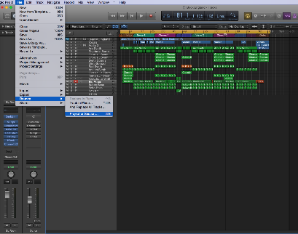
Bouncing your project
pre-master
Set left and right locators
CMD+A selects all regions> U sets locators around the regions selected
File>Bounce>Project or Section( cmd+B)
Bounce Dialogue settings:
PCM 24 bit, 44.1kHz, Interleaved, No Dither, Normalise off
Create a mastering folder and save the file in it.

Slide 9
Setting up a mastering project
Create a new Logic project
Drag all 24bit pre-master bounces into the project
Create a summing track> Name it CD Master
Arrange the regions into your track sequence (Track 1, Track 2 etc)
Set markers at the start and end of every song and name them starting with track 1 and the name of the song
Import reference tracks( make sure they not in your CD master summing stack track)
Create a stereo track in the arrange window by control-clicking on the stereo output channel on your mixer

Slide 10
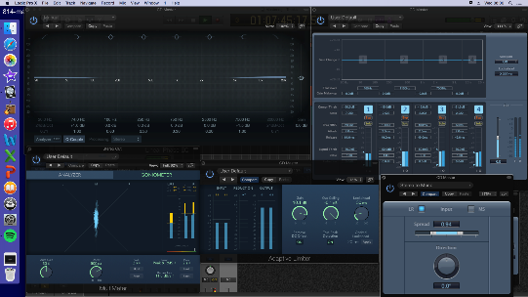
Essential Mastering tools
AIMS: A consistent sound throughout the album and sonically consistent with commercial material.
THE PROCESS IS NOT TO FIX MIXING ISSUES
LINEAR PHASE EQ
Same parameters as Channel EQ, however, it uses more processor power and preserves the phase of the audio signal. This is ideal on stereo tracks and therefore is suitable mastering
You will apply EQ to each track to enhance(subtly) specific frequency band. You can use MATCH EQ plug-in to analyse the EQ and apply it to your track.
MultiMeter
Essential for checking frequency spectrum and phase issues. Insert a Mulitmeter on your Stereo Bus and play your reference track to check the average level, phase correlation and frequency response.
Adaptive Limiter
The limiter ensures your mix does not exceed unity gain(0dB). It’s the final stage to get the maximum overall level.
Multipressor
This Multiband compressor allows you the flexibility of compressing specific frequency ranges and is ideal for mastering. For example, if your track is lacking bottom end you can add more punch by just compressing the lower frequencies and the mids and highs will not be processed.

Slide 11
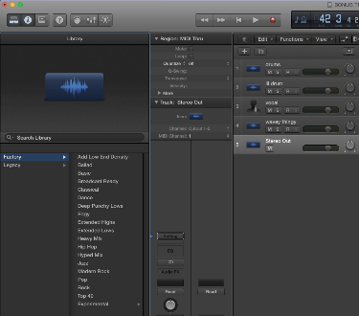
Don’t know where to start, use a logic preset
Logic has a library of mastering presets to get you started
WARNING!! These are generic presets and might not be suitable for your material. A good mastering engineers listens to the mixes and decides which tools will enhance the song
Make sure you created a Stereo Out track in the arrange window by control-clicking>Create Track on your stereo out bus
Click on the the Stereo Out bus and click the Library button at the top right corner. The library presets will pop up
Select a preset from the Factory list. Basic is a good place to start.
If you created a CD master summing track. Drag the effects from the stereo out bus to your CD Master track. ( If you don’t do this the mastering FX will be applied to your already mastered reference tracks) NB: Make sure the order of the FXs are exactly the same.

Slide 12
Keep it consistent
Apply a Multimeter to your stereo out bus and keep checking that your track is consistent with your reference track.
Your ears are the main tools, however, your monitoring system might miss certain key frequencies or you can’t hear a phasing issue. This is when the multimeter becomes essential.
Keep checking!! And play your masters on various systems(e.g. phone, car, studio monitors, headphones…)

Slide 13
Finalise
When you happy with your mastered tracks and they are consistent with each other and your commercial reference tracks it’s time to finalise to CD.
Bounce each track one at a time into a designated CD Final folder.
Make sure your solo the track you want to bounce and have one final listen.
Set your left and right locator around the track you want to bounce( click the region and press U) and check the fades( top and tail).
Bounce the track as a PCM> WAVE> 16bit> 44100>interleaved>POW-r1 dithering( for smooth downsampling). Name the track-TRACK 1, etc.
Create a playlist in iTunes. Arrange the tracks and burn to a CD

Slide 14
Written task-essay 16 marks
Give an overview of the processes used during mastering. How has the sound of
masters changed since 1970?

