Slide 1
Depth and Detail in your mix
Component 1

Slide 2
Aims and objectives
Identify the differences between mono and stereo recordings
Explain the difference between mono and stereo
Evaluate unfamiliar commercial recordings by making judgments on production techniques used in a specific era
The SSS
-participate in all classroom discussion
-justify all answers and write them down

Slide 3
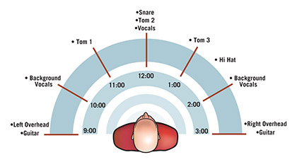
Direct to tape mono recording(1930-1963)
Key Info
YOU NEED TO KNOW THIS
Monophonic (or Monaural) is a single channel of audio. All playback systems and more importantly radio were monophonic in this era.
Panoramic Potentiometer( Pan pot) is used to place the audio signal in the stereo field
Stereo(stereophonic or binaural) is two channels of audio( Left and Right). All analogue tape machines were capable of stereo, however, the music was released on vinyl in mono. Producer used 1 track for the vocals and the other for all other instruments.
NB: Mono sound can be played out of many speakers but it is just reproducing a copy of the same signal.

Slide 4
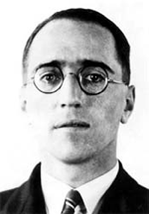
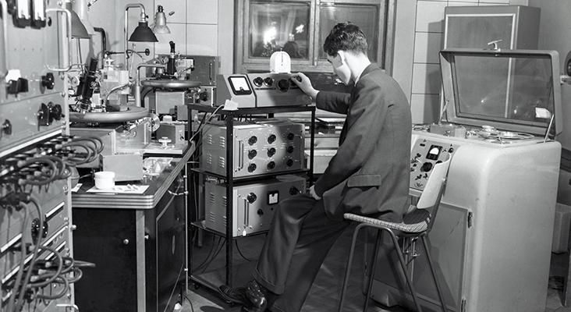
Direct to tape mono recording(1930-1963)
Contextual
Info
Binaural sound was invented by Alan Blumliem in 1931. He worked for EMI and was a prolific inventor and engineer. He created a system whereby a single stylus(needle) can read 2 channels of audio( this was achieved by complex cutting of the grooves).
1934 Blumlien used stereo techniques to record Mozart’s Jupiter Symphony conducted by Sir Thomas Beecham at Abbey Road studio and in 1935 created a test movie to display the capabilities of stereo.
1940 Disney’s Fantansia was the first movie to use Fantasound( i.e. stereo)

Slide 5
TASK: LISTENING
LISTEN to the 2 versions of Stomping at the Savoy made famous by Benny Goodman’s Band. Jot down a few points and discuss at your tables
Which one was recorded in 1936? Give one reason for your answer.
Which one made use of the stereo field(if any)? Explain how the stereo field was used.
In your view, how has stereo changed the way music is produced

Slide 6
TASK: ANALYSIS
Listen to Track 1 and 2 in (Music>AS Music Technlogy>Resources>Component 3). Use the stereo worksheet:
Identify the instruments being played.
Draw their position in the stereo field
Discuss the use of the stereo field.
Which version was the original?
When was the original track recorded?
Was it 2 different recordings of the same song?

Slide 8
Aims and objectives
To be able to use the stereo field effectively
To understand the concept of stereo
To add depth to a mix
To improve your C1 mix

Slide 9
Stereo Image-The “magical”, imaginary space between the Left and Right Speaker
Localisation-concerned with where the sound appears to come from on the left-right axis.
Stereo width-how much of the stereo image the sound occupies. A piano can be wider in image than a vocal.
Stereo focus-how focused the sound is. A sound can come from a very distinct point or appear to emanate from “somewhere over there”.
Stereo spread-how various elements are spread over the stereo field.

Slide 10
Stereo Balance
Level balance between the left and right is important to avoid a one sided mix. This results in an unpleasant image shift.
Always check your left and right levels and make level adjusts to ensure the mix is balanced.
Another undesirable use of the stereo field is the a near monophonic mix, without any use of the sides but everything is gathered in the centre. This is called an I-Mix
Where there is little use of the centre and everything is spread to the side, this is called a V-Mix.
Extreme Left, Right and Centre mix is called a W-Mix.

Slide 11
Task 1
Import the audio into Logic-FULL SPREAD, MIX1, MIX2, MIX3 and MIX4 found in Music\A2 Music Technology\0_MIX TASK\Stereo
Identify the I-Mix, V-Mix, W-Mix and Right Hole mix
Make sure you L and R are working on your headphones
Mix 1=W-Mix
Mix 2=I-Mix
Mix 3=V-Mix
Mix 4=Right Hole

Slide 12
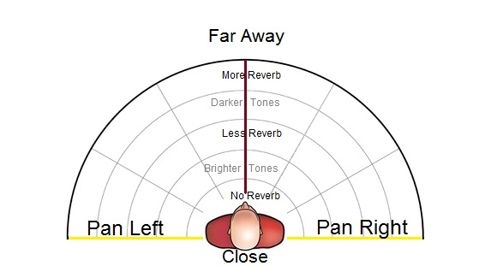
Depth in a mix
Our aim is to have a coherent depth of field. Think about where all the instruments are placed on stage. Vocals up front, drums further back and guitars on the side etc. The only time we want to move depth of field is when a soloist steps up front and plays. Leaving the soloist languishing at the back ,won’t make an effective mix. We use reverb and volume to exploit depth.
Remember, sounds panned to the sides will appear closer than those panned in the centre.

Slide 13
Task 2
1. Use the stereo spread worksheet to place the different elements of one of your reference tracks in the stereo field.
2. Now, check your stereo spread and depth, arrange your elements similar to your reference mix.

Slide 14
Direction Mixer in Logic
The Direction Mixer allows you to truly place a STEREO track in a stereo mix. Your balance pan pot will adjust the level and right levels, therefore panning to the right will make the left content softer, not ideal for a great sounding stereo piano, acoustic guitar or drum kit bus.
Use the Direction knob to place the stereo track in your mix.
Use the the Spread parameter for width. 1.00 is the original width, anything less is narrow and more is wider.

Slide 15
Stereo Spread in Logic
Stereo Spread is used mainly as a mastering tool( i.e. on your stereo bus)
It can extend your stereo base and give your mix that final bit of width
It distributes frequency bands from the middle frequency range to the left and right channels
Keep the Lower Int value low and avoid setting the Lower Freq below 300Hz
Order should remain at 8 bands
BE CAREFUL: it can ruin you mix my making is sound unnatural or shift you stereo image

