Slide 1
MIDI
MUSICAL INSTRUMENT DIGITAL INTERFACE

Slide 2
Starter-5 minutes 5 questions
What does MIDI stand for?
When was MIDI technology invented?
What is the difference between recording audio and MIDI?
How many different velocity values are there?
What is a sequencer?

Slide 3
Starter-5 minutes 5 questions
What does MIDI stand for? MUSICAL INSTRUMENT DIGITAL INTERFACE
When was MIDI technology invented? 1983
What is the difference between recording audio and MIDI? MIDI is a protocol used to communicate specific information from one MIDI compatible device to another.
How many different velocity values are there? 0-127 or 1-128 i.e 128
What is a sequencer?
A device(or software program) that records MIDI data

Slide 4
AIMS and objectives
Explore the development of MIDI
Look at various MIDI compatible devices
Explore the capabilities of MIDI
Understand how MIDI is implemented in DAWs today

Slide 5
What is MIDI?
MIDI is a protocol established in the early 1980s to allow different devices to exchange data
Electronic Instrument manufacturers were interested in adopting a standard to allow different keyboards to communicate with each other
MIDI does NOT carry any audio information

Slide 6
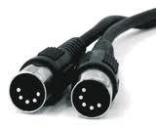
How does midi work
A MIDI interface is required to connect different devices is a MIDI system
MIDI standard uses 3 ports IN, OUT and THRU all connected with a 5 pin DIN cable
MIDI IN-receives the data
MIDI OUT-sends data
MIDI THRU-sends exact copy of the messages received from the IN port

Slide 7
MIDI system

Slide 8
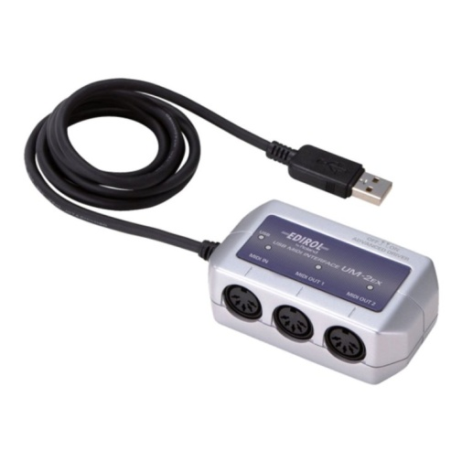
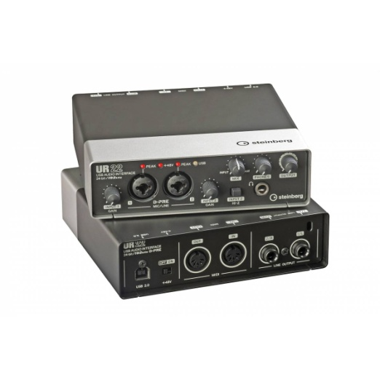
MIDI INTERFACES
Most Hardware MIDI devices(Keyboards, Synths, Samplers etc) are equipped with MIDI ports
Computers require a MIDI interface to connect to external MIDI devices
Interface connect to computers via PCI card, USB and firewire
Most audio interfaces come equipped with MIDI IN, OUT, THRU ports

Slide 9
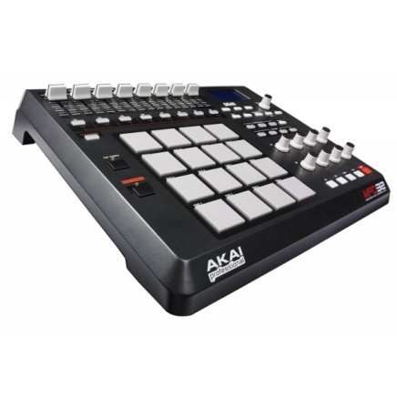
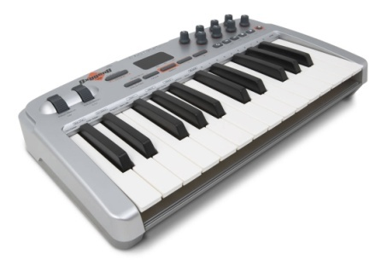
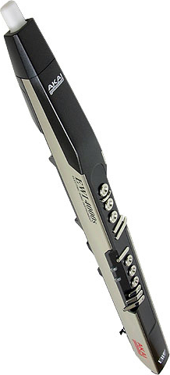
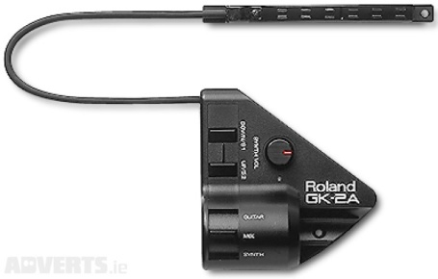
MIDI CONTROLLERS
MIDI controllers transmit MIDI information
MIDI controllers do NOT produce sound and it needs to be connected to a sound module, synthesizer or sampler.
Types of controllers-keyboard controller(most popular), wind controller, guitar controller(pick-up), pad controllers, rotary knobs, sliders, pedals

Slide 10
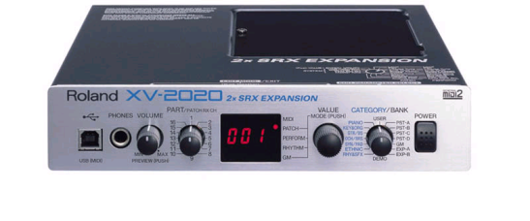
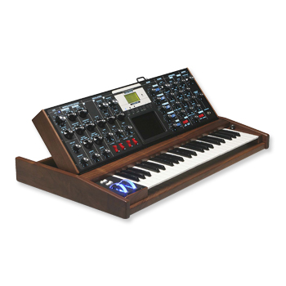
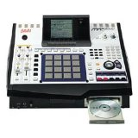
SOUND GENERATORS
Sound Module is a device that has sounds stored on-main use is to expand sound library
Synthesizer Samplers

Slide 11
Task: MIDI system
In room 802, there’s a typical MIDI set up. Draw a diagram clearly labelling the various MIDI devices. You diagram must include the following( ensure you include makes and models of equipment):
MIDI controller
MIDI sound generator
MIDI sequencer
MIDI interface
Clearly label how the data is transferred to these devices including cables e.g. 5 Pin Din Cable, USB etc.

Slide 12
General MIDI is standard adopted by manufacturers which allows different devices from different companies to share the same protocol
MIDI channels-16
Drum Channel always Channel 10
128 values
128 Instrument Sounds
Yamaha uses XG and Roland uses GS

Slide 13
Program Change-Instrument Sounds

Slide 14
MIDI
MIDI MESSAGES

Slide 15
MIDI Messages
Messages are divided in 2 main categories: Channel Messages and System Messages
Channel Messages | System Messages
Channel Voice: Note On, Note Off Monophonic aftertouch, Polyphonic aftertouch, Control Change, Pitch Bend, Program Change | System Real-time: timing clock, start, stop, continue, active sensing, system reset
Channel Mode: All notes off, Local Control on/off, Poly On/Mono On, Omni off, All sound off, Reset all Controllers | System Common: MTC, Song Position pointer, Song Select, tune request, End of SysEx System Exclusive

Slide 16
Channel voice messages
Channel Voice Messages carry information about the performance, e.g. which note we played and how hard we pressed the trigger on the controller.
Note ON | The message is sent every time you press a key/trigger on a MIDI controller. It includes information about the note( 0 to127 or C-2 to G8), the MIDI channel(1-16) and velocity on( how hard you pressed the key: value 0-127)
Note OFF | The message is sent when you release the trigger and includes velocity-off parameters
Aftertouch | The message is sent if you press down harder on a key/trigger after you a Note ON message is received on a sound generating device. Aftertouch triggers parameters such as vibrato, volume, pan etc. Monophonic Aftertouch affects entire range of keyboard. Polyphonic Aftertouch affects individual keys.

Slide 17
Channel voice messages
Pitch Bend | This message is controlled by the pitch-bend wheel on a keyboard controller. It allows you to raise or lower the pitch of the notes being played. It is one of the few MIDI data that do not have a range of 128 steps. In order to allow a more detailed and accurate tracking of the transposition, the range of this MIDI message extends from 0 to 16,383. Usually, a sequencer would display 0 as the center position (non-transposed), +8191 fully raised and –8192 fully lowered.
Program Change | This message is used to change the patch(sound/instrument) assigned to a certain MIDI channel. Value Range 0-127. Sounds are stored in Banks of 128 programs. Bank Change controller message is required to access more sounds.

Slide 18
CONTROL CHANGE
These messages allow you to control certain parameters of a MIDI channel. There are 128 CCs (0–127); that is, the range of each controller extends from 0 to 127.
Most Commonly Used CCs
CC#1 Modulation | Sets the modulation wheel to the specified value. Usually this parameter controls the vibrato effect
CC#7 Volume | Controls the volume level of a MIDI channel
CC#10 Pan | Controls the pan of a MIDI channel: 64=center, 127=100% right and 0=100% left
CC#64 Sustain | Controls the sustain pedal function of a MIDI Channel. It has 2 positions: 0-63=off and 64-127=on

Slide 21
TASK: ANALYSING MIDI DATA using the event list editor
Drag the MIDI file into Logic and answer complete the table:
NB: change BPM to 109, the bass part starts in bar 2
In bar 6 of the bass track, a MIDI controller has been used to add musical expression to the performance. Describe the controller in the table below.
MIDI controller number | MIDI controller name | Highest value reached in bar 6

Slide 22
TASK: ANALYSING MIDI DATA using the event list editor
Drag the MIDI file into Logic and answer complete the table:
NB: change BPM to 109, the bass part starts in bar 2
In bar 6 of the bass track, a MIDI controller has been used to add musical expression to the performance. Describe the controller in the table below.
MIDI controller number | MIDI controller name | Highest value reached in bar 6
1 | Modulation | 127

Slide 23
Written task unit 4 style(16 Marks)
Discuss how MIDI technology is implemented in DAWs(Digital Audio Workstations) today.
Key Points:
MIDI sequencers are integrated into top Music Production software e.g. Logic , Pro Tools, Cubase etc.
MIDI editing capabilities with powerfully MIDI editors to manipulate data and messages
GM compatible
Piano Roll, List, Hyper editors
Automation of MIDI messages e.g lanes in the Piano editor
External MIDI tracks to send data to MIDI compatible hardware

Slide 24
Advanced Sequencing
Using advanced quantize features for a less mechanical performance
Using the MIDI transform for a more realistic sequence

Slide 25
Advance quantize
The Q settings in the Inspector section gives your a variety of options to modify your MIDI events

Slide 26
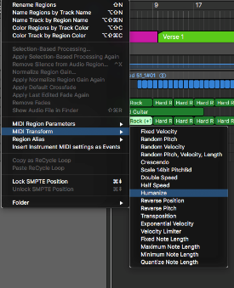
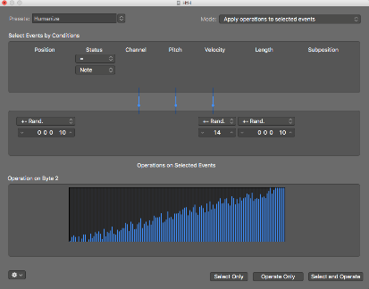
MIDI TRANSFORM WINDOW
Allows you to alter MIDI events easily and you don’t have to go through the tedious process of changing individual notes in the piano. NB: It applies random values and will not apply specific and accurate MIDI editing.
The HUMANIZE preset is the most useful as it randomizes Position, Velocity and Length.
Steps
Click on the region you want to HUMANIZE
Select Function in the arrange or Piano Roll Windows
Select MIDI Transform>Humanize
In the MIDI Transform window click Operate Only.

