Slide 1
Brief history of electric guitars
Brief history of electric guitars
1920s | George Beauchamp develops the first guitar to use a pick-up( horse-shoe magnet and wound copper coil). A Hawaiian styled guitar played on the lap. Beauchamp and Adolf Rickenbacker set up the Electro String Company to manufacture the “frying pan”
1930s | Lloyd Loar, an engineer for Gibson, invented the first Spanish style electric guitar( played standing or sitting) called the Viviphone in 1933. Gibson produces the ES( Electro Spanish) 150 in 1936 considered to be the first commercially successful Spanish-style electric guitar. The hollowed-bodied ES 150 was popular amongst jazz musicians but it’s main flaw was feedback.
1940s | Les Paul invents the Log in 1946 which was the first solid-bodied guitar, which reduced the feedback problem of the hollow-bodied guitar. At the same time, Les Paul friend Leo Fender, was experimenting with the solid-body idea.
1950s | Leo Fender launches the Broadcaster in 1951, later renamed the Telecaster Fender Precision Bass 1951 and 1954 Fender Stratocaster launched Gibson launches the Les Paul design featuring the P90 pick-ups in 1952 1957 Gibson Les Paul features a new type of pick-up called Humbuckers
1960s | Fender designs the Jazzmaster and Jaguar
80s- present | 1980s the superstrat designs with low actions for tapping techniques and fast virtuosic playing manufactured by Jackson and Ibanez 2002 the Line 6 Variax modelling guitar developed to emulate classic Fender and Gibson designs

Slide 2
HALL OF FAME
Gibson ES series
Fender Telecaster
Fender Stratocaster
Gibson Les Paul

Slide 3
1.Body
Electric Guitar bodies varies from solid wood or “hollow” designs.
Examples:
Fender Strat solid body
Gibson ES150 hollow body
Parts of Electric guitar
8.Wammy bar
A lever attached to the bridge to enable the player to quickly vary the tension, changing the pitch to create a vibrato, portamento or pitch bend effect
2.neck
Strings are stretched along the neck, which is shaped so a player can place their fingers around it to play notes
7.Pickup selector
Used to switch between pickups which can dramatically change the tone of the guitar. Usually 3-way pickups
3.Fretboard and frets
This is the area in front of the neck where the player places his fingers to form notes and chords. The frets divides the it into separate notes
4.Tuning pegs
Increases or decreases the tension of the string. This raises and lowers the pitch until it’s in tune
5.Volume and tone control
Volume control increase the level of the output signal and the tone control increase the brightness if the signal
6.pickups
Turns the string vibrations into an audio signal

Slide 4
PICK-UP TECHNOLOGY
Humbuckers contain 2 coils in one housing, and were original designed to cancel out the hum produced by single-coil pickups. They produce a warm, mellow sound with higher output and more presence. They favour the mid-range I can sound muddy in some genres
Single coil pickups are narrow pickups that you’ll see fitted to many guitars, including models such as the Fender Strat and Tele. Single coils have a brighter, cutting sound that’s very versatile, though they can sound thin in heavier style rock music

Slide 5
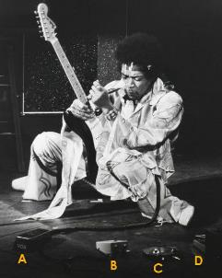
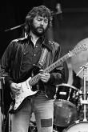
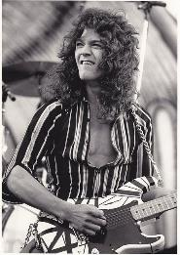
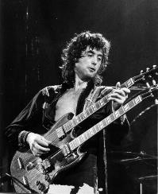
The rise of the guitar hero
Early multitracking
65-69
As bands and artist move into the recording studio to explore the technology, live performance is developing into a more theatrical and virtuosic experience. The solid-body electric guitar as the sound of rock ‘n roll and many artists were exploiting and extending the sound and capability of the instrument. In the late 60s, Jimi Hendrix paved the way for electric guitar virtuosity with his flamboyant performances. Amps, at this stage, came with built-in effects like tremolo, spring reverb and they were purposefully overdriven to create distortion. Simple fuzz pedals were used in the early 60s e.g. Keith Richards in Satisfaction. However, effects pedals were increasing in popularity because of guitarist like Hendrix. He famously used octave pedals, Vox Cry Baby Wah-Wah(Purple Haze ‘67) and a Uni-Vox chorus pedal(Fire and Purple ‘68).
Examples of guitar heros-Eric Clapton, Jimmy Page, David Gilmore…and the list continues
The virtuosic guitar driven music led to further developments and experimentation in the 70s i.e. progressive and psychedelic rock. It would also influence other styles like funk, disco and reggae.

Slide 6
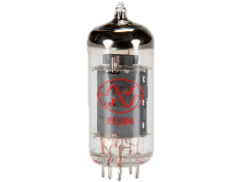
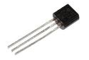
Let’s pause for some history of amplification
Power turns the amplifier on. As it is a valve amp, these valves take time to charge the grid to a less negative state and so standby is used to keep the tubes in this state but cut the output and other working parts of the amp.
1904: John Ambrose Flemming discovers ‘the simplest valve’ - ‘The Diode’
1906: Lee De Forest invents the ‘Triode’ Valve by increasing the electrode count inside the valve by one. Modulation between the cathode and anode enabled current or voltage gain. This was then used in telephone communication and radio.
1927: First widely produced commercial valve amplifier. A very small amp with a large speaker cone. They were relatively quiet. It was typically introduced in the 1920s along with cheap guitars in ‘bundle’ sets.
1950s and 1960s: ‘The Golden Age of Amplification’. The building of valve amp units was refined and developed. Amps were larger and louder. Classic and still desirable amps such as the Fender Deluxe and Twin Reverb (pictured), the Marshall Super Lead (pictured) and the Vox AC30. Various budget ‘Department Store’ amps also gained popularity such as the Danelectro and Silvertone lines developed by Sears. These are still also used and desirable today.
Mid 1960s onwards: The growing the use of transistor technology soon changed amplification. As silicon transistor technology was cheaper to manufacture it soon became a standard in amplification. This brought a decline in valve technology across the industry and things such as HiFi equipment soon also were mostly built with transistor technology. ‘CRT’ Televisions were one of the last mainstream products to be produced using tubes. However, valve amplifiers are still built today due to popular demand and the sound quality offered by them.
Vacuum Tube(Valve) vs Solid State( Transistor)
Valve were used since the earliest days of electrical amplification. It started out as a simple diode and later evolved into a triode which was more stable. Valves have to heat up and requires time to run consistently. When driven the signal is distorted adding colour and harmonics to the tone. This type of distortion is considered warm and desirable, where as transistors have no moving parts and the distortion(clipping) is harsh. Transistors are cheaper and smaller and therefore forms the basis of most electronic amplification.

Slide 7
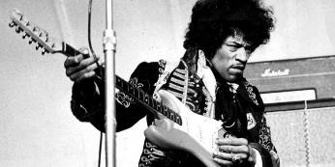
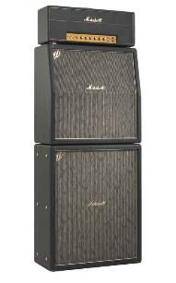
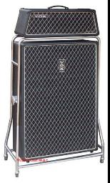
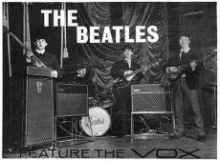
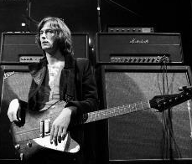
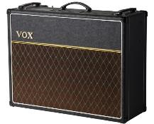
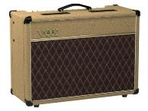
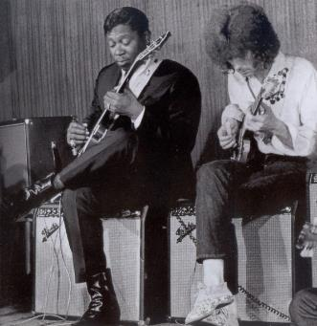
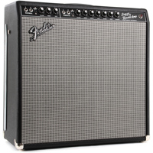
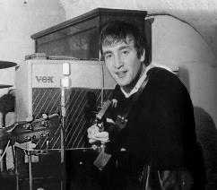
Amp Cabinet
Fender Blackface Super Twin
Sound of the 60s VOX AC 15 ,30 and AC100

Slide 8
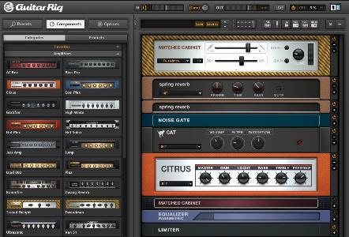
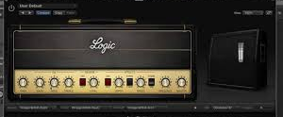
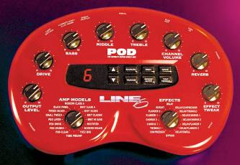
amp modelling
Used in DAWs as a plug-in. It emulates vintage guitar amplifiers(cabinets), often includes tremolos, gates and compressors as presets. Microphone type and placement are parameters that can be adjusted.
Hardware amp modelling devices are available such as the Line 6 pod which comes packed with a variety of amp models from solid state to tube amps.

Slide 9
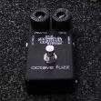
1960 tech inventory
Pedal board
Jim Morris Octave Pedal
Vox Cry Baby Wah-Wah
Maestro Fuzz Pedal
Uni-Vibe Chorus Pedal
Uni-Fuzz U-250 Fuzz pedal

Slide 10
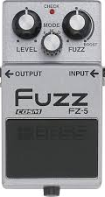
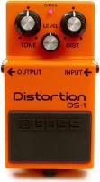
Distortion as an effect
fuzz
Overdrive
Fuzz sounds tinnier and less refined than other types of distortion. Used in the mid-60s by Keith Richards, Jimi Hendrix and the psychedelic rock movement. Often used to make a bass sound gritty and dirty.
Name is derived from the signal overdriving the valves of an amplifier. It’s a mild, crunchy distortion associated with electric guitar, however, it is used with great effect on organ, harmonica etc.
Distortion
VIRTUAL Pedalboards
Used in DAWs as a plug-in. It emulates vintage guitar amplifiers(cabinets), often includes tremolos, gates and compressors as presets. Microphone type and placement are parameters that can be adjusted.
Distortion is the aggressive, overpowering sound of rock and heavy metal guitar, which began in the 70s with bands such as Led Zepplin and Black Sabbath

Slide 11
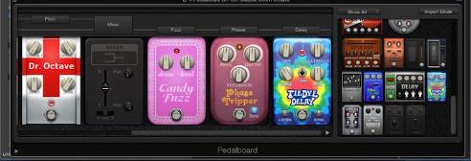
More effect pedals
Wah
CHorus
A wah pedal moves a frequency peak in response to the position of the pedal, make the part sound like something singing “wah wah”. Used in blues, rock, funk, reggae and many other genres.
Listen to Voodoo Child by Jimi Hendrix and The Fly by U2
Chorus imitates the subtle variations in pitch that occur when the same part is being played or sung by 2 or more players at the same time( like a choir i.e. chorus). Mainly used on 80s guitar and also associated with electric piano and synths.
Listen to Purple Rain by Prince and Come as you are by Nirvana.
tremolo
VIRTUAL Pedalboards
Tremolo varies the volume of the sound electronically by a pre-set rate and sounds like the instrument is pulsing, throbbing or cutting in and out. It was popularised by 1960s surf music.
Listen to How Soon Is Now by The Smiths and Bang Bang Nancy Sinatra
Used in DAWs as a plug-in. It emulates guitar pedals, often includes distortion, gates and compressors as presets. In-line mixers and spiltters are included for a more complex sound.

