Slide 1
Phase https://www.youtube.com/watch?v=_N0ER4A73QE
Phase describes the relationship between 2 or more waveforms. Phase is measured in degrees. This can be demonstrated by a simple sine wave. A sine wave starts when its cycle starts, this is 0 degrees. One complete cycle is 360 degrees, ½ cycle is 180 degrees and ¼ is 90 degrees.
If one sine wave reaches a ¼ cycle when a cycle begins of an identical waveform, the 2 are said to be 90 degrees out of phase.
2 identical signals that are 180 degrees out of phase with each other will cancel.
IMPORTANT: We deal with complex waveforms which contain many frequencies. If 2 complex waveforms are delayed, each frequency within them will have its own phase shift.

Slide 2
Types of phase relation
Out of Phase(or phase shifted)
When 2 waveforms start at different times e.g. we delay(or nudge) a duplicated vocal track and not the original or we use more than 1 microphone on a sound source at different distances.
IN-PHASE
When 2 waveforms start at exactly the same time. The waveform is reinforced
Phase-inverted
When both waveforms start at the same time but their amplitude is inverted.

Slide 3
Phase problems
Phase Cancellation
In order to describe the phase relationship between two identical waveforms, regardless of their frequency (that is, how fast they're repeating), mathematicians often quantify the offset between them in degrees, where 360 degrees equals the duration of each waveform repetition. Therefore, a zero-degree phase relationship between two sine waves makes them perfectly in phase, giving the highest combined signal level, whereas a 180-degree phase relationship puts them perfectly out of phase, resulting in total phase cancellation — and therefore silence as the combined output. All the other possible phase relationships put the waveforms partially out of phase with each other, resulting in partial phase cancellation.
Comb filtering
Comb filtering creates peaks and troughs in frequency response, and is caused when signals that are identical but have phase differences — such as may result from multi-miking a drum kit — are summed. An undesirably coloured sound can result. The same effect can be harnessed deliberately to create flanging

Slide 4
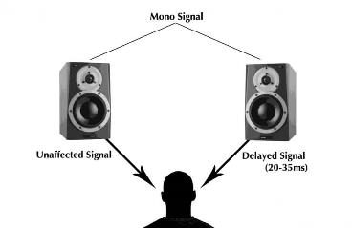
Haas effect( or precedence effect) https://www.youtube.com/watch?v=GxOrN6Nhros
1949 Helmut Haas determined that if 2 identical sounds is played in quick succession, the sound will be perceived as one sound(fused) if it’s less than 40ms. Above 40ms is perceived as 2 sounds(echo)
He research concentrated on psychoacoustics and how we perceive the directional qualities of sound. The relationship between the direct sound and the delayed(or reflected) sound, informs us where the sound is coming from(localization). The Haas effect, therefore, uses short delays to create a stereo image, which can be more effective than panning.
Haas was interested in what happens when an initial sound is quickly succeeded by similar sounds from various directions. His findings teach us that the directivity of the sound is determined solely by the initial sound provided that (a) the successive sounds arrive within 1–35 ms of the initial sound and (b) the successive sounds are less than 10 dB louder than the initial sound. Although the successive sounds do not give any directivity cues, they still play a spatial role. The Haas trick simply involves an original signal panned to one extreme, and a ghost copy, which is delayed by 1–35 ms, sent to the other

Slide 5
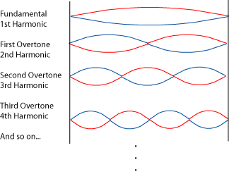
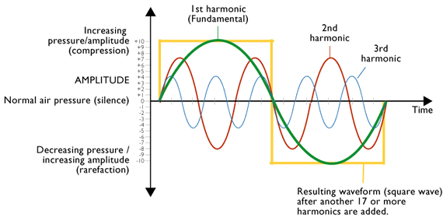
Distortion
Total Harmonic Distortion(THD)
When distortion passes through a nonlinear system( analogue) different types of distortion is produced. One such distortion is harmonic distortion which adds harmonics(additional frequencies). THD measures the harmonic distortion produced by an analogue device. Tube(valve) devices produces a characteristic low-order harmonics which differs from transistor devices.
Inter-modulation(IMD)
Just as harmonic distortion, IMD produces additional frequencies, however, they are not related to the harmonics of the sound. IMD is often considered harsh and undesirable.
In the most basic terms, distortions occurs when the maximum level of analogue device is exceeded. Analogue distortion can be appealing for example overloading a guitar amp for overdrive effects or tape saturation to add warmth.
Digital distortion( known as digital clipping) occurs when the maximum level of a digital device is exceeded, however, this is a less appealing and should be avoided at all costs.

Slide 6
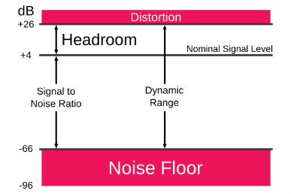
Key words and terminology
DYNAMIC RANGE
SIGNAL TO NOISE RATIO
The dynamic range is the difference between the noise floor and the maximum level that a system can operate with before distortion.
SNR represents the relationship between the wanted signal and unwanted noise.
Often used to describe the noise generated by equipment. The higher the SNR, the less likely the noise is to cause a problem. ( Check the specs!!)
Noise Floor
Dynamic Range of various systems
The best available A/D convertors | 122dB
Human hearing | 120dB
CD (16 bit system) | 96dB
Tape with noise reduction | 75dB
Vinyl | 60dB
The noise floor is the level at which the background noise exists in a system. Quality equipment has a lower noise floor and increased dynamic range

Slide 7
Distortion as an effect
Overdrive
fuzz
Name is derived from the signal overdriving the valves of an amplifier. It’s a mild, crunchy distortion associated with electric guitar, however, it is used with great effect on organ, harmonica etc.
Fuzz sounds tinnier and less refined than other types of distortion. Used in the mid-60s by Keith Richards, Jimi Hendrix and the psychedelic rock movement. Often used to make a bass sound gritty and dirty.
Bitcrusher
Amp modelling
Low-resolution digital distortion effect. It emulates the sound of early digital audio devices.
Used in DAWs as a plug-in. It emulates vintage guitar amplifiers(cabinets), often includes tremolos, gates and compressors as presets. Microphone type and placement are parameters that can be adjusted.

Slide 8
Task-Write an essay opener… 5mins
Distortion is used on the electric guitar to modify the tone and increase sustain.
Describe what distortion is. Describe the various ways that distortion has been added to the electric guitar from the 1950s to the present day.

Slide 9
Task-now finish the essay 15 mins
Distortion is used on the electric guitar to modify the tone and increase sustain.
Describe what distortion is. Describe the various ways that distortion has been added to the electric guitar from the 1950s to the present day.

