Slide 1
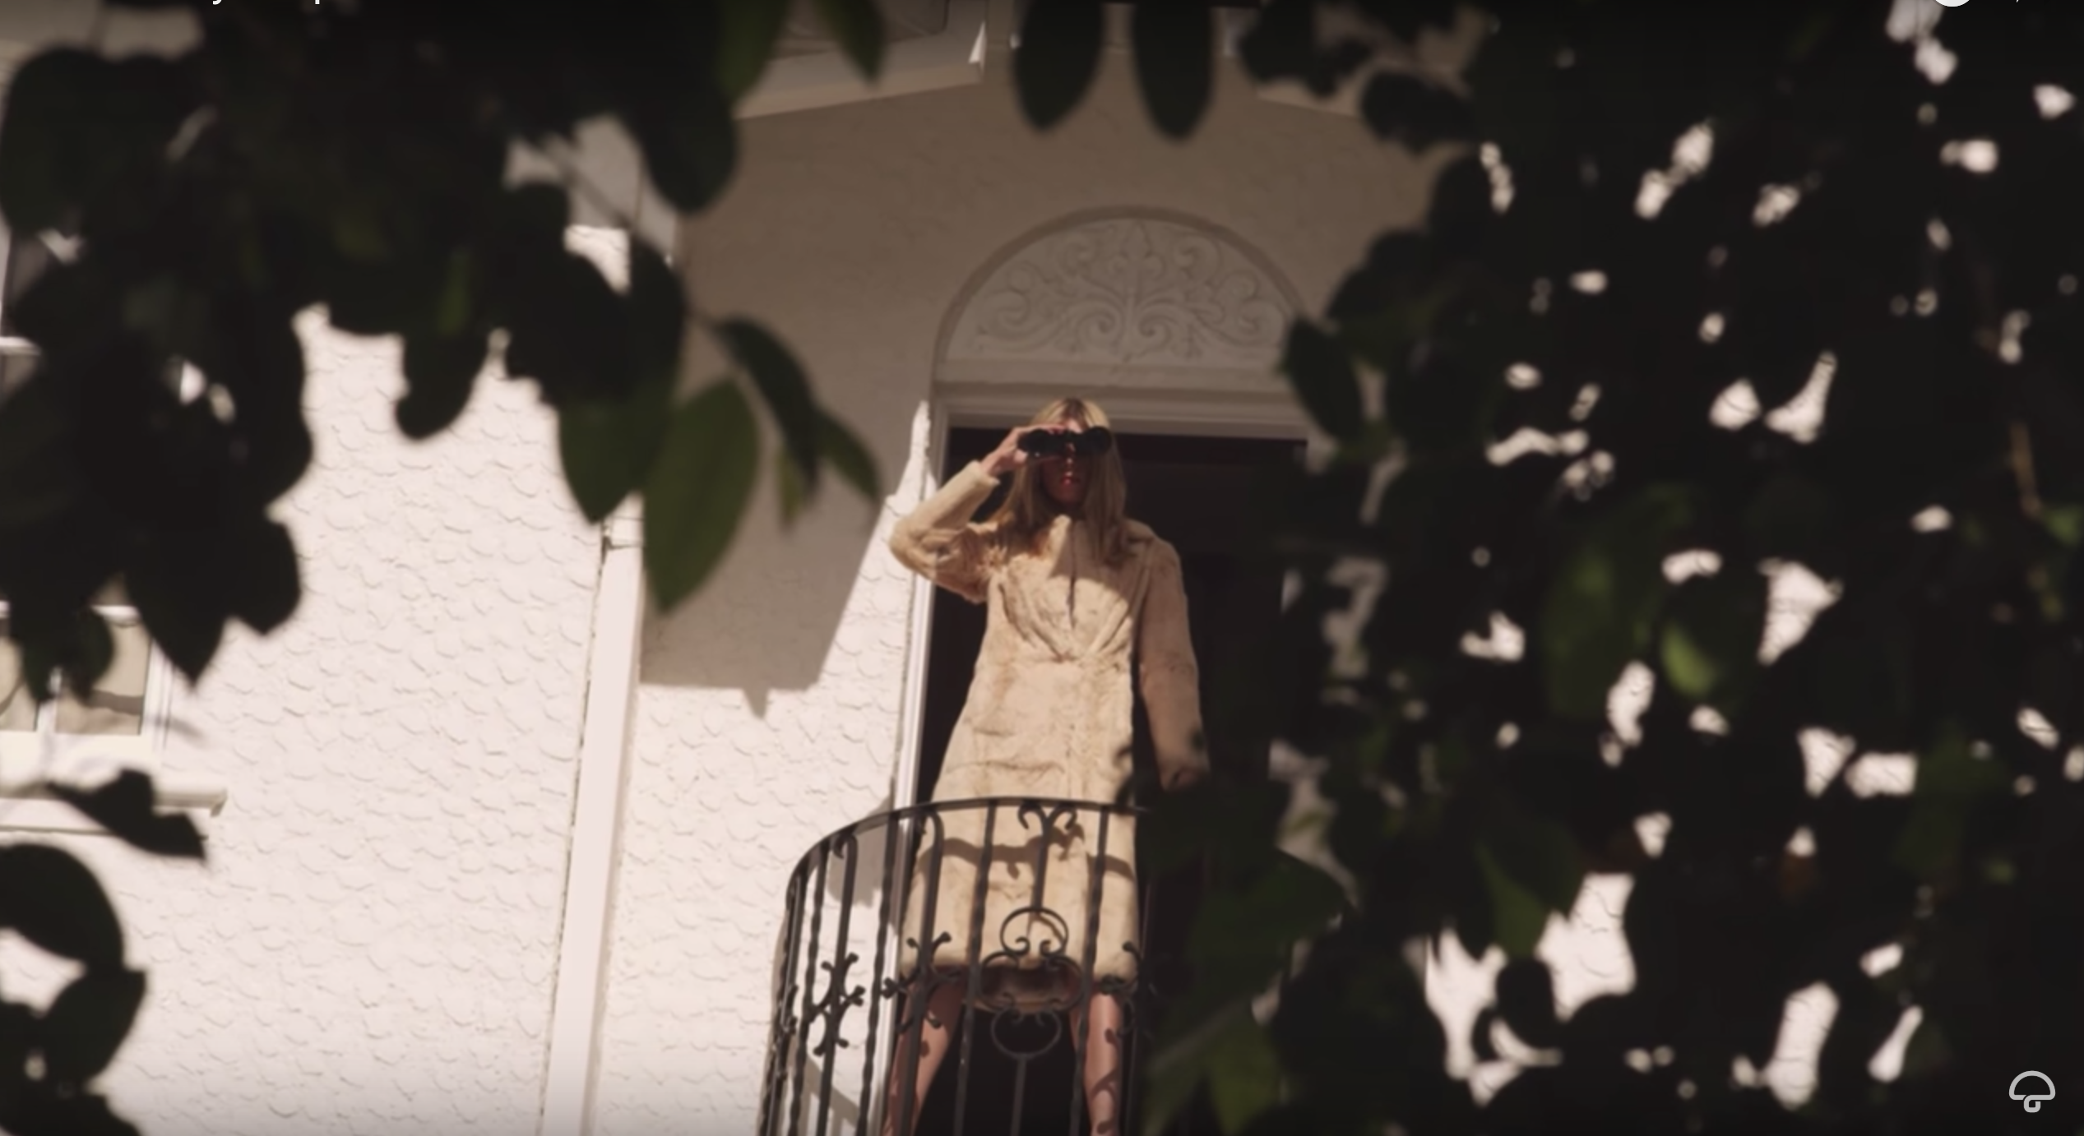
RIPTIDE
VANCE JOY (2013)
Component 1: Section A
USE THE CONTEXT MIND MAP TO MAKE NOTES FROM THIS POWERPOINT AND BRING TO YOUR FIRST RIPTIDE CLASS

Slide 2
 | COMPONENT 1 |  |  |  |  | COMPONENT 2
Sector | Marketing | Advertising | Music Video | Newspaper | Film | Magazine
Text | Kiss of the Vampire | Tide | Formation | The Times | Black Panther | Vogue (1965)
 |  | WaterAid | Riptide | Daily Mirror | I, Daniel Blake | The Big Issue
Media Language | Y | Y | Y | Y |  | Y
Representation | Y | Y | Y | Y |  | Y
Industries |  |  |  | Y | Y | Y
Audiences |  | Y |  | Y |  | Y
Contexts | Y | Y | Y | Y | Y | Y

Slide 3
PRODUCTION
Vance Joy (real name James Keogh) is an Australian singer-songwriter signed to Atlantic Records (a subsidiary of major label, Warner). His music can be categorised as fitting into the indie folk-pop genre.
Riptide was Vance Joy’s first single to be released in the USA, following his debut EP, God Loves You When You’re Dancing. It became a platinum selling single.
The video was directed by Dimitri Basil and Laura Gorun and has had nearly 300 million views on YouTube.
The video includes intertextual references, literary devices and metaphors.
Watch your set text Riptide here

Slide 4
GENRE: CODES AND CONVENTIONS: INDIE MUSIC VIDEOS
Codes and Conventions
Cutting to the beat
Lip synching
Performance shots of band/artist
Dynamic camera shots
Pop star mise-en-scene
Clear narrative
Using the blue Codes and Conventions table on the top of mind map tick which you spot in the Vance Joy Riptide video and his follow up Georgia

Slide 5
Economic contexts – discussion points:
Do you think the low budget, unique style of the music video was an artistic decision or an economic one?
Vance Joy’s Georgia (2014) makes use of a larger budget, special effects and elaborate, coherent narrative.
Do you think that is linked to the way that bands might start out with small low budget productions which increase in scope and budget as they gain popularity and fans?
How does budget impact on artistic decisions and the visual style of music videos?
Are videos an advert for the band or a representation of how “valuable” the band are to producers? Are mainstream audiences impressed by larger budget music videos and attracted to the apparent implied “quality” of that band?
Add notes and your thoughts on the questions to your mind map

Slide 6
Social and Cultural Contexts
Add notes to your mind map
The video makes intertextual references to different media forms and offers a wide variety of seemingly unconnected elements.
Montage editing is used in an overt way - a wide range of contrasting shots juxtaposed (often through hard jump cuts) to convey a large amount of information.
This invites audience interpretation. Sergei Eisenstein’s ideas could be applied here. Eisenstein was a Russian director (1898-1948) who developed the concept of “intellectual montage” - where new ideas emerge from the collision of images and generate new meanings that might not otherwise exist.
For example the sequence where a male and a female suddenly turn their heads to look at something off-screen and the next shot shows a seemingly unrelated pile of dollar bills - consider the connections audiences are being asked to make through this use of montage.
Many of these cuts also have a clear link to the lyrics. Look out for visual metaphors and significant edits when analysing the video.

Slide 7
Social and Cultural Contexts
Add notes to your mind map
There is also evidence of the influence of surrealism: Salvador Dali (Spanish artist, 1904-1989) and Luis Buñuel, right (Spanish filmmaker, 1900-1983)
When watching the video it is important to consider the context of the music video in terms of the texts and media forms it references and explore the significance of these texts in relation to the way women in particular are represented.
Watching sequences from Buñuel and Dali’s Un Chien Andalou (1929) to explore surrealist film, consider the way this film explores violence and sexual desire in a way that might inform the music video.
Is this linked to the subconscious and account for the video’s sometimes dream-like logic?

Slide 8
Questions: Answer on back of mind map
1a) In your own words define intellectual montage editing?
1b) What makes this famous scene from Battleship Potempkin dir. Einsenstein (1925) a montage? https://www.youtube.com/watch?v=Ps-v-kZzfec
1c) Can you find another example of intellectual montage editing (could be from film, tv, music video etc) don’t write about the film Rocky, that is not an intellectual montage rather a montage compressing time.
2a) https://www.youtube.com/watch?v=PX1pk_exO7A
2b) Who were the 3 greats of Spanish art?
2c) What were the 3 central themes for Buñuel films?
2d) Which, if any of these themes appear in Riptide?
2d) https://www.youtube.com/watch?v=SJndr9mRGgE&has_verified=1
2e) Why is Un Chien Andalou relevant to understanding Riptide? Consider the infamous eye cutting scene, is there a comparable scene in Riptide?
3a) Do you think the low budget, unique style of Riptide was an artistic decision or an economic one?
3b) How does budget impact on artistic decisions and the visual style of music videos?
3c) Are videos an advert for the band or an indication of how “valuable” the band are to producers?
3d) Are mainstream audiences impressed by larger budget music videos and attracted to the apparent implied “quality” of that band? What’s your view?

Slide 9
As well as feedback they’ll be an activity assessing how well you know the music video, so re-watch 3 x here

