Slide 1
UNIT 4
PROMOTING A BRAND Learning aim a

Slide 2
The promotional mix
Promotion is not just advertising. Businesses have many promotional options available:
ADVERTISING
SALES PROMOTION
PERSONAL SELLING
PUBLIC RELATIONS
DIRECT MARKETING
PERSONAL SELLING

Slide 3
Effective Promotion should follow the aida model
Attention – First, the promotion has to grab the attention of the target market
Interest – Second, the promotion should allow the target market to develop an interest in the product
Desire – Third, the promotion should spark a desire to want the product
Action – Fourth, the promotion should make the target market want the product so much, they go out and buy it
A.I.D.A.

Slide 4
Sky was uk’s biggest advertiser in 2019
https://www.youtube.com/watch?v=NxmnUSVWCOk
Think about how this ad triggers “aida”

Slide 5
Source: campaign magazine

Slide 6
Methods of advertising
Moving Image: often shown on TV, cinema, DVD or video.
Print: newspapers, magazines, billboard posters, direct mail, press releases.
Ambient: (surrounding area): bus & taxi sides, reverse of parking receipts & bus tickets, desktop items such as pens & mouse mats.
Digital: SMS text messages, blogs, podcasts, pop-up banners on internet, social networking sites e.g. Facebook or Twitter.
Audio: radio, podcasts, public address systems.

Slide 7
Sales promotion
Sales promotions are used over a short period of time to encourage and persuade customers to purchase a product.
They can also be used to encourage agents or sales teams to improve sales on identified products.
A business may use a sales promotion to introduce a new product onto the market or to try to increase sales on existing products.

Slide 8
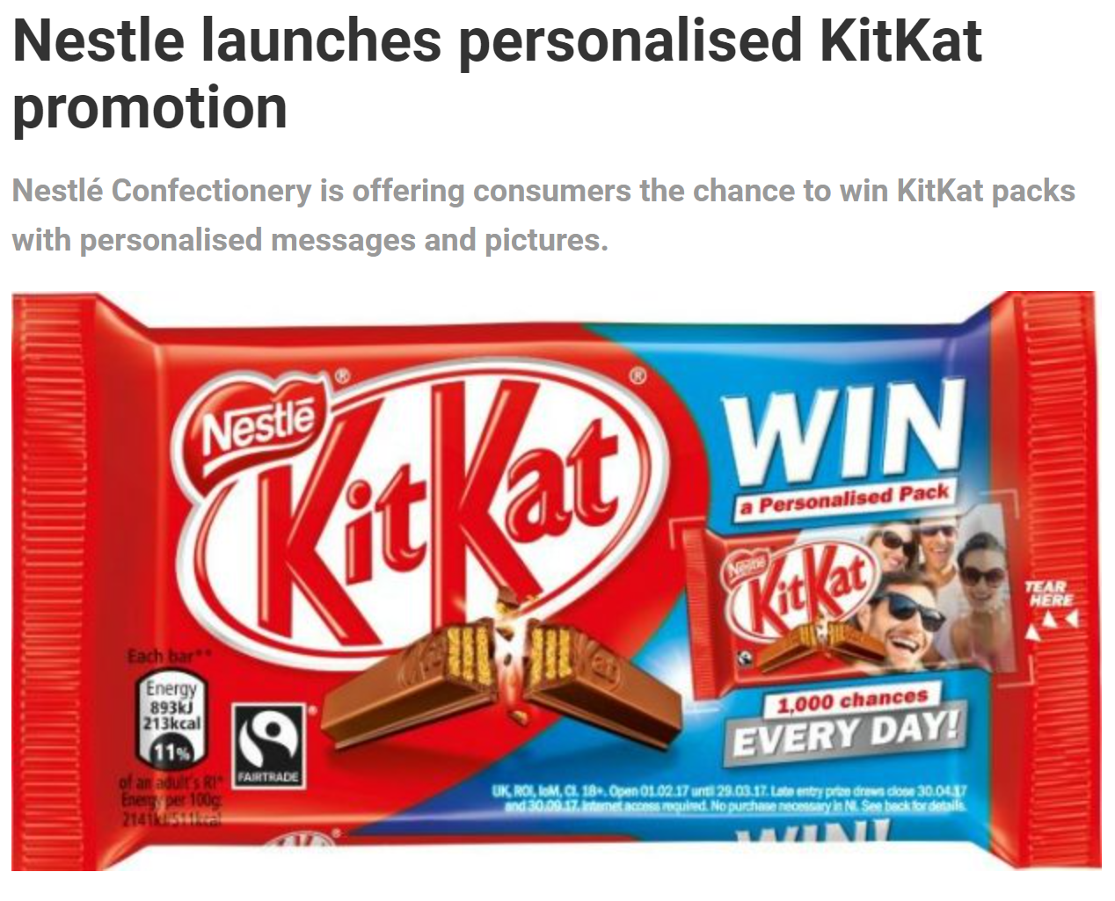
Sky sales promotion black Friday 2019

Slide 9
Sales promotions
Price promotion – could reduce the price of a product to introduce it onto the market or reduce the price of an existing product. Can be used in B2B markets by offering a lower price for larger offer.
Coupons – can be used to offer a price reduction or other incentive such as a free sample.
Competitions – customers can win a prize when they buy a product, may include an “instant win” in package.

Slide 10
Sales promotions
BOGOF – Buy-One-Get-One-Free
Money Refunds – when a customer buys a product such as a car or a mobile phone they are offered a cash refund.
Loyalty incentives – aim is to encourage customers to buy a product over a period of time in return for a free product.

Slide 11
Public relations activities
Promotion of a product, brand or business by placing information about it in the media without paying for the time or media space directly.
Methods: exhibitions, sponsorship, press releases
Example: See this link

Slide 12
Direct mail
This is when a business communicates directly with a customer, establishing an individual relationship between the business and the customer.
Methods: Direct mail (junk mail), mail order
catalogues, magazines.

Slide 13
PERSONAL SELLING
‘The personal touch’ of a sales person selling a consignment of goods, usually from one business to another.
The sales person will form bonds and links with the buyers of the business buying the goods in an effort for them to remain loyal.
The buyers often expect to be given good discounts and other perks if they are in a position of power. Often, the buyers negotiate the price down. The sales team try to develop bonds with the buyers to secure distribution and retail space.

