Slide 1
UNIT 4
PROMOTING A BRAND Learning aim a

Slide 2
Topic A4 PROMOTIONAL ACTIVITIES IN business
How business identify which customers their promotions will target?
There are 2 main types of market that need to be identified: What do you think these stand for?
B2B
B2C

Slide 3
Types of Business
Business to business (B2B) – one business marketing and selling to another business such as a supplier or retailer.
Business to consumer (B2C) – this is where a business sells directly to the customer.

Slide 4
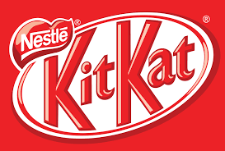
Business to business (B2B)
Transactions between B2B are much larger.
A business will want to focus its promotional activity on building good relationships to secure repeat business.
Companies in B2B markets will use promotional market mix methods such as advertising directly to consumers and personal selling to sell their products to shops.
When purchasing from a supplier a retailer will be looking for quality goods but will also want to save money.
Focus of retailer needs to match that of supplier either cheap products where quality is secondary or high quality where price is secondary, such as luxury goods market.

Slide 5
Business to consumer (B2C)
Promotional activities need to persuade the customer who are consumers to buy the product.
A business will use different methods of sales promotions to entice the customers to buy.
Businesses may use loyalty cards to return to the store or adverts to create awareness of latest product.
The customer will review prices against those of competitors
Customers will also choose to buy from an outlet that they know or trust
Remember, KITKAT is B2B AND B2C. Kitkat promotes itself direct to customers – creating demand direct from consumers – as well as marketing itself to businesses such as supermarkets and vending machine companies.

Slide 6
For M2, you need to write about How kitkat identifies their target market? What is their Market segmentation
Involves dividing customers into groups according to their:
Age - people have different needs at different ages
Family Status - people have different needs if they are married, in couples, single & if they have children
Gender - certain goods such as hair products & clothes are promoted differently
Income – consumers can be divided up according to how much they earn e.g. premium goods compared to basic range of more affordable items.

Slide 7
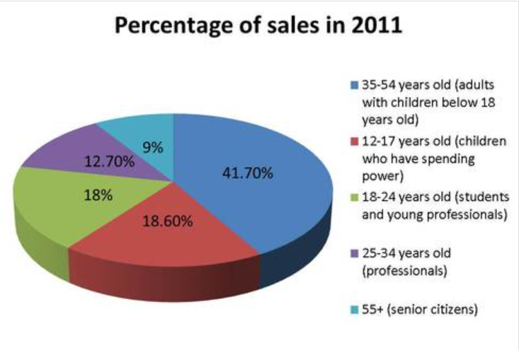
Who buys kitkat – 2011 market research
Market research shows Kitkat’s biggest consumer segment is middle aged adults with children still at home – in other words Millennials, Gen X and their children

Slide 8
Market segmentation continued
Attitudes - some people are interested in ethical goods such as “Fairtrade” goods. Newspapers such as The Times are targeted at a different market to The Sun for instance.
Interests - markets can be segmented according to peoples interests & hobbies.
Lifestyles – some services are aimed specifically to people who have busy lifestyles such as house clearing, shirt-ironing, window cleaning.
Who is KitKat’s target market? Why?

Slide 9
Using promotional activities in business
To achieve its marketing and promotional objectives a business will need to set SMART objectives. To answer M2, suggest what Kitkat’s SMART objectives might be for their promotion
Specific | What they want to achieve from their promotional activity? More customers ? Extra revenue?
Measurable | How many customers do you want to attract? How much more market share or revenue do you want?
Achievable | Is it possible to meet the objective? Is there enough demand?
Realistic | Do you have the capacity to meet the objective?
Time-related | When do you want to achieve the objective by? In a month, 6 months or a year?

Slide 10
Example SMART objectives for a business
Specific – say increase sales by 2% in 6 months
Measurable – they are able to measure increase in sales against current figures
Achievable – business will need to have assessed whether 2% is achievable in current environment
Realistic – will have reviewed its resources, competition, sales figures & market trends to ensure 2% is achievable
Time-related – has identified increase sales in 6 months

Slide 11
For M2 write about kitkat’s Appropriate promotional mix – give examples of what they do for each
Advertising – 2 elements – the message giving benefits & features and the medium used – TV, radio or social network sites.
Sales Promotions – used to introduce new products onto the market or to remind customers about existing products. Usually short-term and could be price promotions, loyalty cards, coupons or free gifts.

Slide 12
Appropriate promotional mix
Public Relations – Positive media articles and recognition for sponsoring local events, charities or sporting activities are all useful to create a positive image of the business.
Direct marketing – direct contact with the customers to inform them about products or services e.g. mail shots
Personal Selling – 1:1 communication between salesperson and customer.

Slide 13
For m2 you need to explain the Importance of Appropriate promotional mix for kitkat
Type of promotional activities selected will depend on the type of product sold and the market aimed for.
The promotional mix needs to create a good image of the business, provide all the relevant information to potential & existing customers.
Appropriateness of promotional mix will also depend on the business’s target segment as it needs to reach and be understood by them.
Digital advertising would be more appropriate for a younger audience and radio advert more appropriate for older age group.

Slide 14
For m2 explain that kitkat Benefits by having an Appropriate promotional mix
Selecting an appropriate promotional mix means that a business spends it money efficiently.
Otherwise money is wasted on activities that attract few customers.
Well-planned promotional activities will also make a business more competitive
If customers are not aware of and are not updated about the products, the business will not be able to compete with competitors and could lose sales.
Effective communication about the products will generate an interest thereby increasing sales & profit margins.

Slide 15
Communicating with market segment using the AIDA Model
This describes the 4 steps a business needs to use to encourage customers to buy its products.
If a business understands the AIDA model it will know what customers want and expects from its products
The business will be able to meet and satisfy customers’ needs and expectations.

Slide 16
AIDA Model
Attention/awareness – Good promotional material needs to attract attention of customers
Interest –The features of the product need to be communicated in an interesting way with a focus on benefits & advantages of product
Desire – It needs to be able to persuade customer that they want the product e.g. by highlighting the price & any special offers
Action – Once a business has created desire for the product they must give the customer an opportunity to in purchase it by stating how they can buy it & where from.

Slide 17
Activity 5 – M2
Explain the importance of selecting an appropriate promotional mix for a selected branded product.
You will need to explain the importance of selecting an appropriate promotional mix for the brand you have used. You will need to look at how the brand identifies the target market including the setting of SMART objectives and explain why it is important to select an appropriate promotional mix for the identified target market. You will need to explain the benefits of selecting an appropriate promotional mix and communicating with the selected market segment using the AIDA model.

Slide 18
Activity 6– D1
Evaluate the effectiveness of the promotional mix for a selected branded product.
In the final part of your information booklet you must evaluate the effectiveness of the promotional mix for your selected brand. To do this you need to review the evidence you have produced, look at the strengths and weaknesses of the promotional mix for your selected brand and then form a detailed conclusion.

