Slide 1
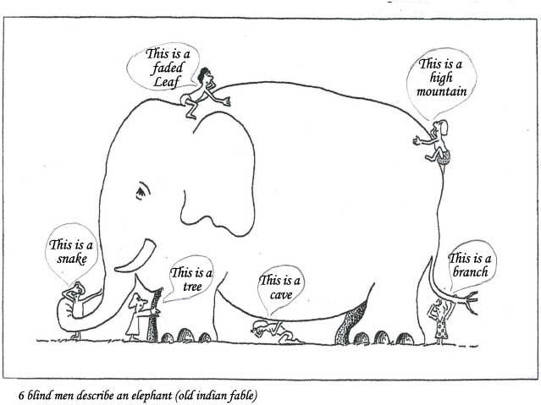
Paradigm shifts
A set of theories that explain the way a particular subject is understood at a particular time.
They can shift with new evidence e.g. ‘the earth is flat’ shifts to ‘the earth is round’
Sociology has no set paradigm because there is no unified theory to explain the social world.

