Slide 1
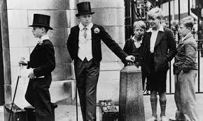
What are your values?
Starter:
What do you understand by the term ‘values’?
Compare this with the person next to you.
Write down something you care about, something you would like to change (global warming, media representation of women, animal cruelty).
Discuss how you would go about researching this area in order to make a change.
What values do you associate with a) feminists; b) Marxists; c) Functionalists; d) New Right
How might their values affect what their research finds or the conclusions they draw from their research?

Slide 2
Objectivity and values in sociology Theory and methods
What are we looking for?
The DEBATE:
Can sociologists remain objective and value free when researching sociology, or whether bias is inevitable and desirable.
What key sociologists think about this debate
The strengths and limitations of the different views as to whether sociology can and should be value-free (objective)

Slide 3
Intro:
Everyone has values – beliefs, opinions and prejudices
Our values are influenced by our background: class, gender, ethnicity, experiences and upbringing
Everyone has a different set of values and beliefs, and that’s ok!
When studying sociology, can we be objective, value free and without bias?
What do you think?

Slide 4
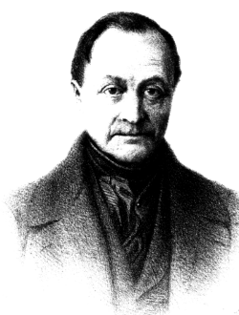
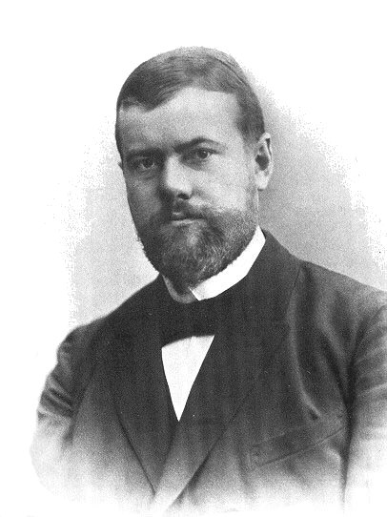
POSITIVISM-Comte
Interpretivism-Weber
* Sociology should be totally value-free.
* Sociology should study observable stuff: social facts, that can be recorded as quantitative data so correlations can be identified between variables.
* Sociology should be value relevant, but cannot be value-free.
* Sociologists will use their subjective feelings to identify a research topic & the concepts they feel are relevant.
* But sociologists can be objective in how they carry out their research, once they’ve identified concepts.
Watch– don’t judge.

Slide 5
Values in the research process:
Operationalising key concepts.
Choosing which topic to research.
Choosing a research method.
Getting funding.
Interpreting findings.
Recording responses.
Selecting appropriate questions.
Selecting which findings to include in the report.
Deciding what report will be used for.
Deciding where report will be published.

Slide 6
The key arguments:
Yes- Value Free
Some sociologists believe that it is possible to keep opinion and values out of research, in fact they believe this is preferable!
Postivisits and functionalists
‘On the fence’ and value laden
Some sociologists agree that there is a distinction between facts (objectivity) and values, however, they argue that values are important in many areas of sociological research Weber
No- committed
Some sociologists argue that it is impossible to keep values separate from sociological research, and that this is not desireable!
Howard Becker

Slide 7
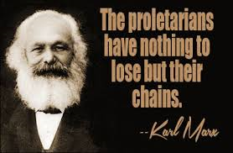
Classical sociologists and values
How do they believe sociology should be studied?
Durkheim and Comte:
Sociology’s job was to discover the truth about how society works – sociology is ‘the queen of sciences’
Marx
Saw himself as a scientist – aim of Marx’s sociology was to revel the truth of the development of class based society, a scientific approach will show us how to reach an ideal communist society
All make no distinction between the facts revealed by science and the values that we should hold – as they believe that science can tell us what these values should be
Weber
Makes a clear distinction between values and facts, and we cannot derive the one from the other
E.g. research might show that divorcees are more likely to commit suicide. However, this fact does not demonstrate the truth of the value judgment that we should make divorce harder to obtain.
There is nothing about the fact that compels us to accept the value
There are various values surrounding this fact, none of them are ‘proven’
Therefore, to a certain extent, Weber believes facts and values should be separate

Slide 8
Weber
However, Weber does see an essential role for values in sociological research
Values as a guide
Society is made up of an infinity of facts making it impossible to study everything!
Therefore, a researcher picks facts and studies those facts
But how do we pick what to study?
We select the facts based on what we think is important
Their value relevance to us
Feminists: value gender equality
2. Data collection and hypothesis testing
When we collect data we must keep our values separate
E.g. we should not ask leading questions designed to give the answers that we want to hear
Weber observes that keeping values separate when testing a hypothesis is difficult
3. Values in the interpretation of data
Values are important when interpreting what we have found
We are determining the significance of the factual data we have collected, in the context of what we have chosen to study
Weber believes we should be open about our values so that others can see our unconscious bias
4. Values and the sociologist as a citizen
Sociologists must take moral responsibility for the harm their research may do.
E.g. Einstein’s theories helped make the atomic bomb possible; yet he subsequently spoke out against nuclear weapons

Slide 9
Summary of Weber
Sees values as relevant to the sociologist in choosing what to research, in interpreting the data collected and in deciding the use to which the findings should be put.
But a sociologists values must be kept out of the actual process of fact gathering

Slide 10
Value freedom and commitment
Some sociologists argue for a ‘committed sociology’ in which the sociologist spells out the importance of their values to their research

Slide 11
The key arguments:
Yes- Value Free
Some sociologists believe that it is possible to keep opinion and values out of research, in fact they believe this is preferable!
Postivisits and functionalists
‘On the fence’ and value laden
Some sociologists agree that there is a distinction between facts (objectivity) and values, however, they argue that values are important in many areas of sociological research Weber
No- committed
Some sociologists argue that it is impossible to keep values separate from sociological research, and that this is not desireable!
Howard Becker

Slide 12
This is HOWARD BECKER.
He says it’s impossible to study anything without using your personal and political beliefs to understand and judge it.

Slide 13
Committed Sociology
The third view comes from critical sociological perspectives such as feminists and Marxists, and sociologists considering research on disability or discrimination.
They claim that sociology should not be value free and that values should guide the approach of what is being studied - in other words research should be committed to it’s cause.
It is not possible or desirable to keep values out of research
In Gouldner’s (1975) view, value-free sociology is:
Impossible: because either the sociologist’s own values, or those of their paymasters, are bound to be reflected in their work
Undesirable: since without values to guide research, sociologists are merely selling their services to the highest bidder

Slide 14
Becker: whose side are we on?
Becker argues that values are always present in sociology and therefore the issue is – whose side are we on?
Becker argues that sociologists should adopt a compassionate stance and take the side of the underdogs – the criminals, mental patients and other powerless groups
This is to give them a voice, and a previously hidden side of social reality can be revealed
Taking the side of the powerless rather than the powerful

Slide 15
Objectivity and Relativism
Are all research findings, just a reflection of the researchers values rather than a true picture of what is actually occurring?
Relativism suggests that we all have different views as to what is true, and there is no scientific way of proving people right or wrong.
Relativism argues that there is no one truth… just lots of truths, what you believe to be true, is true….to you….So people that believe the world if flat, that is the absolute truth to them.

Slide 16
Factors affecting Values
Funding and career goals
Most research is funded by someone other than the researcher themselves e.g Government funded/ businesses – therefore the values of the research will be a reflection of the way it is funded.
The sociologists research will embody the values and interests of the paymaster.
Sociologists who wish to further their careers may choose “fashionable topics” as they are more likely to get published
Perspectives and methods
Different perspectives embody different values about how society is, or should be.
This will effect the topics they research, the methods they use and their analysis of the findings

Slide 17
Exam question
Evaluate the view that sociology should be studied value-free
(20 marks)
Create three PEEL paragraghs one to support this argument and one against it.
Include evidence/ studies/ theory.

Slide 18
Tasks
- Make sure the following is completed: using the information from the powerpoint/ notes at the end of your booklet and page 425-431 of Browne
- Complete the notes on page 12 of your booklet
- Complete a plan and write an essay for the 20 mark question
“Evaluate the view that sociology should be studied value-free”
(20 marks)
Outline and explain two ways that sociology can be value free [10]
Outline and explain two ways that sociology cannot be value free [10]

